Slide 1

Monthly Report – August 2026

Slide 2

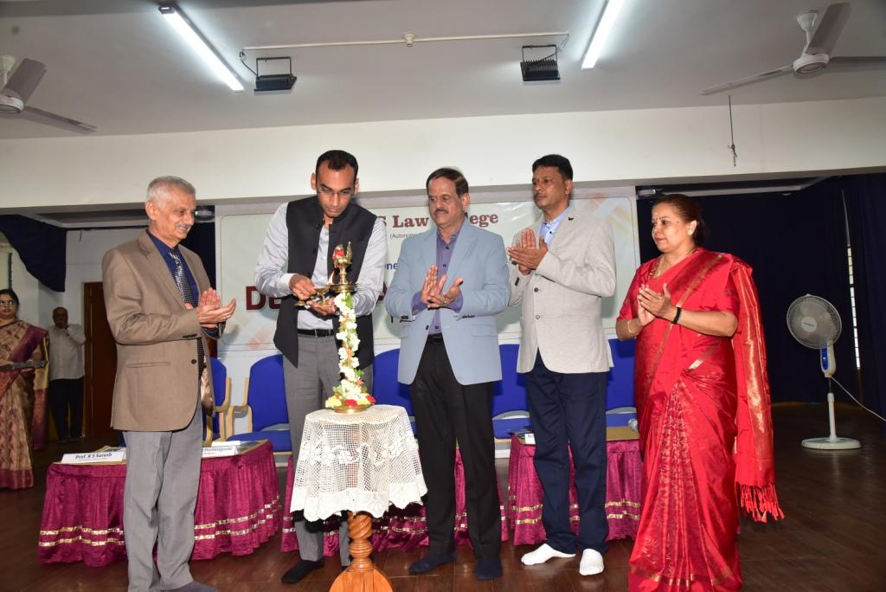
Deeksharambh (Orientation Programme) – 2026
Inauguration of Deeksharambh - 2026 by Sri. Shivaprasad Shantanagoudar, Advocate, Bangalore, Dr. C.G. Betsurmath, Executive Secretary, JSS Mahavidyapeetha, Mysuru, and Sri. H.N. Venkatesh (Law Guide), Advocate, Mysuru on 01-08-26

Slide 3
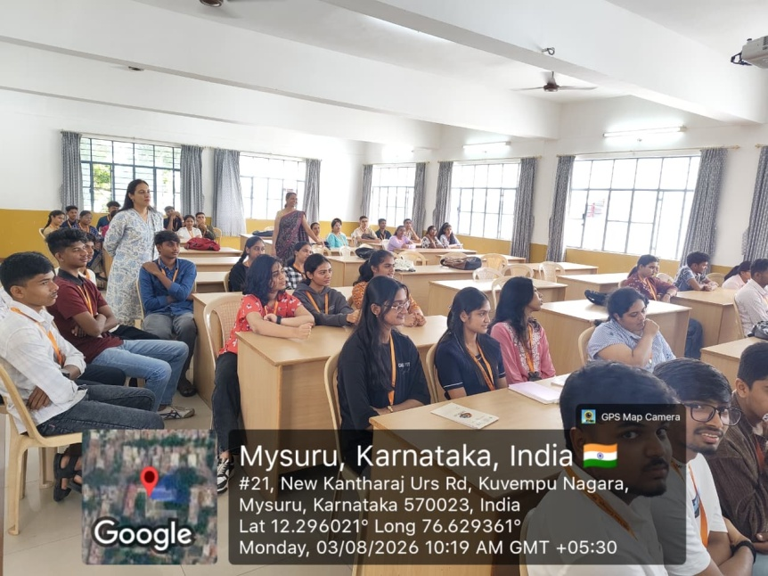
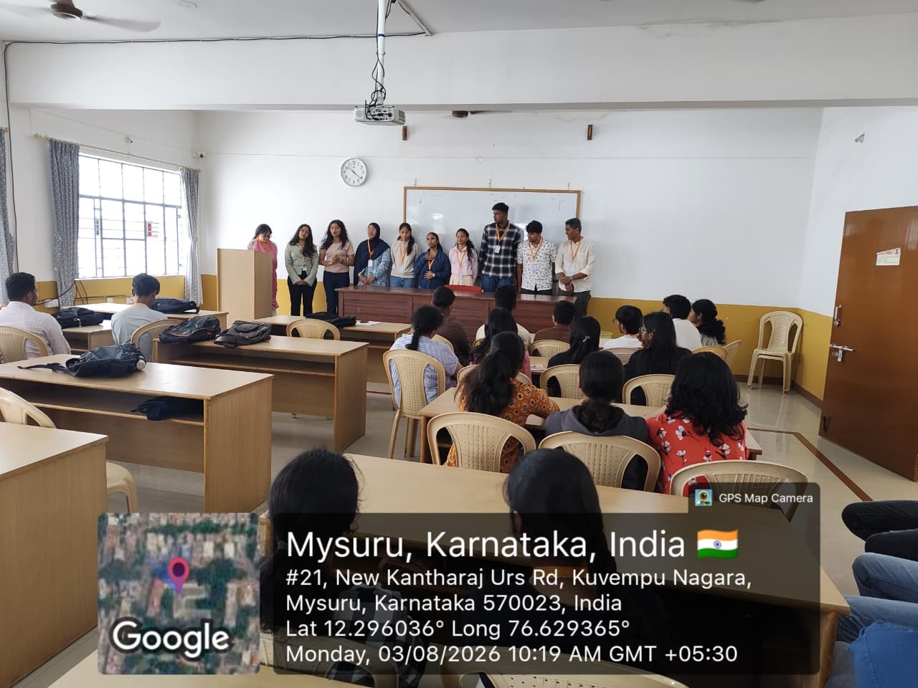
Deeksharambh (Orientation Programme) – 2026
Ice – breaking session on 03-08-26

Slide 4
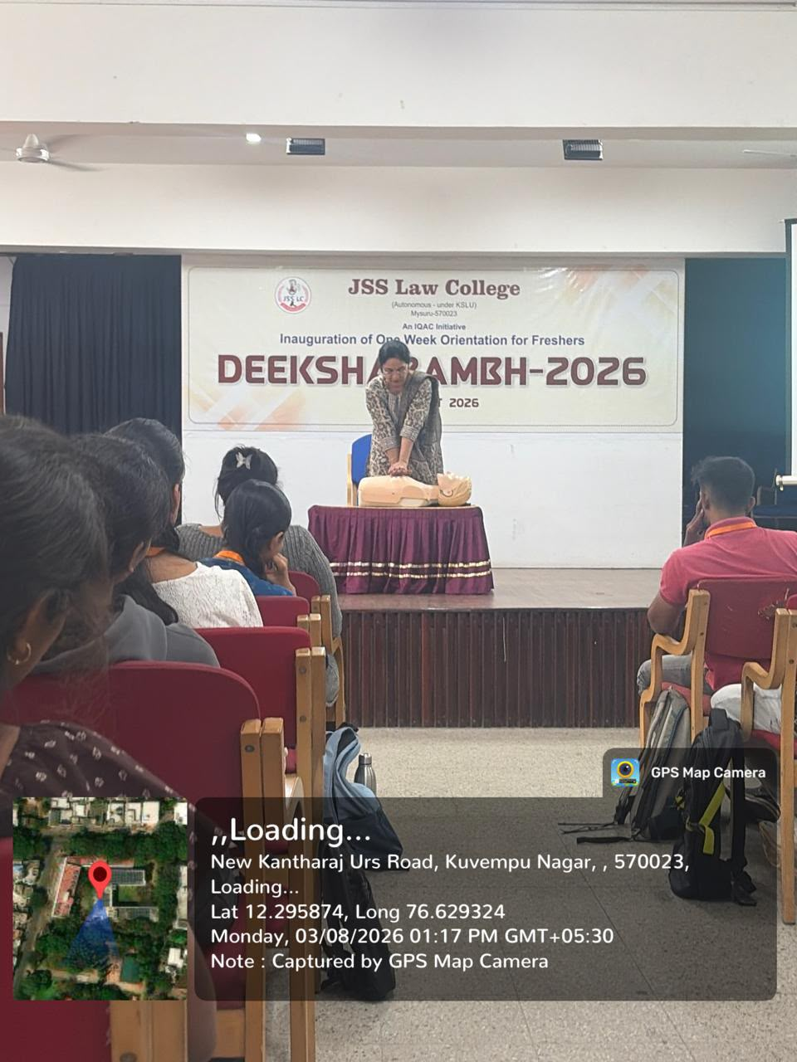
Deeksharambh (Orientation Programme) – 2026
Lecture on Essential Life-Saving Skills
by Dr. Archana S, Associate Professor, Department of Anaesthesia, and Chief Coordinator, JSS AHER
on 03-08-26

Slide 5
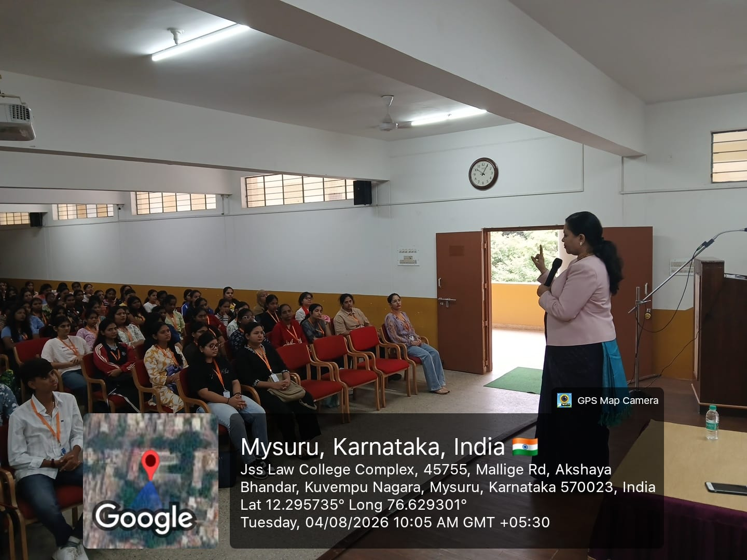
Deeksharambh (Orientation Programme) – 2026
Special talk on Judiciary as a Career
by Smt. Roopa K.N, VI Additional District and Sessions Judge, Mysuru on 04-08-26

Slide 6
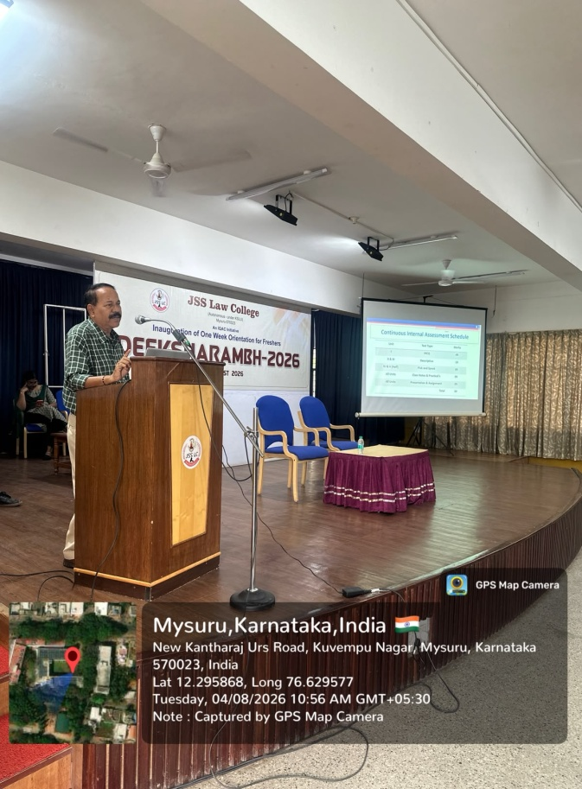
Deeksharambh (Orientation Programme) – 2026
Information on Exams, CIA and Internship on 04-08-26
by Prof. P Shivananda Bharathi, Controller of Examinations

Slide 7
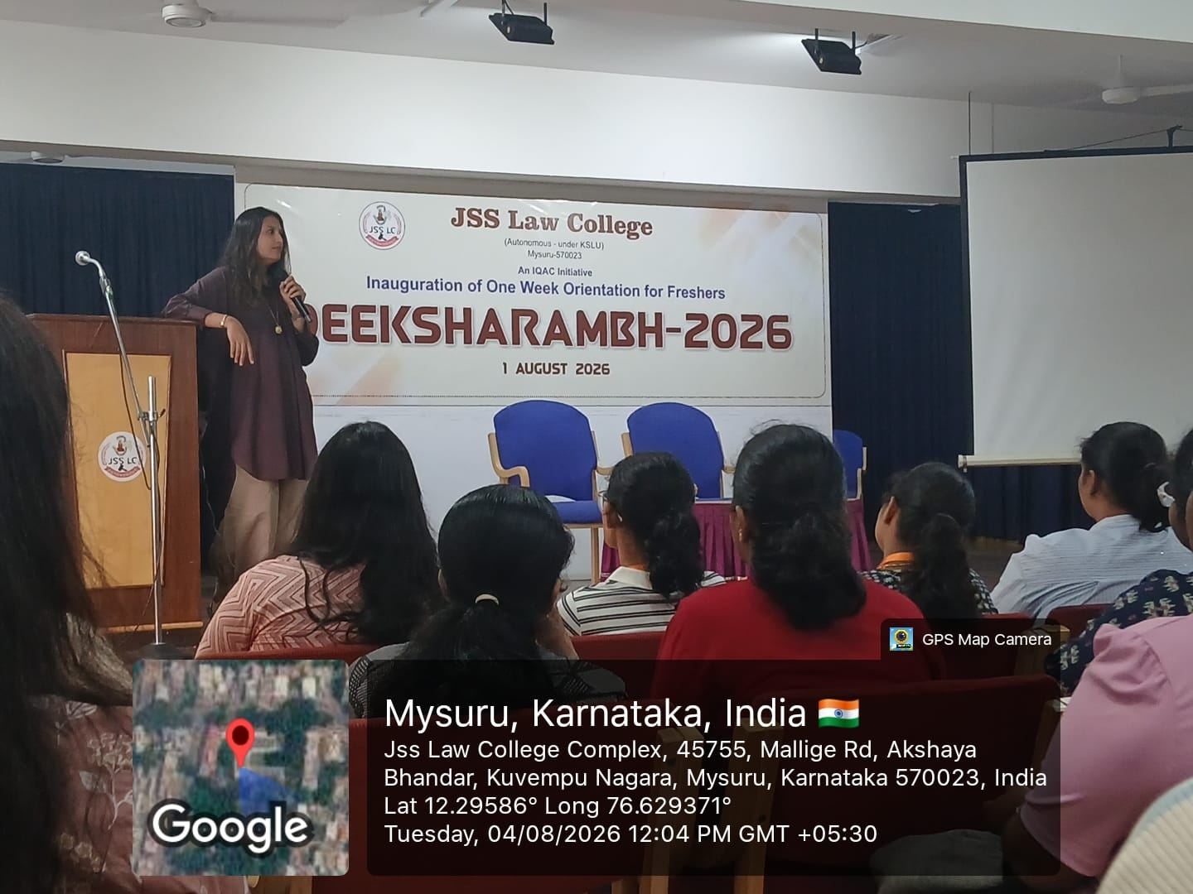
Deeksharambh (Orientation Programme) – 2026
Talk on Digital Discipline and Online Etiquette
by Ms. Sangeetha, Journalist and Marketing Consultant, Bengaluru, on 04-08-26

Slide 8
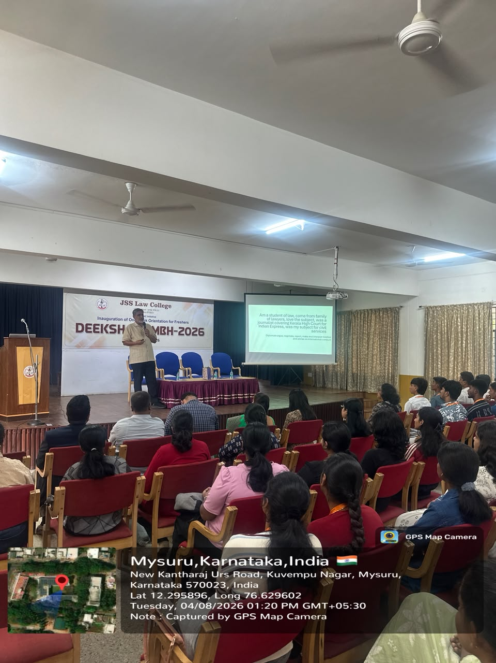
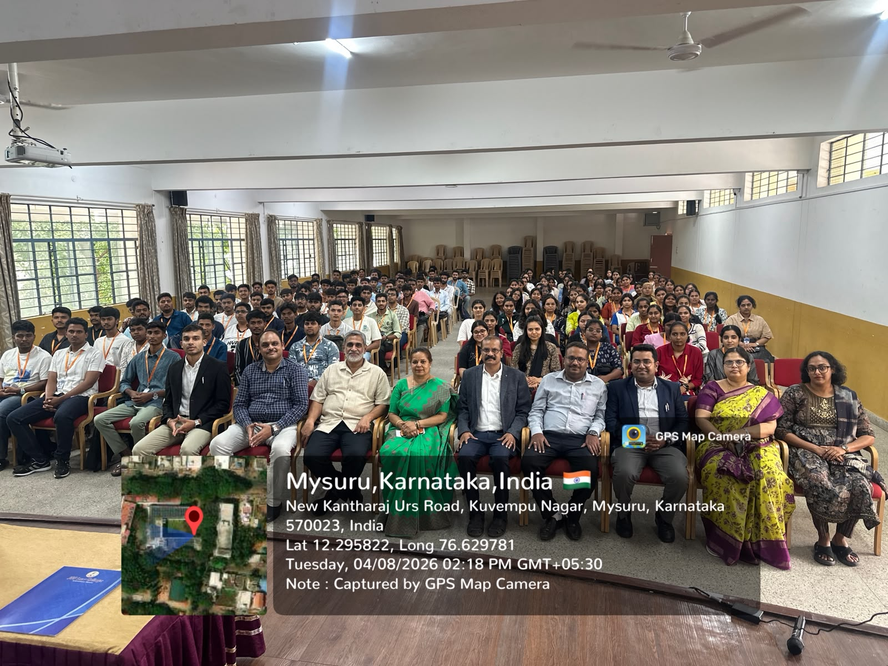
Deeksharambh (Orientation Programme) – 2026
Interaction on the topic-From the Classroom to the World
by Shri. Venu Rajamony (IFS), Professor of Diplomatic Practice, Jindal Global Law School, Sonipat, Haryana, on 04-08-26

Slide 9
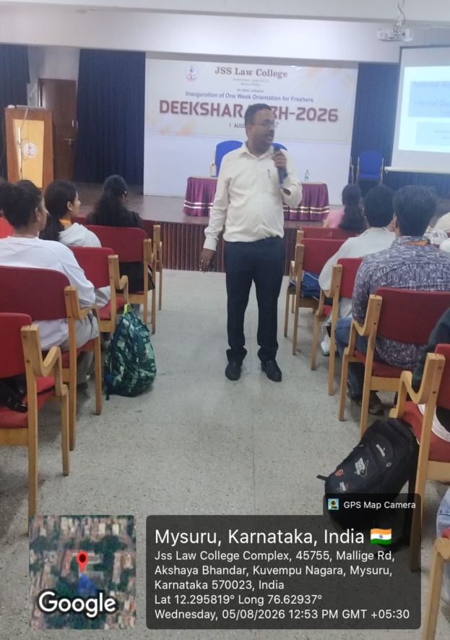
Deeksharambh (Orientation Programme) – 2026
Introduction to IQAC, NAAC and the Legal Services Clinic on 05-08-26
by Dr. A T Jagadish, Assistant Professor

Slide 10
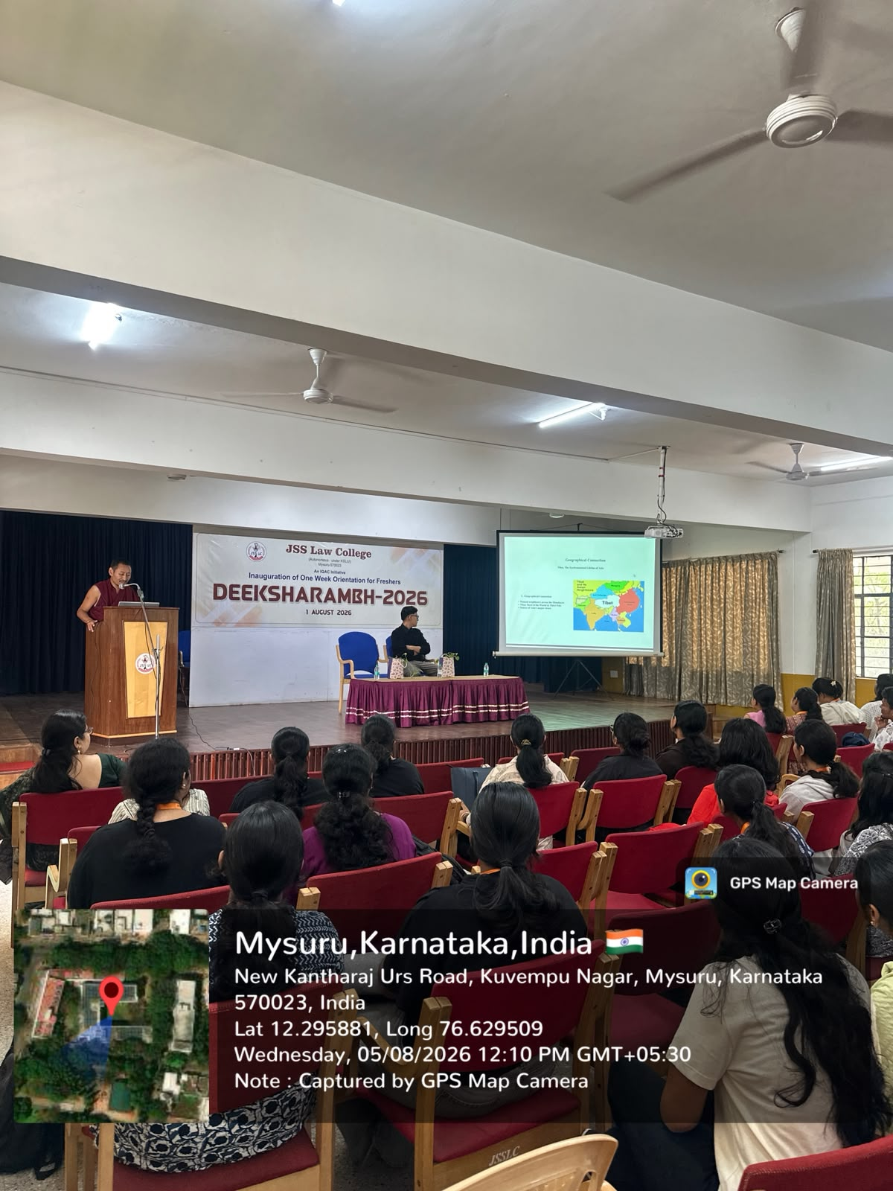
Deeksharambh (Orientation Programme) – 2026
Talk on Indo-Tibetan Relationship by Dr. Sonam Phuntsok, Chairman, The Shenphen Charitable Trust, on 05-08-26

Slide 11
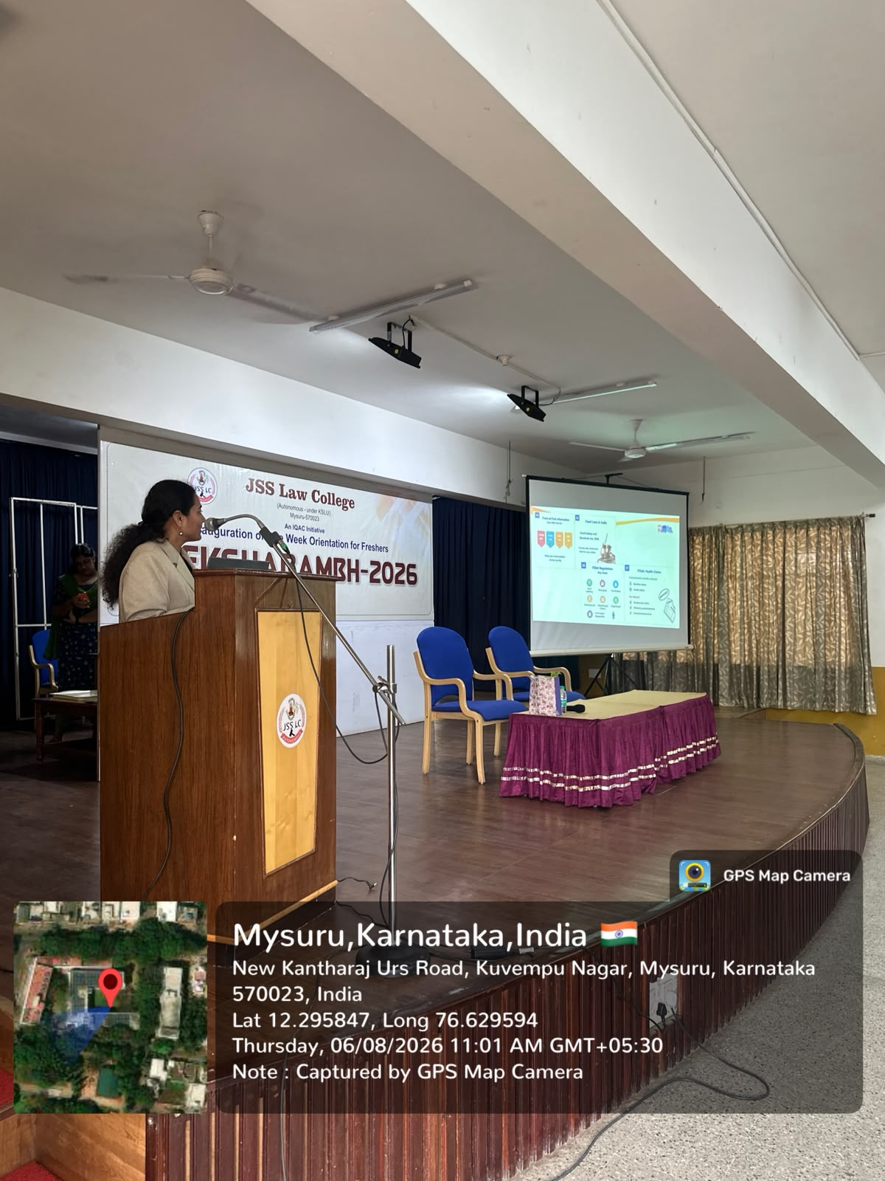
Deeksharambh (Orientation Programme) – 2026
Special Talk on Health and Nutrition by Dr. Sudha Sairam, Assistant Professor, Department of Nutrition and Dietetics, JSS AHER, Mysuru, on 06-08-26

Slide 12
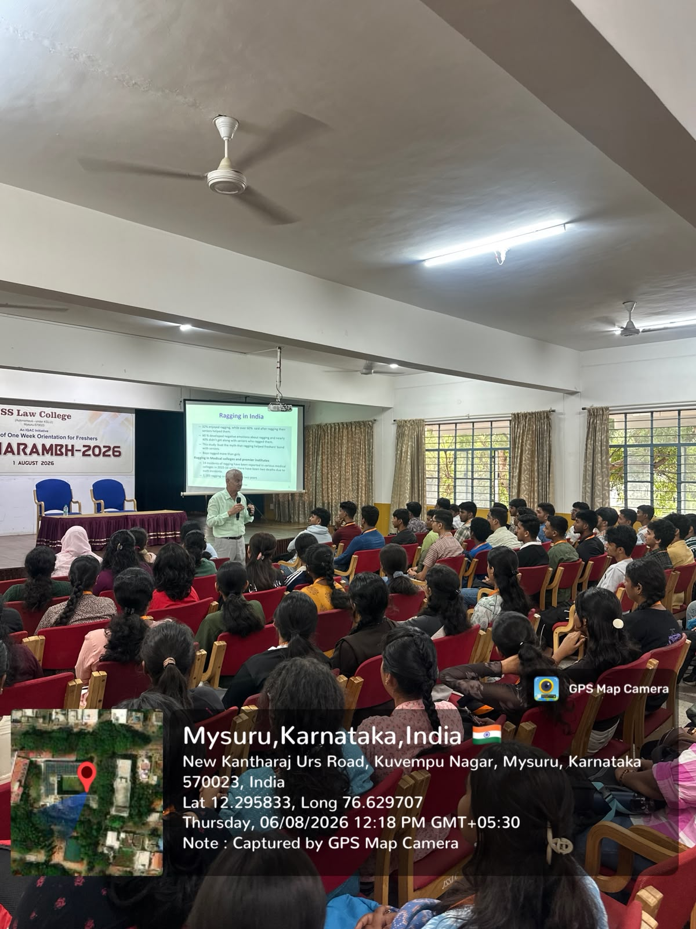
Deeksharambh (Orientation Programme) – 2026
Awareness on Sexual Harassment at the Workplace and Ragging, on 06-08-26
by Professor K S Suresh, Chief Executive

Slide 13
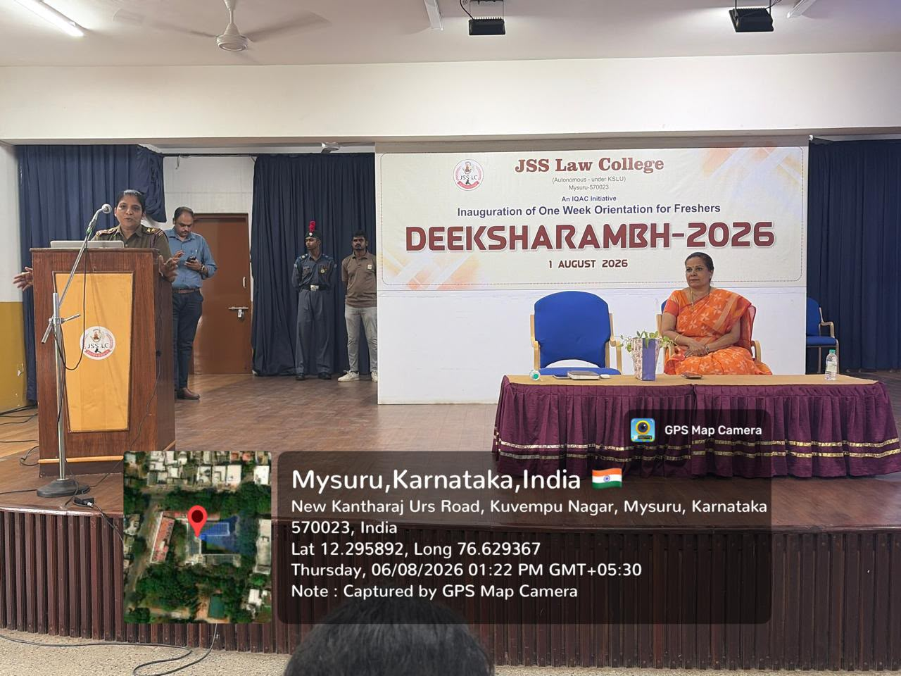
Deeksharambh (Orientation Programme) – 2026
Introduction to National Cadet Corps by Ms. Divya K P, Senior Girl Cadet Instructor, on 06-08-26

Slide 14
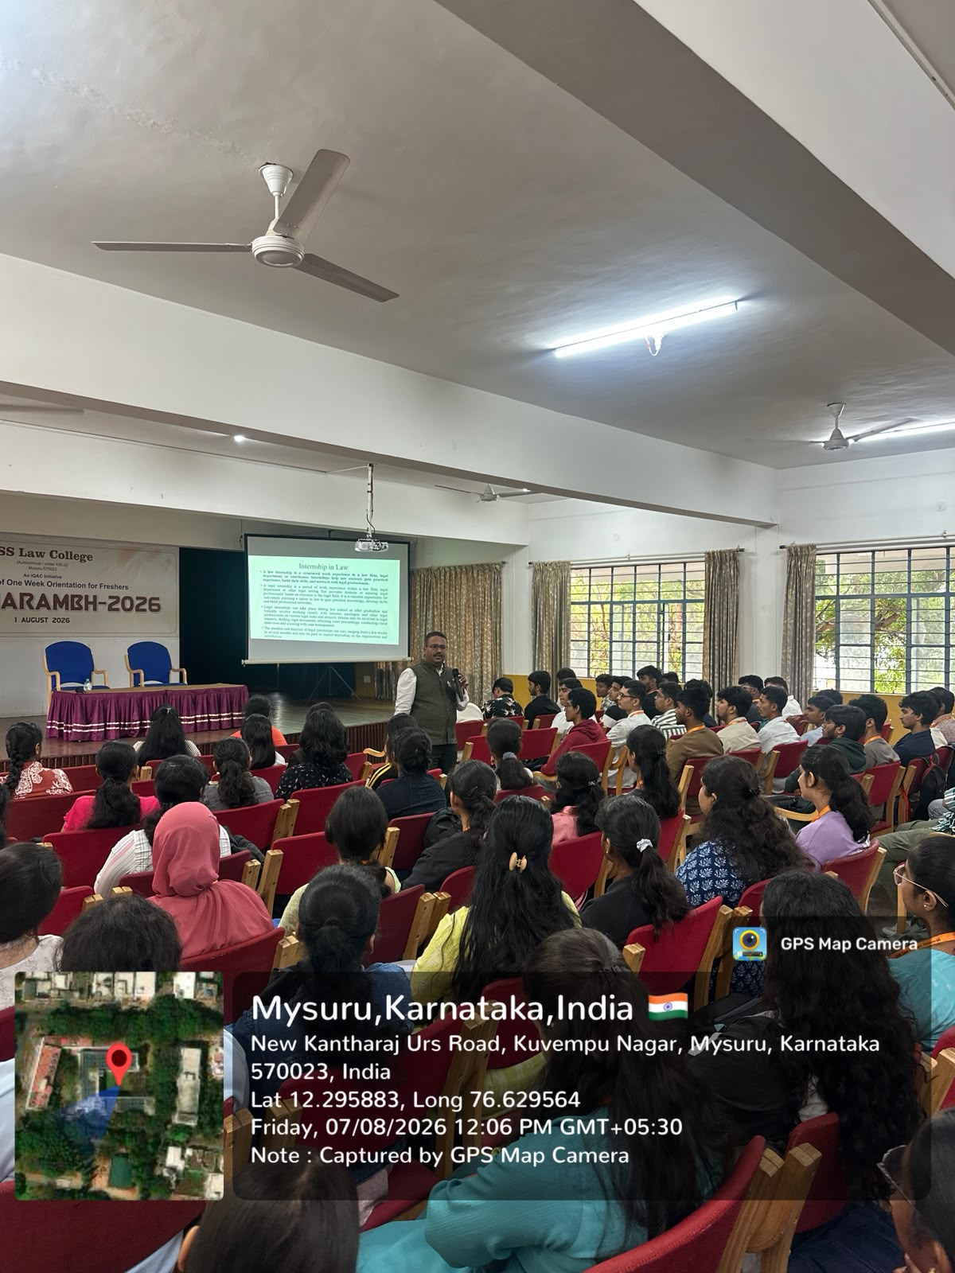
Deeksharambh (Orientation Programme) – 2026
Talk on Core Competencies for Law Students on 07-08-26
by Dr. Jagadish A T Asssistant Professor

Slide 15
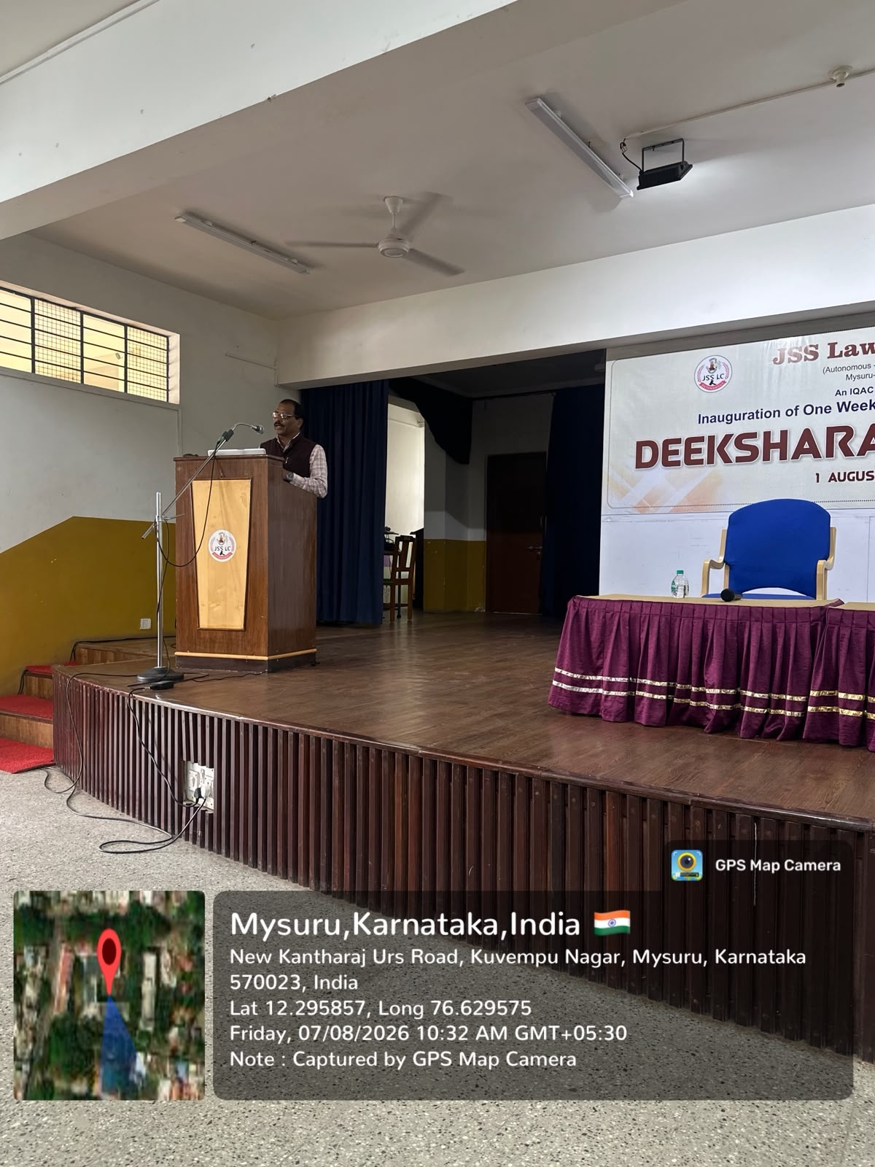
Deeksharambh (Orientation Programme) – 2026
Introduction of National Service Scheme on 07-08-26
by Sri. Suresh Kumar, Physical Education Director

Slide 16
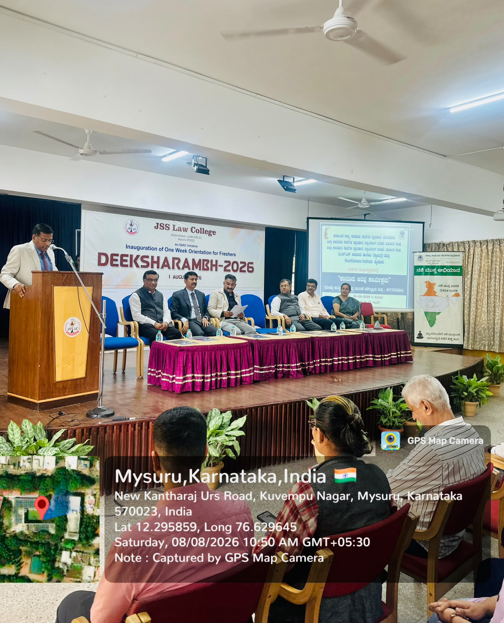
Deeksharambh (Orientation Programme) – 2026
Legal Awareness Programme on POCSO, Prevention of Abuse and Anti-Ragging by Mr. K. Madhusudhan, Regional Facilitator, Heartfulness Institute, Shri Anand P. Hogade, District Judge, Fast Track Special Court-I, Mysore, Shri Nagaraja Siddappa Ankasadoddi, Senior Civil Judge and Member Secretary, District Legal Services Authority, Mysore, Shri Santosh S. Nagarale, Senior Advocate, Hon'ble High Court of Karnataka, and Legal Adviser to the Hon'ble Governor, Shri Madhukar Deshpande, Senior Advocate, Hon'ble High Court of Karnataka, and Shri S. Lokesh, President, Bar Association, Mysore on 08-08-26

Slide 17
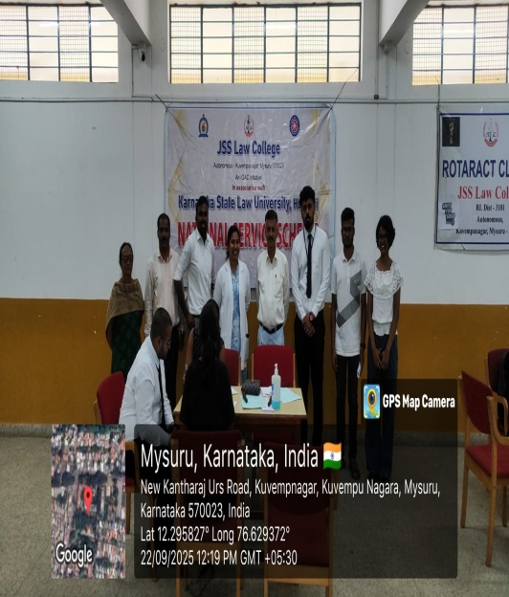
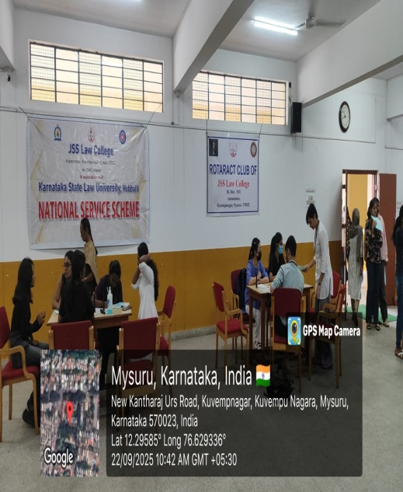
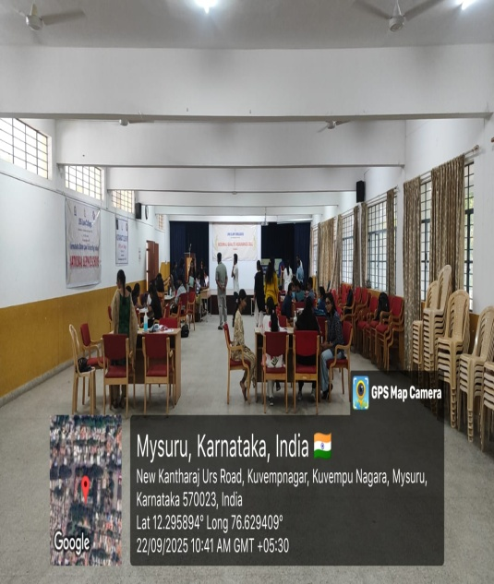
General Health Checkup
General health checkup for faculty and students, jointly organized by NSS Cell & Department of Community Medicine, JSS Medical College and Hospital, Mysuru held on 12.08.2026.

Slide 18
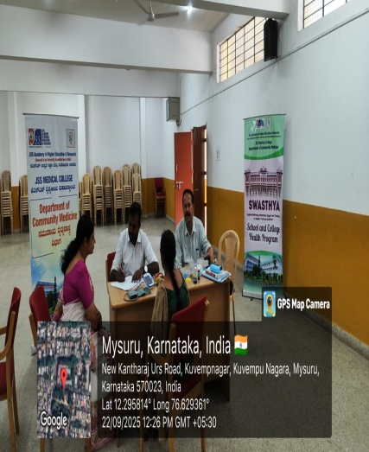
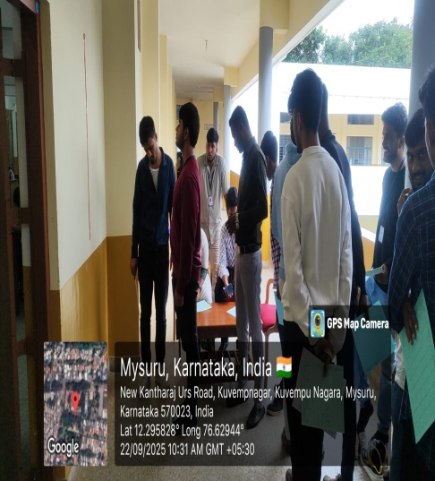
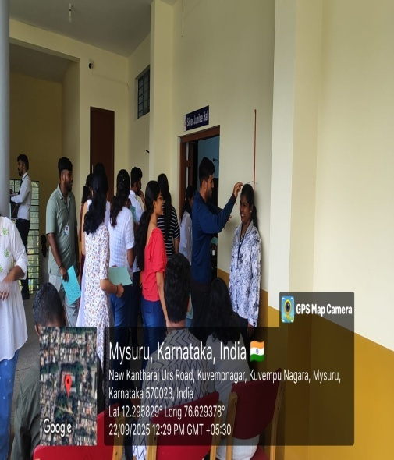
General Health Checkup
General health checkup for faculty and students, jointly organized by NSS Cell & Department of Community Medicine, JSS Medical College and Hospital, Mysuru held on 12.08.2026.

Slide 19
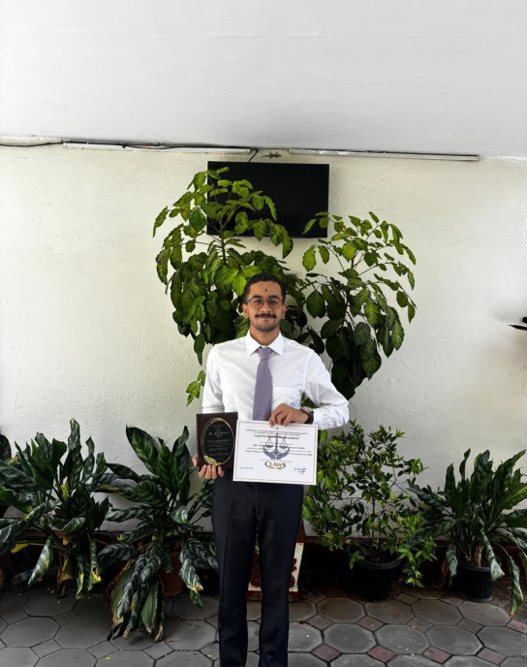
CLAWS – National Article Writing Competition 2026
Mr. Avik Sriram, Final-year LL.B. student secured First Prize in the National Article Writing Competition - 2026 organised by the Commercial Lawyers Association for Welfare and Solidarity (CLAWS), conducted in Chennai on 22.08.2026

Slide 20
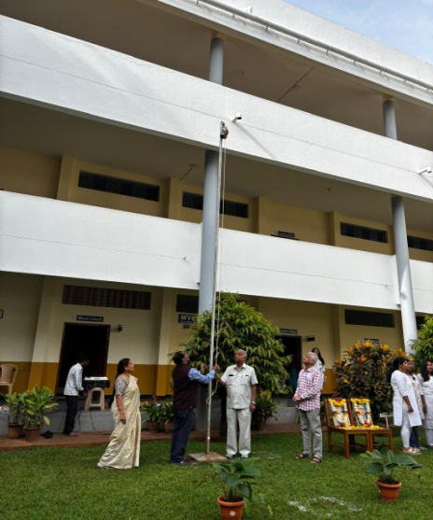
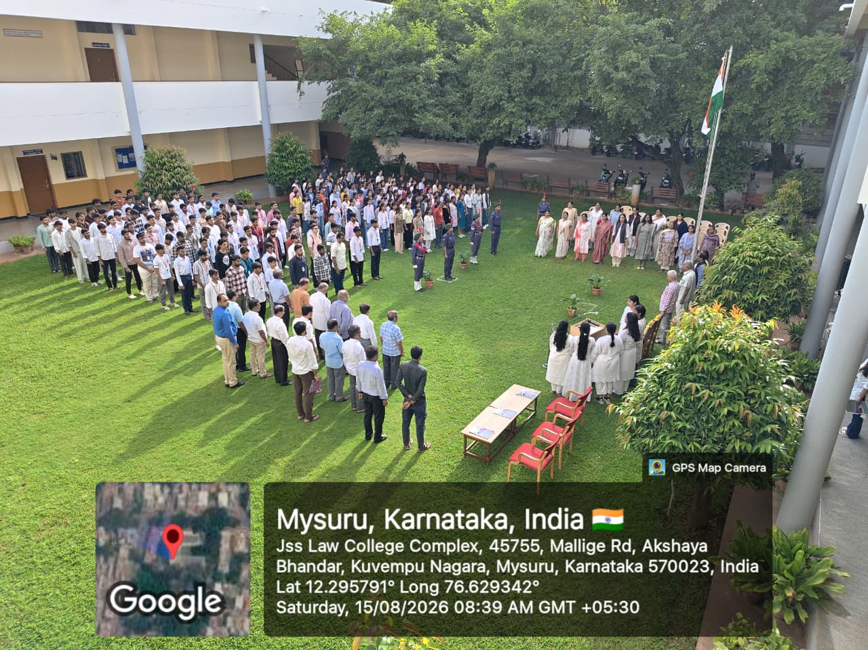
Independence Day – 05.08.2026
80th Independence Day celebrated on 15.08.2026, jointly organized by the NCC Wing, NSS Cell, and Cultural Committee. Sri. Thontadarya, Senior Bharatiya Janata Party (BJP) Leader and Former Member of the Legislative Council (MLC), Mysuru was the Chief Guest.

Slide 21
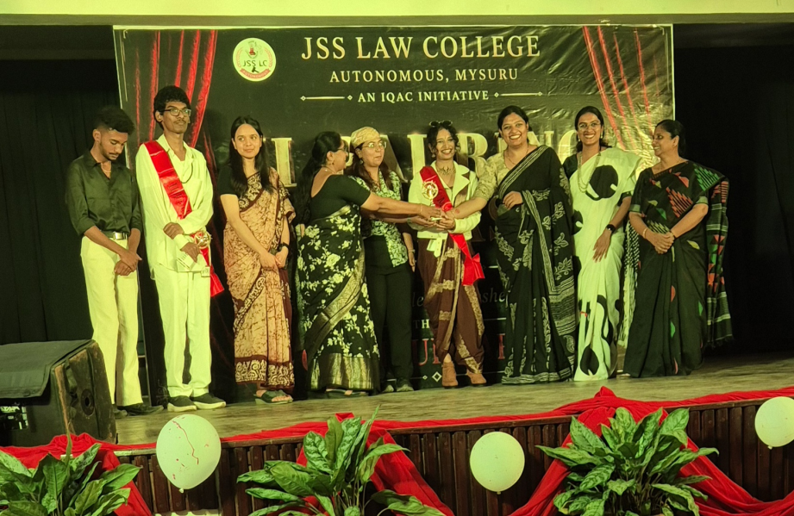
Freshers’Day
"IL PADRINO E A CASA," a vibrant Freshers' Day event, on 22.08.2026, organised by Cultural Cub and hosted by the fourth-year BA.LLB. (Hons.) and BBA.LLB.(Hons.) students. Mr. Bharath of First Semester, BA.LLB. (Hons.) and Ms. Siri of First Semester, LL.B. claimed the prestigious titles of Mr. and Ms. Black Coat, respectively

Slide 22
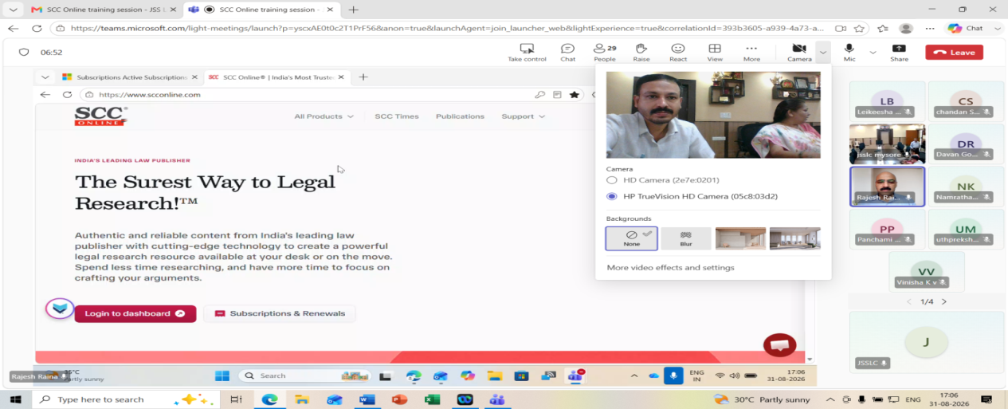
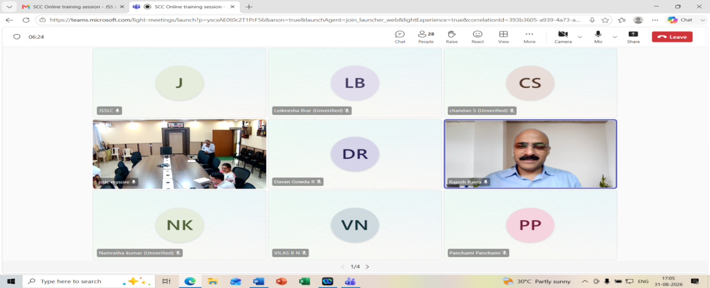
Workshop on SCC Online Database: Resources & Use
Workshop on “SCC Online Database: Resources & Use” was organized by the Library Committee on 31.08.2026, at 5:00 PM, through Online Platform (Microsoft Team). The resource person was Sri. Rajesh Raina, Deputy Manager – Learning Centre at Eastern Book Co. Pvt. Ltd., New Delhi.

Slide 23
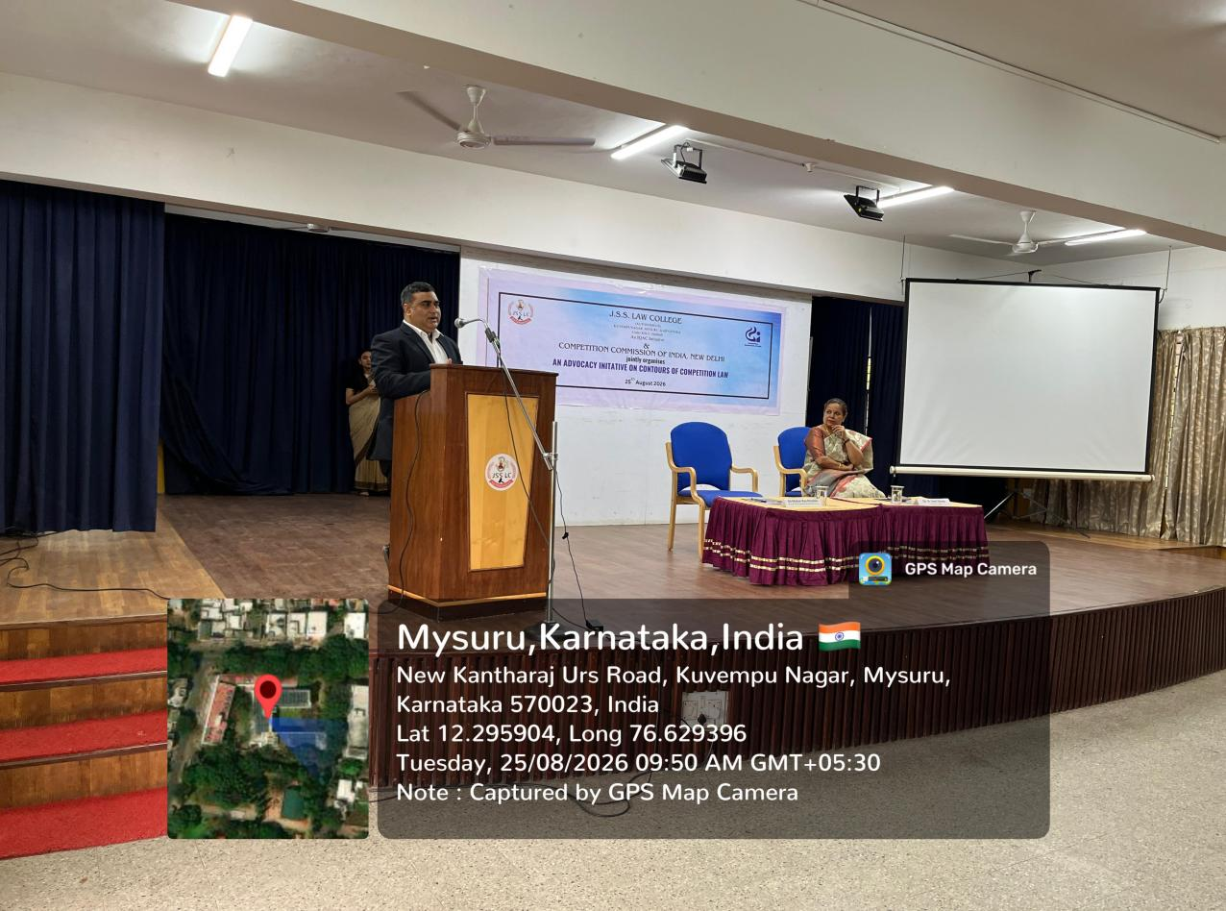
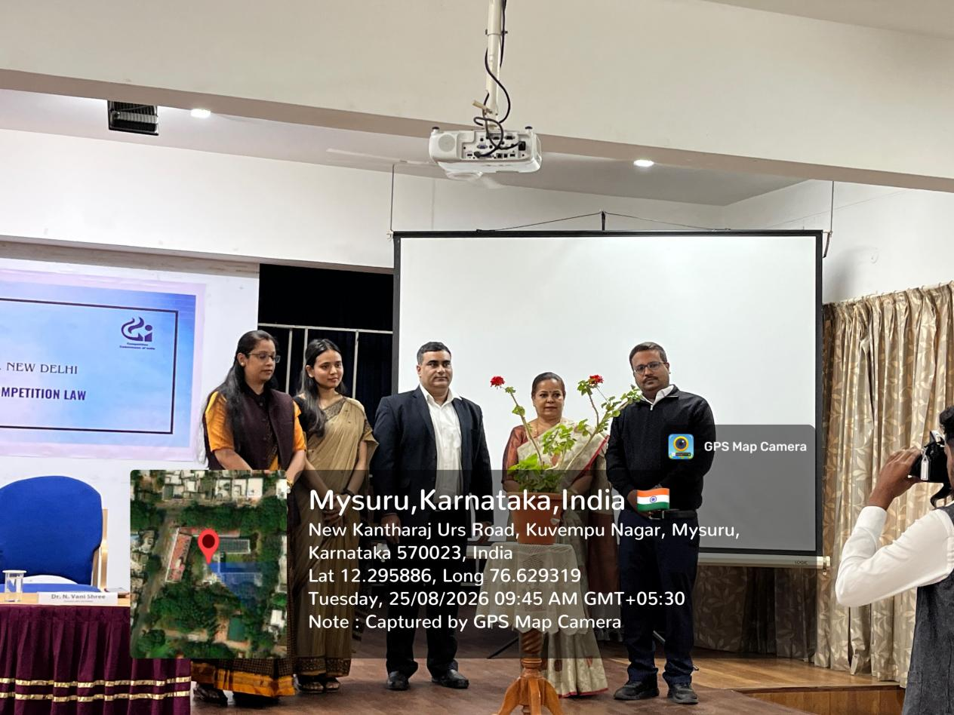
One-Day Workshop on Competition Law
On 25.08.2026, JSS Law College (Autonomous), Mysuru, organized a One-Day Workshop on Competition Law titled “An Advocacy Initiative on Contours of Competition Law”, with Shri Mohan Rao Ronanki, Director (Economics), CCI, as the Resource Person.

Slide 24
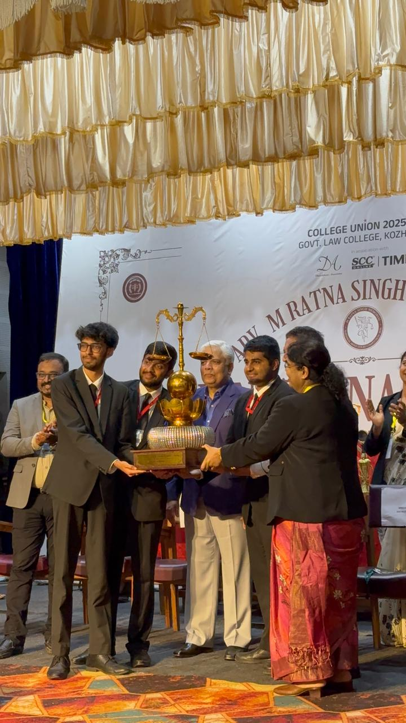
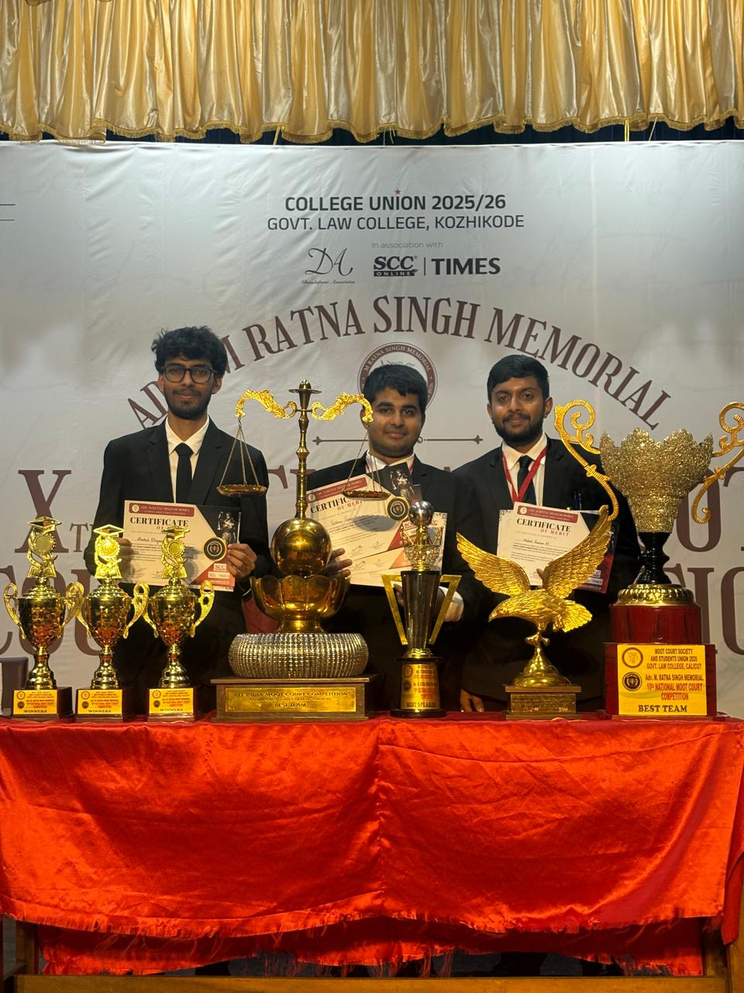
Moot Court Achievements
Winners of the National Moot Court Competition
Mr. Vaishnav Kiran, Mr. Anshul Winyaas, and Mr. Mithul Pranav, students of IV Year B.A. LL.B. (Hons.), represented JSS Law College in the 10th Ratna Singh Memorial National Moot Court Competition was organised by Government Law College, Kozhikode held from 14.08.2026 to 16.08.2026. The team was ultimately adjudged the Winners in the competition and was awarded a cash prize of Rs. 50, 000/- . In addition, Mr. Vaishnav Kisran was adjudged the Best Speaker among all participants and was awarded a cash prize of ₹8,000 in recognition of his performance in oral advocacy.

Slide 25
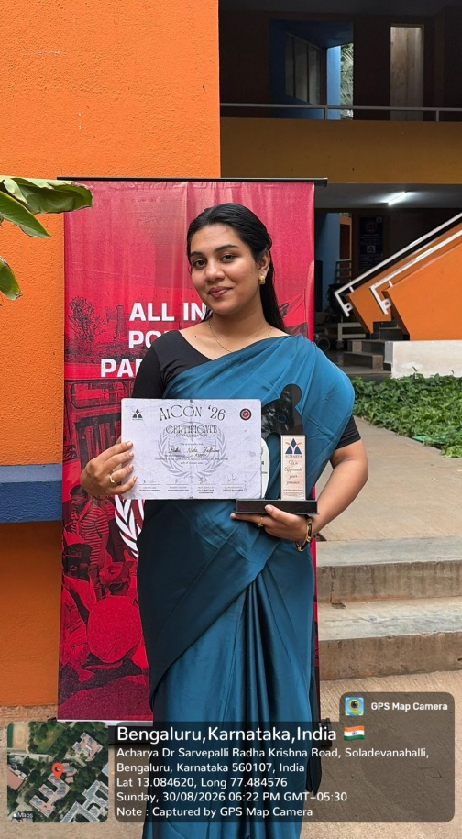
AICON 2026
Ms. Bibi Nida Fathima of IX Semester BA., LL.B (Hons.) participated in AICON 2026, hosted by Acharya Institute of Technology, Bengaluru, held from 28.08.2026 to 30.08.2026. Ms. Bibi Nida Fathima was awarded High Commendation in the AIPPM Committee, along with a trophy and cash prize of ₹7,000/-.

Slide 26
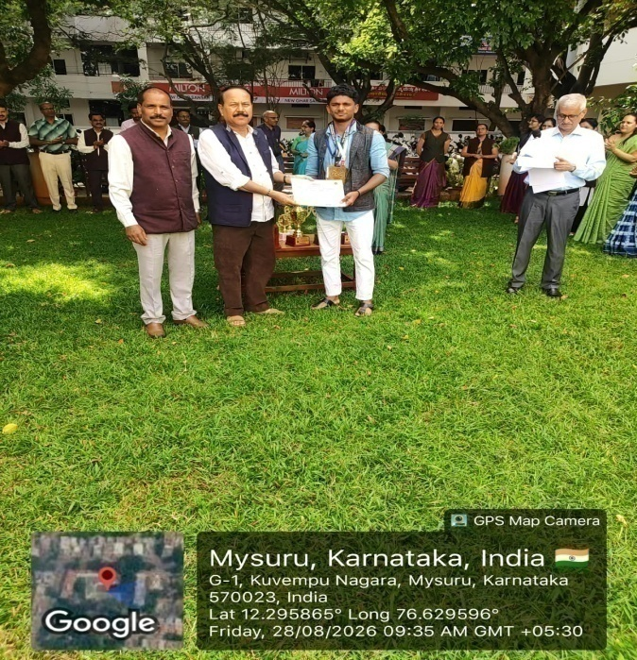
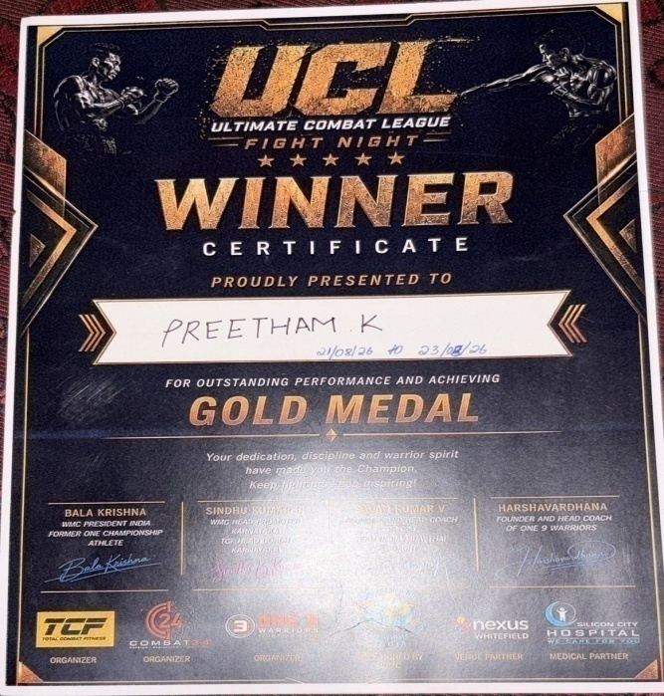
District Level UCL
Mixed Martial Arts Fight Championship 2026
Mr. Preetham. K of V Semester BBA., LL.B (Hons.), participated in the District Level UCL Mixed Martial Arts Fight Championship 2026 held from 21.08.2026 to 23.08.2026 at Bengaluru and secured I Place (Gold Medal).

Slide 27
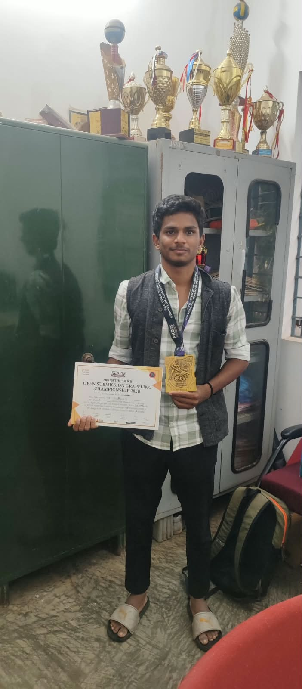
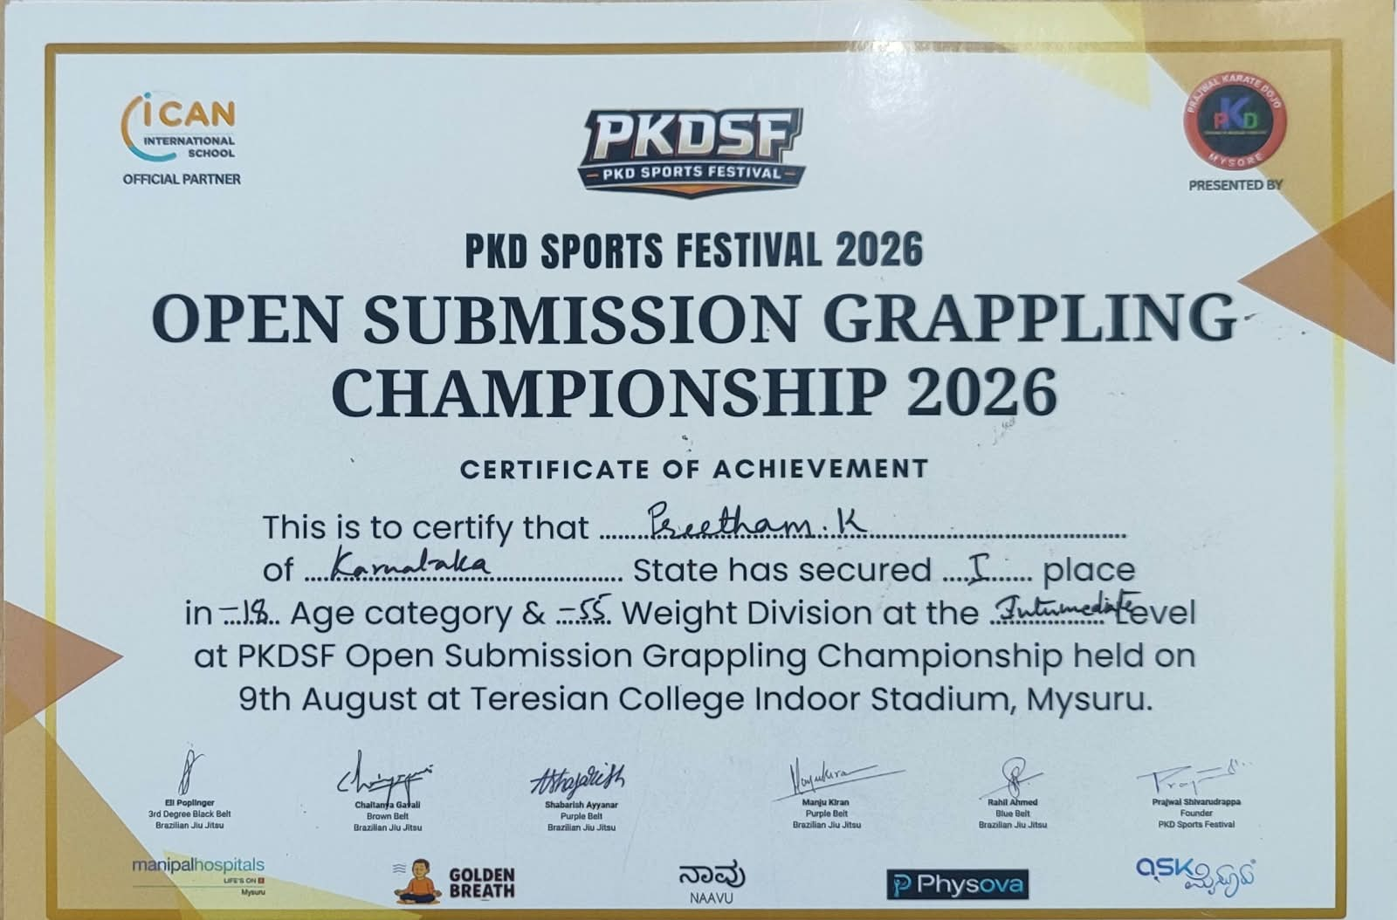
PKD Sports Festival 2026 Open Submission Grappling Championship 2026
Mr. Preetham. K of V Semester BBA., LL.B (Hons.), PKD Sports Festival 2026 Open Submission Grappling Championship 2026 held on 09.08.20266 at Teresian College, Mysuru. He represented of Karnataka State and secured I Place in 18 age category & 55 weight division at the intermediate level.

Slide 28
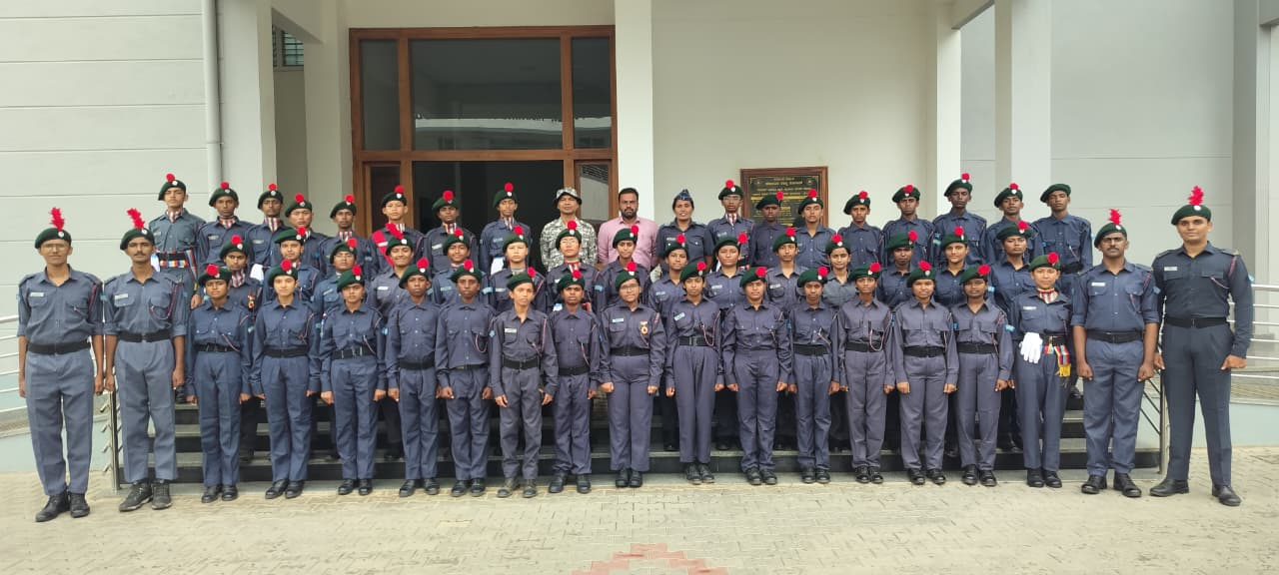
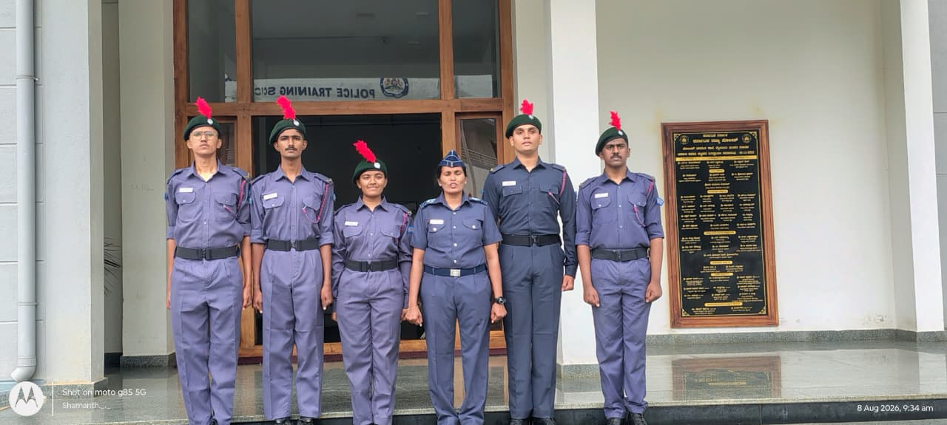
Annual Training Camp – 2026
The Annual Training Camp – 2026 was held at Police Training School from 02.08.2026 to 11.08.2026. Cadet. Gaurav, Cadet. Diya, Cadet. Prithvi, Cadet. Neel Gowda and Cadet. Shamanth attended the Annual Training Camp.

Slide 29
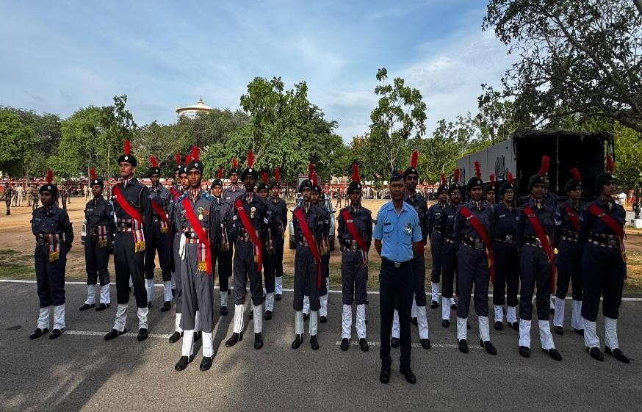
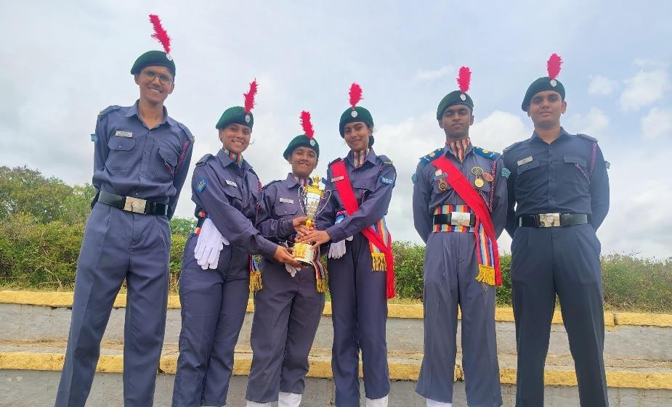
Independence Day Celebrations
On 15.08.2026, the NCC Air Wing cadets participated in the Independence Day celebrations and parade at Bannimantap, Mysuru

Slide 30
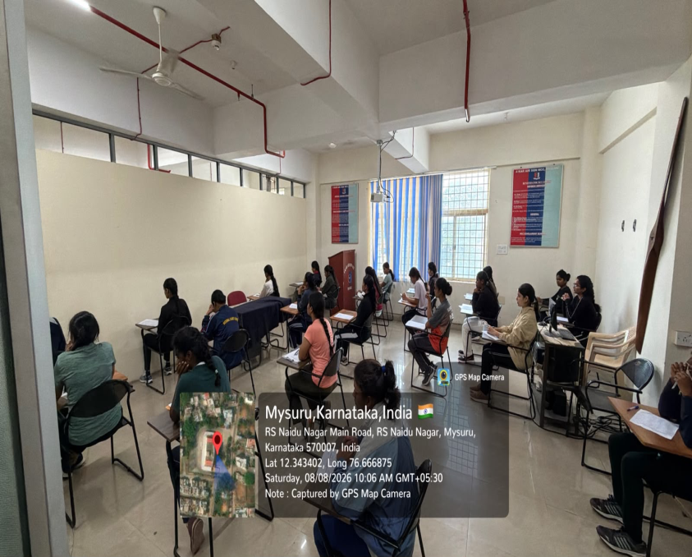
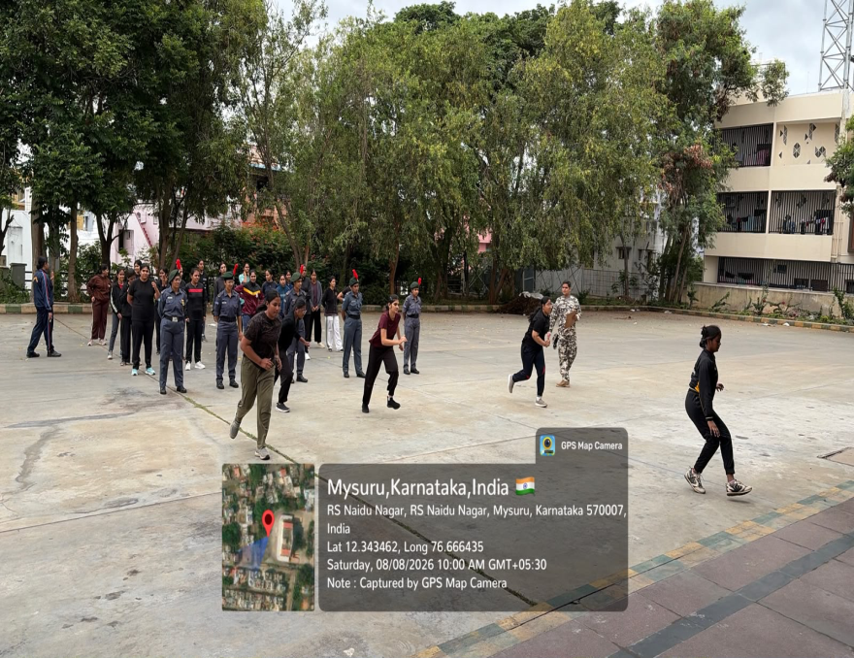
NCC Cadets Enrolment
On 08.08.2026, the NCC First Year Cadets Enrolment of 4 KarAir Squadron NCC, Mysuru.

Slide 31
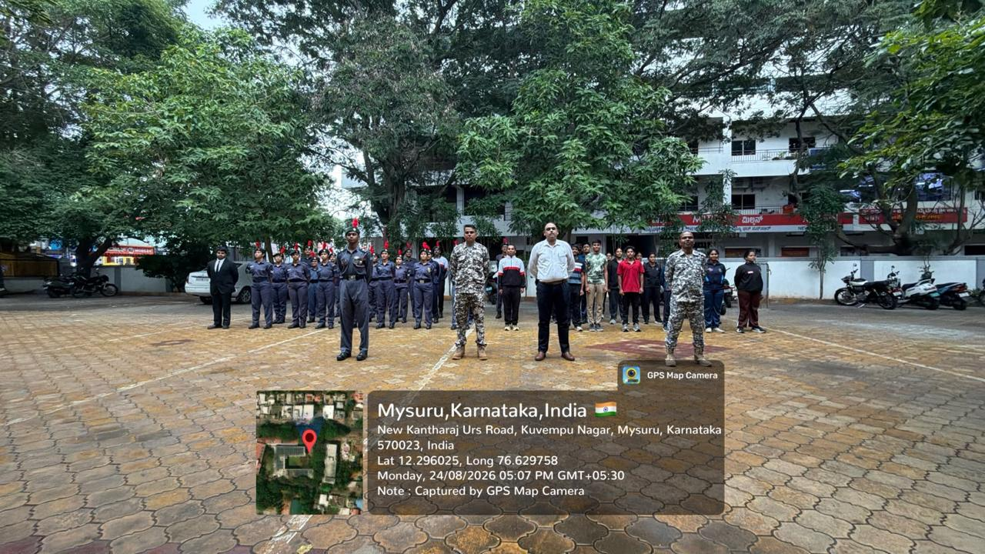
NCC Weekly Parade
On 24.08.2026 – NCC Weekly Parade held in the college.

Slide 32
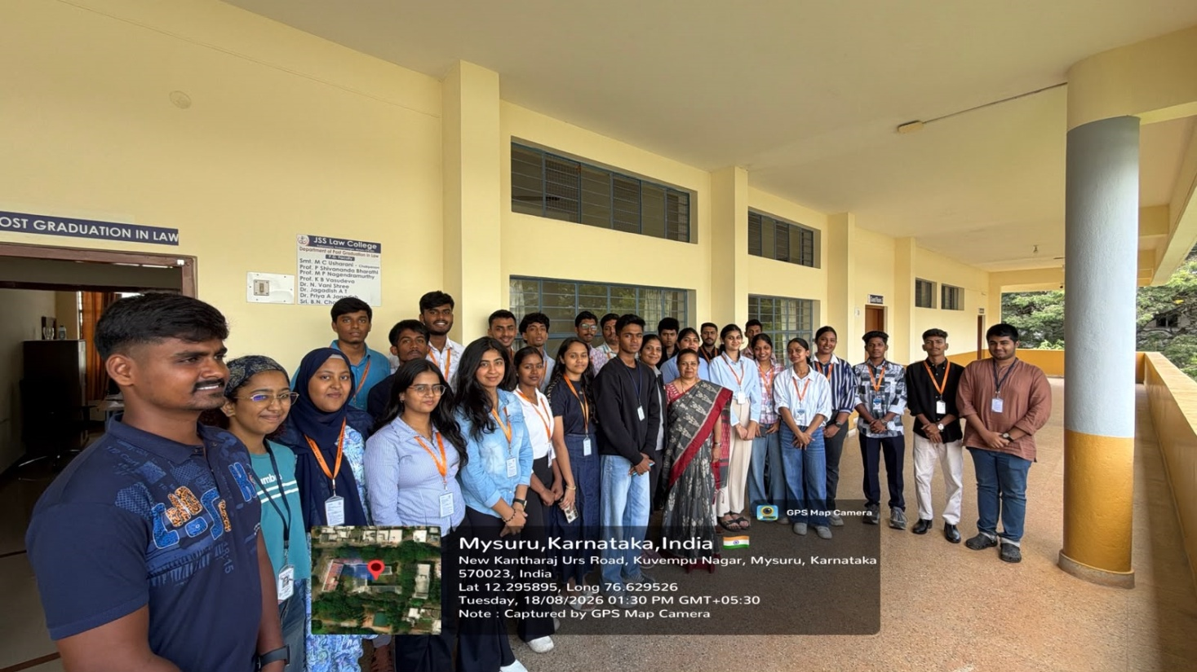
Interview and Selection of NCC Cadets
On 18.08.2026, Interview and Selection for the training year 2026-27 was conducted in the college.

Slide 33

Special Interactive Session
Shri. Venu Rajamony (IFS), Former Ambassador of India to the Netherlands and Former Press Secretary to the President of India on the theme “From the Classroom to the World: Why Law Students Matter in Global Affairs”, held on 04.08.2026 organised by JSSLC Alumni Association and NEETI Forum.

Slide 34

Legal Awareness Programme
JSS Law College (Autonomous), Mysore, in collaboration with the Karnataka State Legal Services Authority, District Legal Services Authority, Mysuru, Department of Law, Mysore Bar Association and Heartfulness Institute, organised a Legal Awareness Programme on POCSO, Prevention of Drug Abuse and Anti-Ragging. The programme featured Shri Anand P. Hogade, District Judge, Fast Track Special Court-I, Mysore; Shri Nagaraja Siddappa Ankasadoddi, Senior Civil Judge & Member Secretary, DLSA, Mysore; Shri Santosh S. Nagarale, Senior Advocate, Hon’ble Karnataka High Court and Legal Adviser to the Hon’ble Governor; Shri Madhukar Deshpande, Senior Advocate, Hon’ble Karnataka High Court; & Shri S. Lokesh, President, Bar Association, Mysuru.

Slide 35
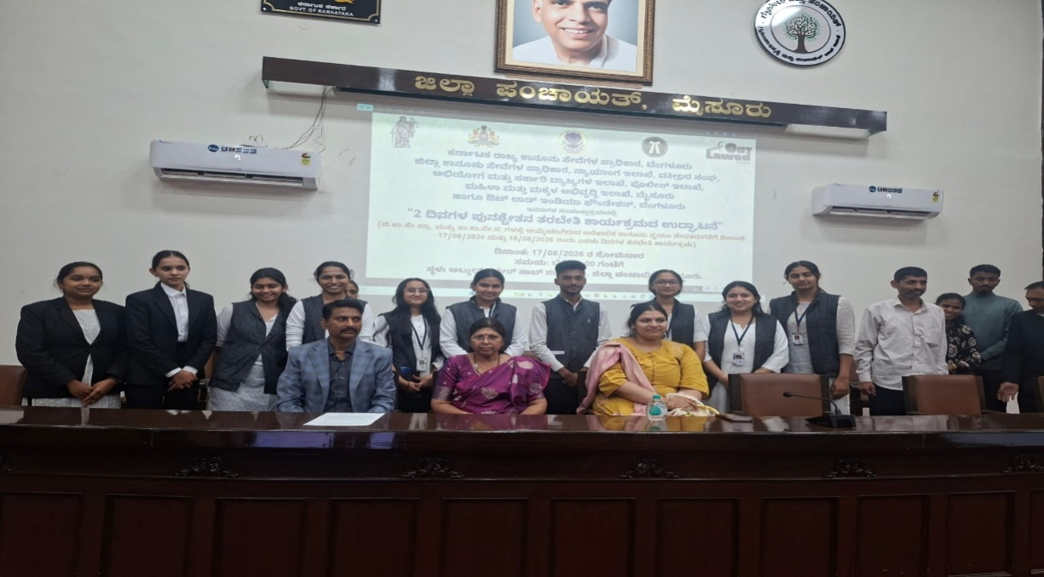
Refresher Training Programme
10 Para-legal volunteers of JSS Law College, Autonomous participated in Refresher Training Programme held on 17.08.2026 and 18.08.2026 organized by the District Legal Services Authority, Mysuru at Zilla Panchayat, Abdul Nazar Saba Hall.

Slide 36
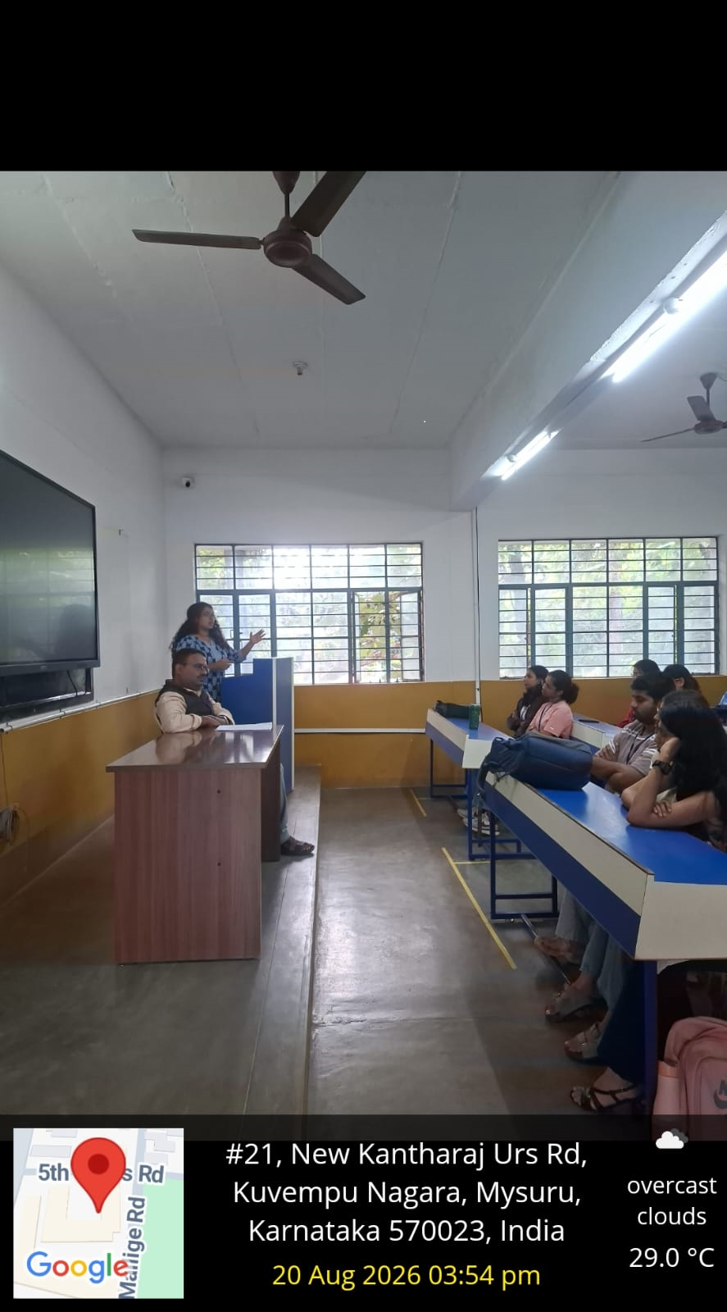
Legal Services Clinic Meeting
Legal Services clinic meeting was held on 20.08.2026 in the college.

Slide 37
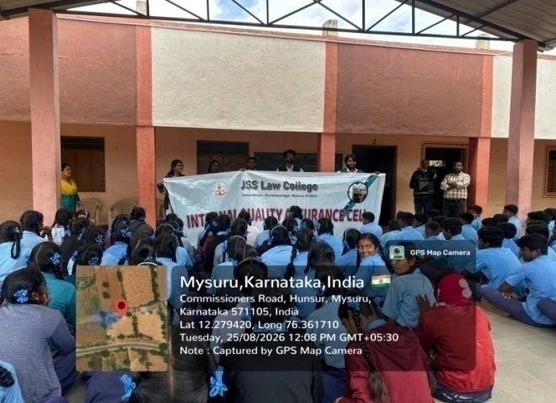
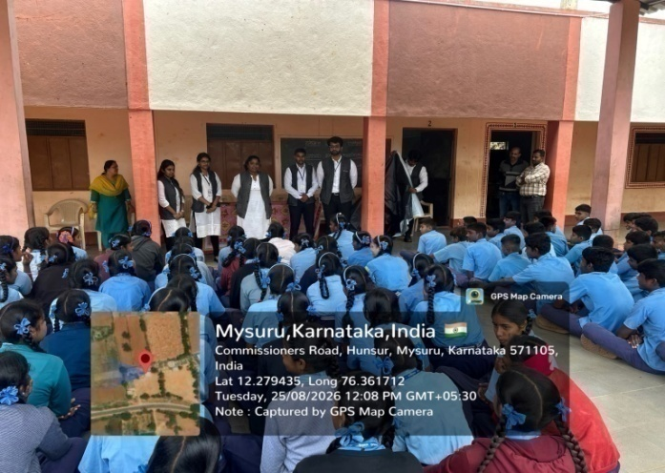


Legal Awareness & Vocational Training Programme
Legal Awareness and Vocational Training Programme at Government High School, Udduru, Hunsur, conducted by students of V Semester BALLB (Hons.) on 05.08.2026
.

Slide 38


A Talk by Dr. N Vani Shree
Dr. N Vani Shree delivered a Talk on the Drug Use, Misuse and Abuse at the JSS College for Women, Saraswathipuram, Mysuru, on 18.08.2026, between 2.30pm to 3.30pm, organized by the Hindi Department.

Slide 39

An Awareness Talk on Anti-Ragging Day
Mr. Ashraya S Chakroborty was invited as a Guest Speaker to deliver an awareness talk on Anti-Ragging Day, organized by JSS Medical College, JSSAHER, Mysuru on 18.08.2026.

Slide 40

MUN Orientation Programme
Model United Nations Society of JSS Law College conducted an orientation programme for the I year students of BA., LL.B(Hons.), BBA., LL.B (Hons.) and LL.B ON 13.08.2026 at Silver Jubilee Hall.

Slide 41


Moot Court Orientation
The Moot Court Orientation for the academic year 2026–27 was conducted on 24th , 25th and 27th August 2026.

