Slide 1

Monthly Report – June 2026

Slide 2

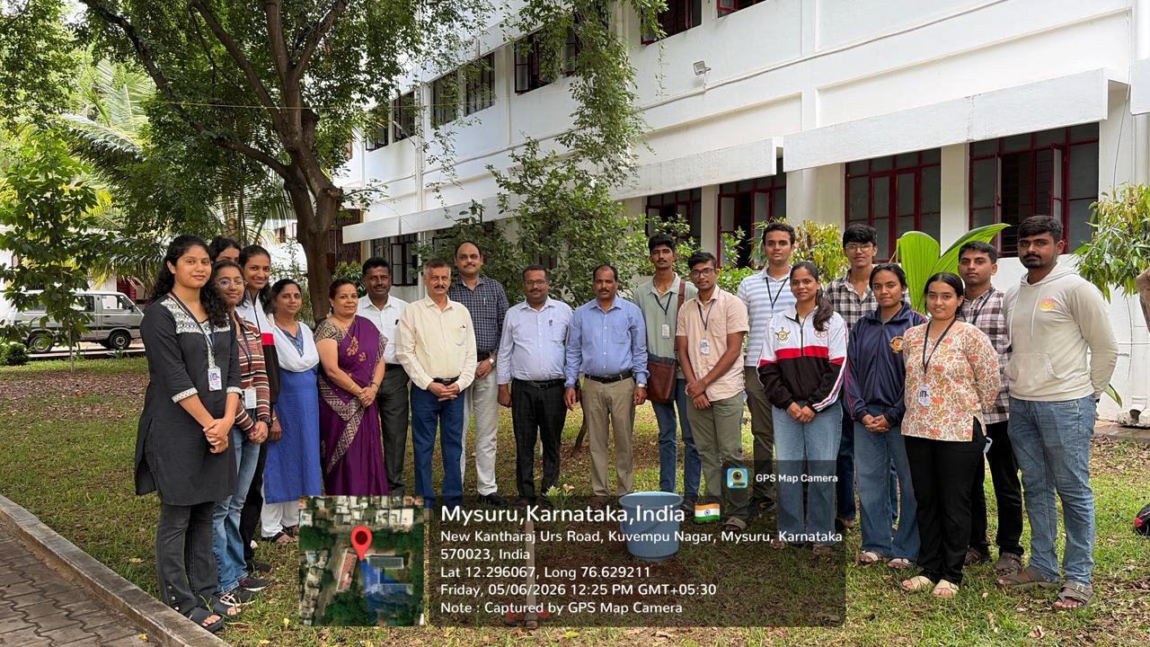
World Environment Day 2026
On the occasion of World Environment Day on 05.06.2026, the NCC cadets of 4 Kar Air Sqn, Mysuru, in association with NSS JSS, Law College, Autonomous, Mysuru, participated in the tree-plantation activity at our college campus.

Slide 3
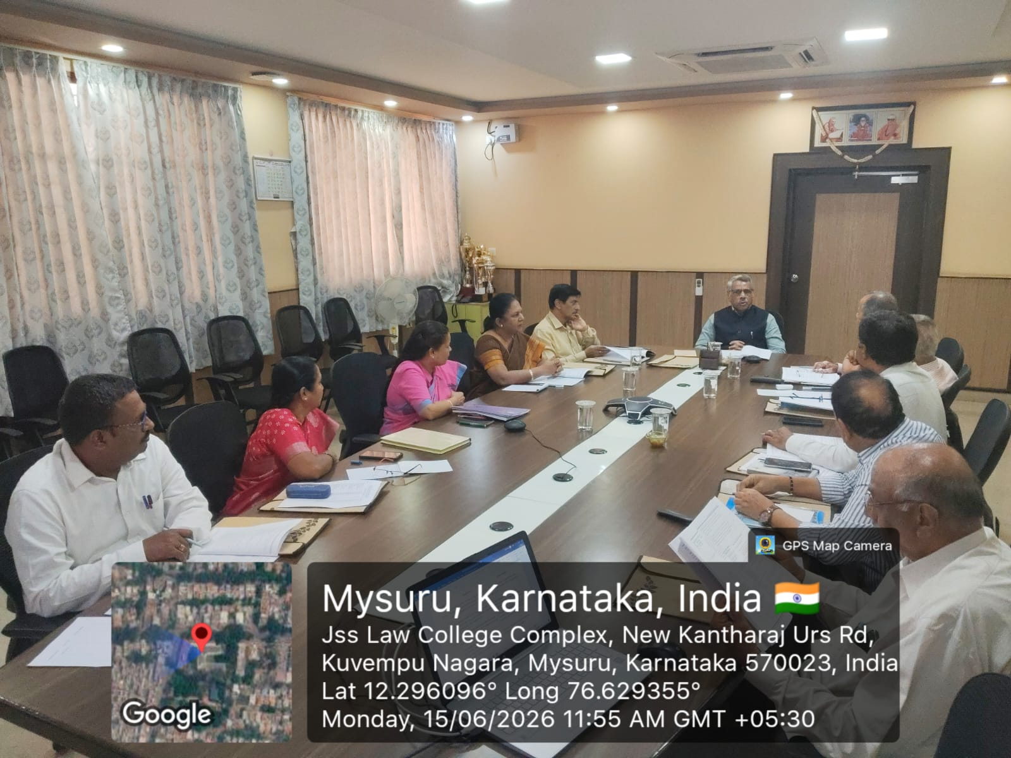
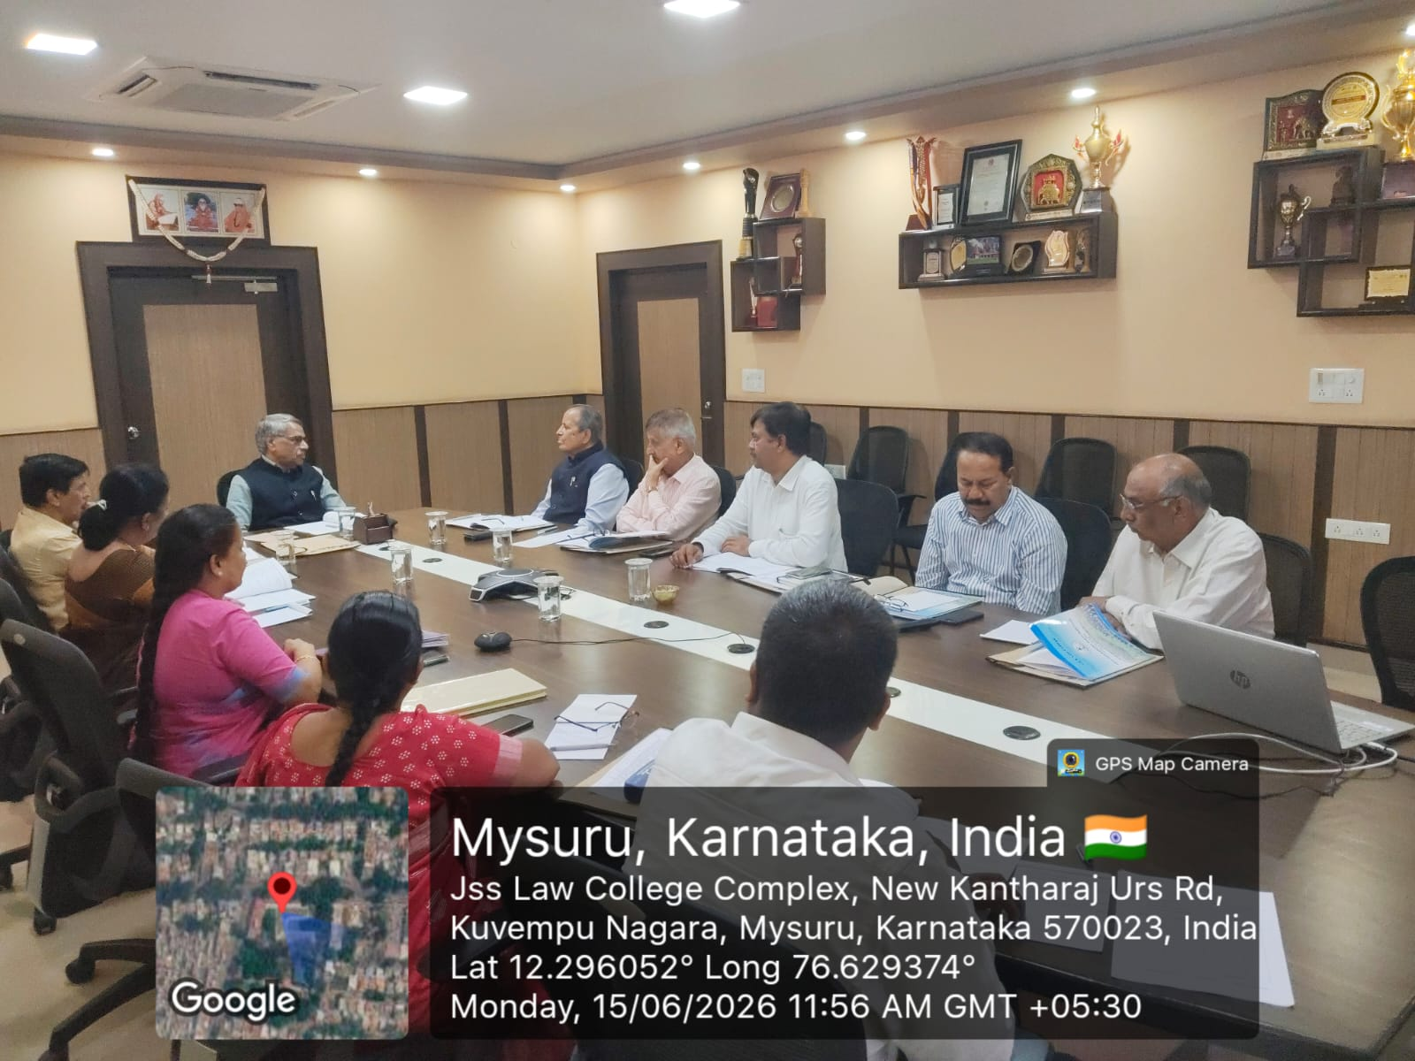
Governing Body Meeting
37th Governing Body Meeting was held on 15.06.2026.

Slide 4
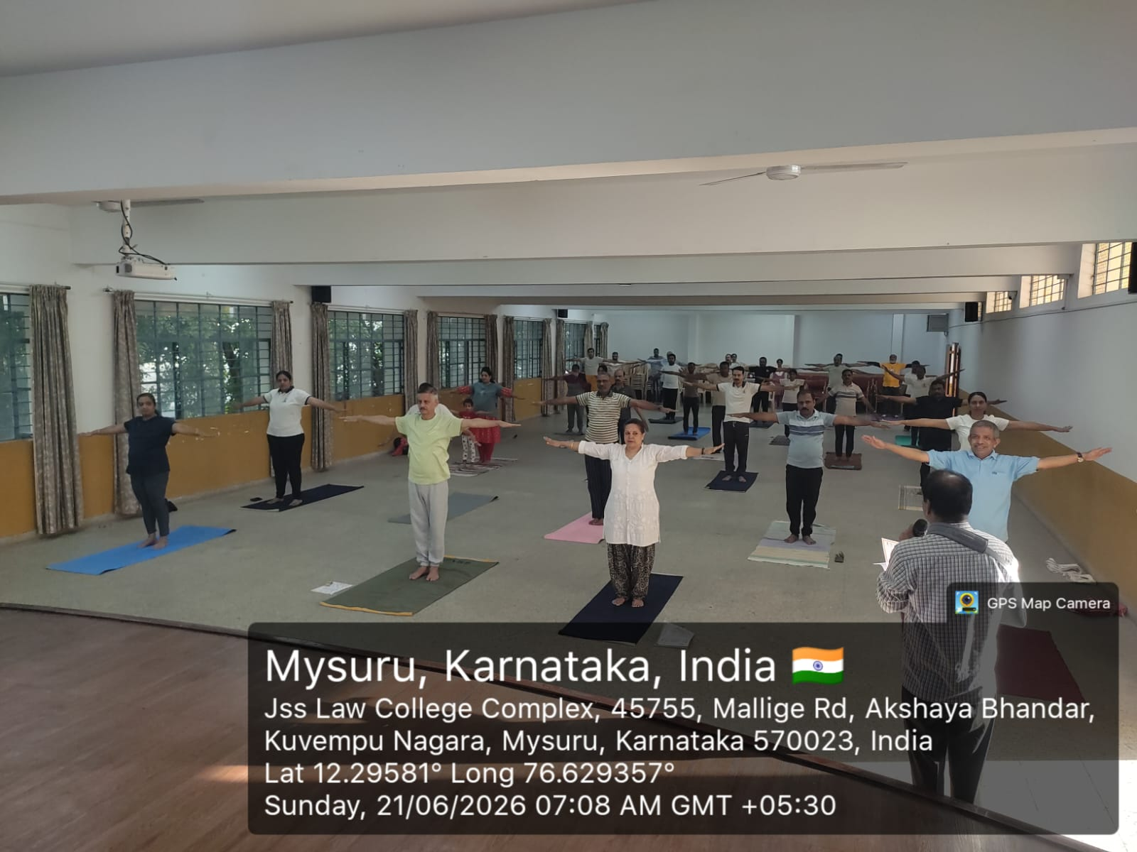
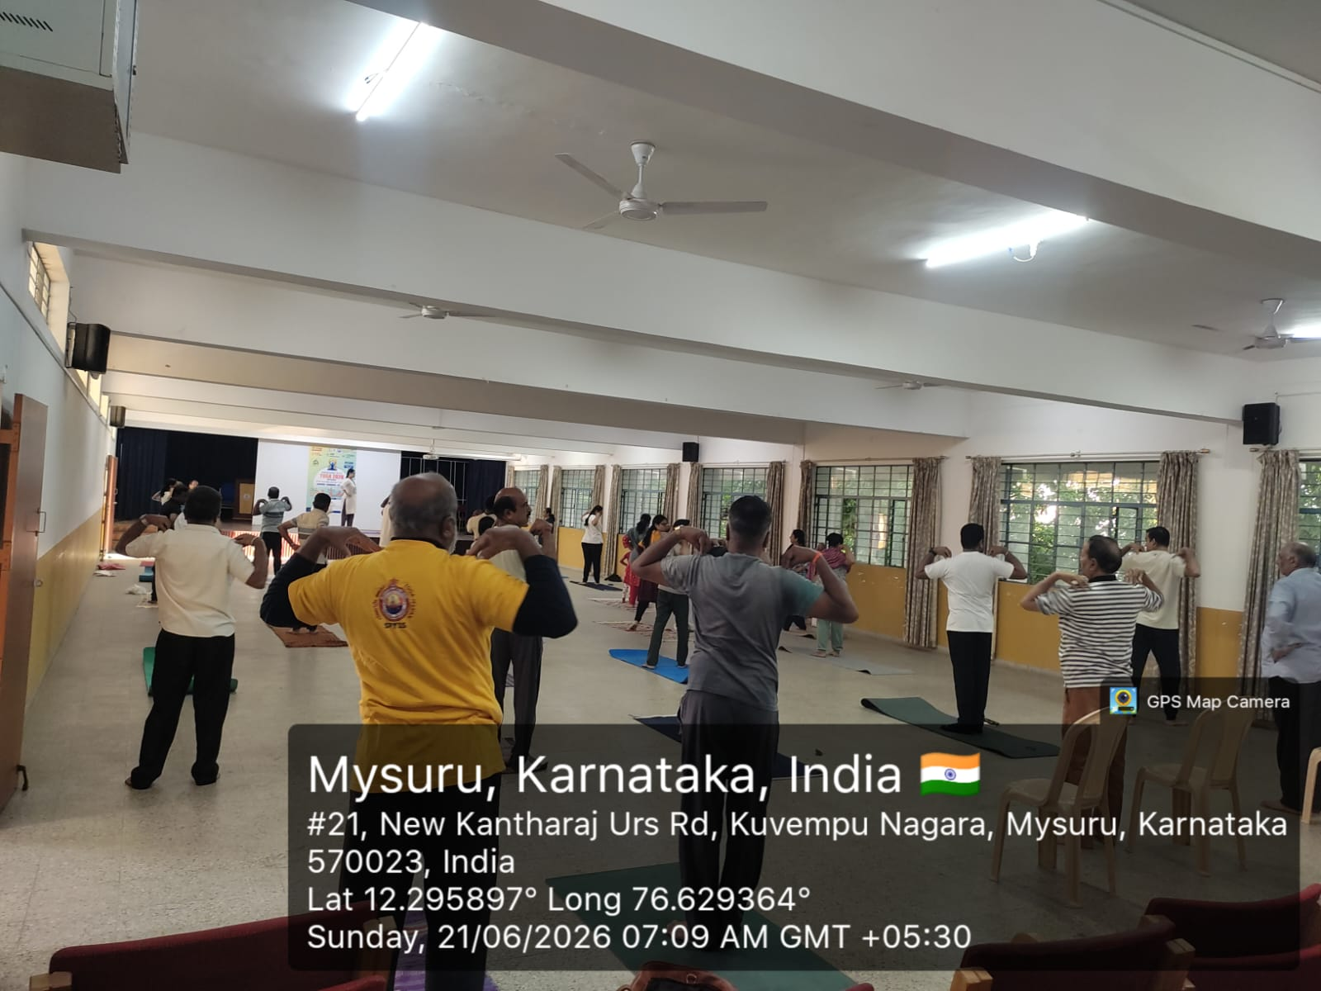
International Yoga Day 2026
On 21.06.2026, the College celebrated the International Day of Yoga 2026 under the theme ‘Yoga for Healthy Ageing”

Slide 5
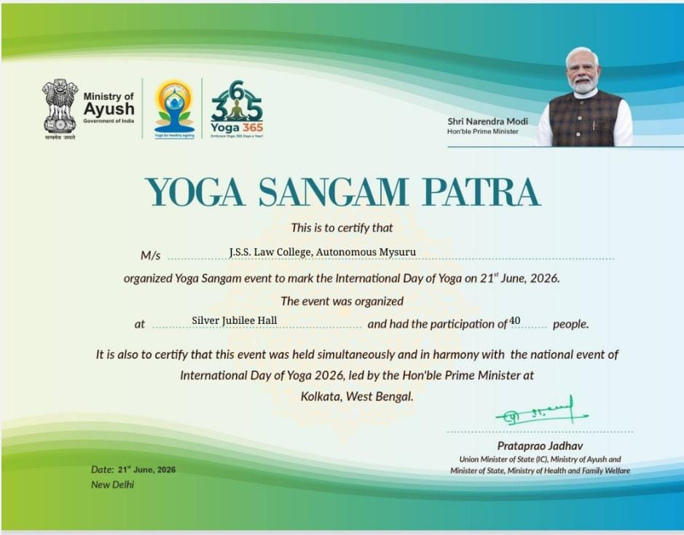
International Yoga Day 2026
On 21.06.2026, the College celebrated the International Day of Yoga 2026 under the theme ‘Yoga for Healthy Ageing”

Slide 6
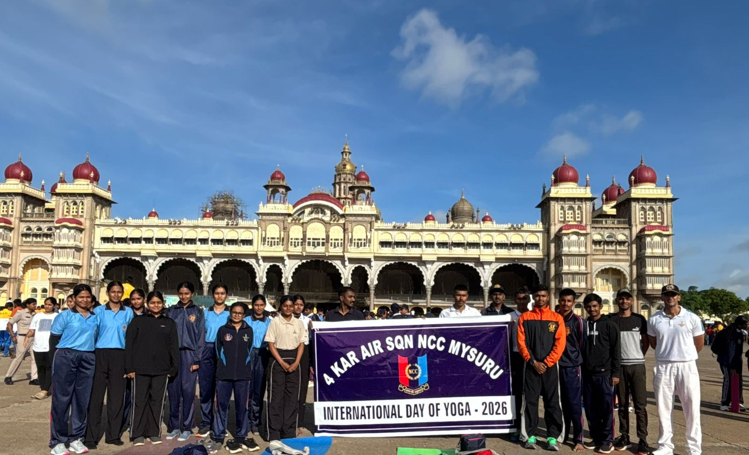
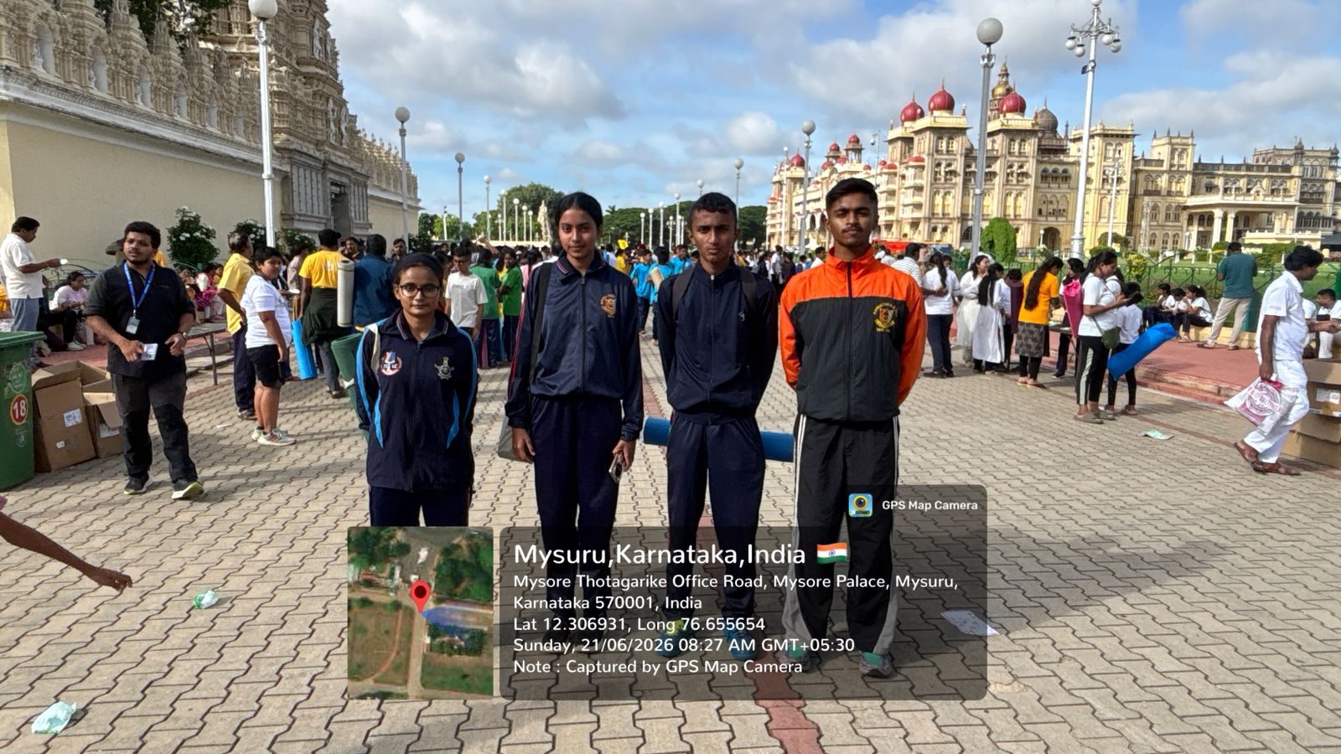
International Yoga Day 2026
Air Wing NCC cadets of JSS Law College actively participated in the 12th International Yoga Day, a yoga session organized at the Mysuru Palace Grounds on 21.06.2026.

