Slide 1

Monthly Report – July 2026

Slide 2

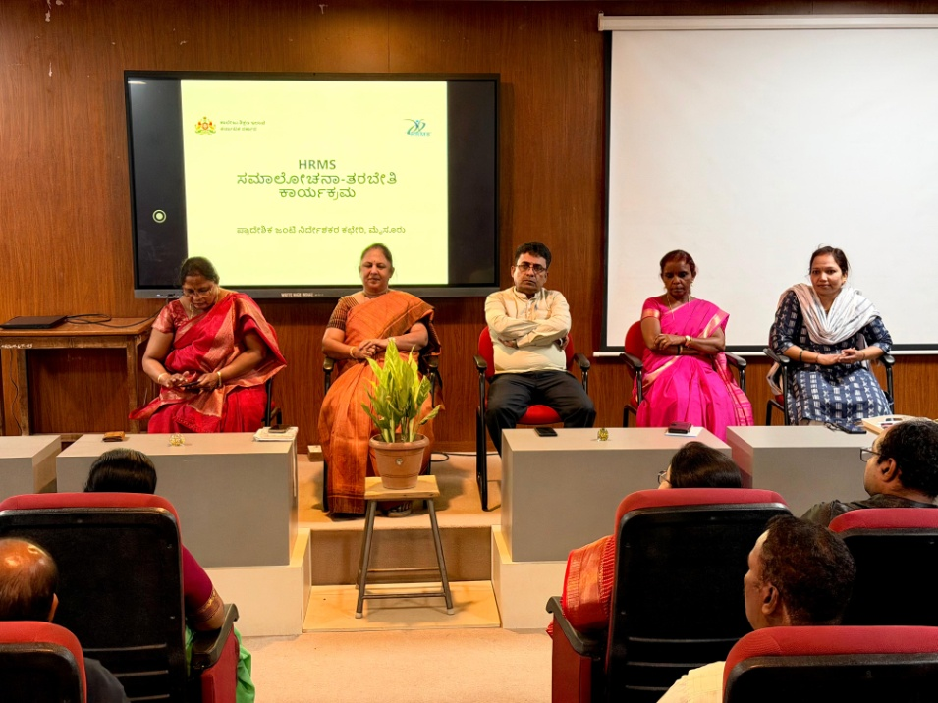
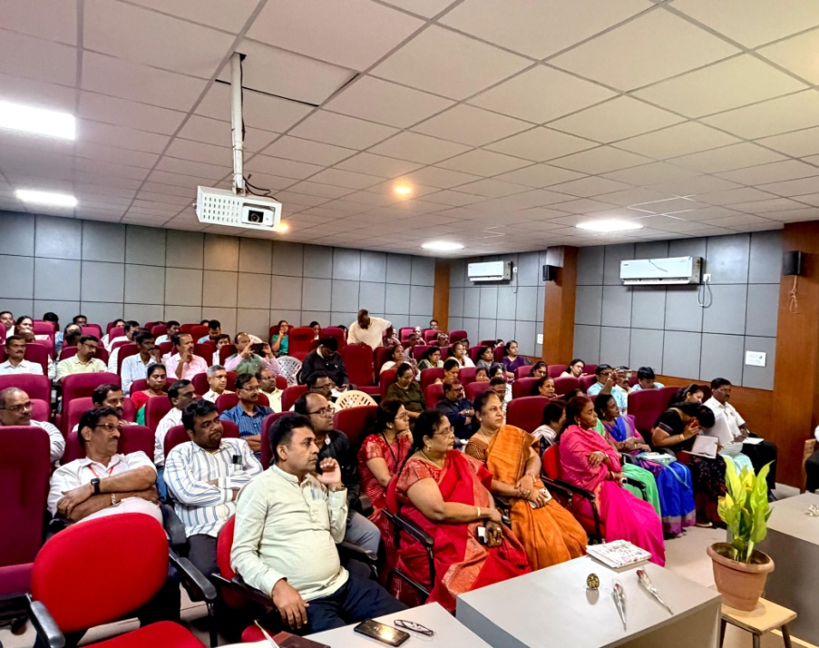
Training Workshop on HRMS
Dr. N Vani Shree, Mr. Shashidhar B and Mr. Prakash attending a Training Workshop on HRMS related matters convened by the Joint Director, Collegiate Education, Mysuru region on 15.07.2026.
.

Slide 3
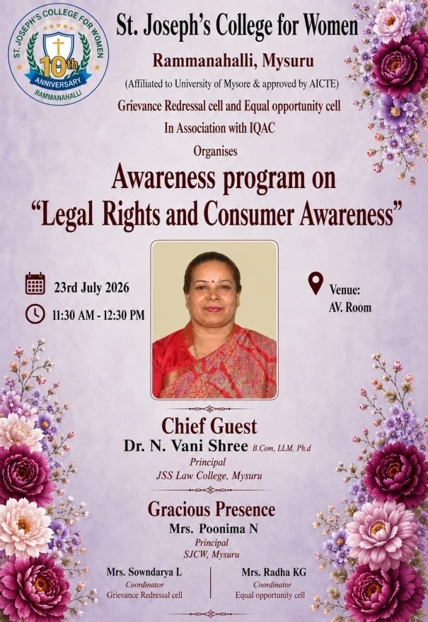
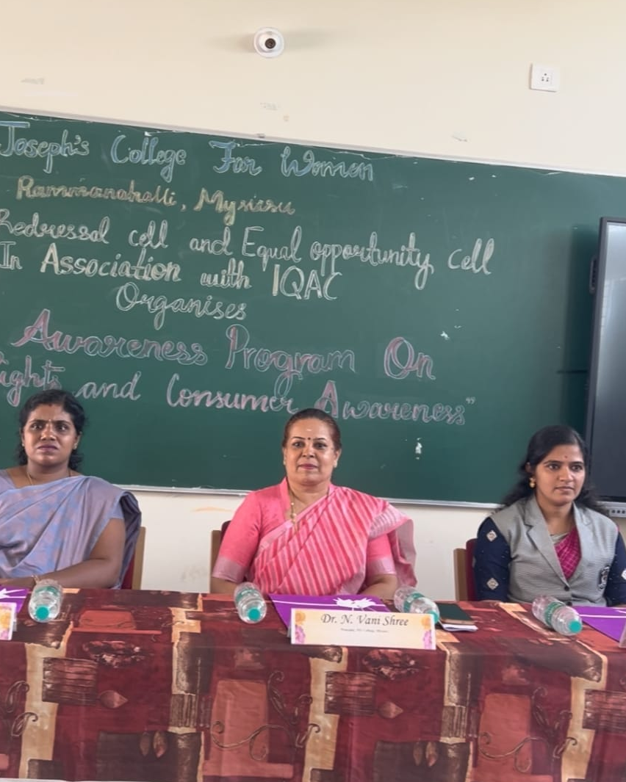
Guest Lecture by Dr. N. Vani Shree
On the topic: ‘An Awareness Programme on Legal Rights and Consumer Awareness’, organized by the IQAC of St. Joseph’s College For Women, Rammanahalli, Mysuru on 23.07.2026.

Slide 4
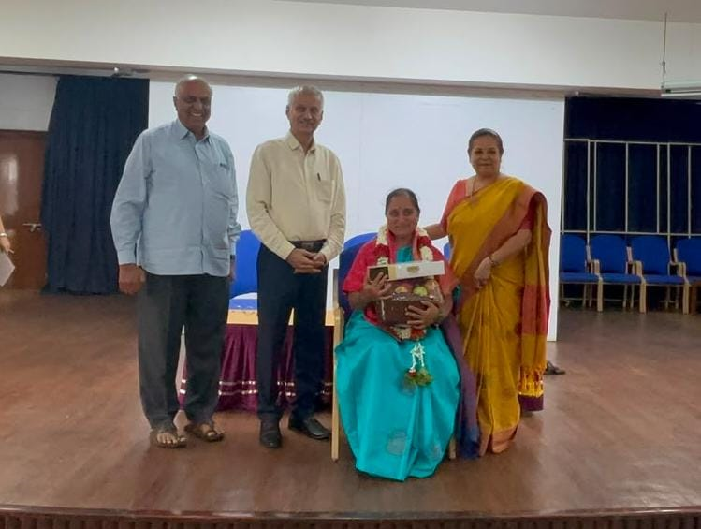
Farewell Programme
On 30.07.2026 , Smt. Sunitha N, Assistant Professor, BBA Department was felicitated by the Chief Executive Prof. K S Suresh, Principal and staff members.

Slide 5
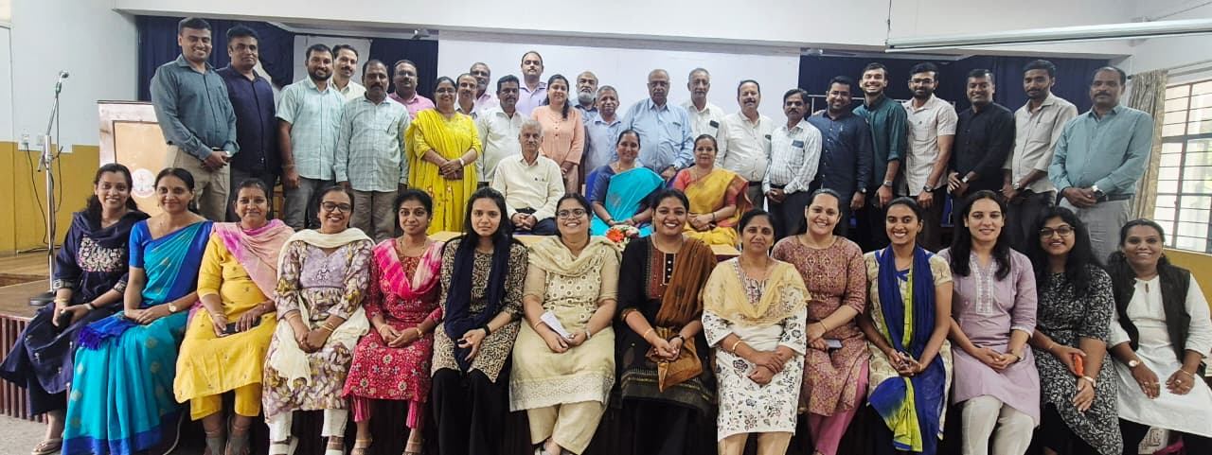
Farewell Programme
On 30.07.2026 , Smt. Sunitha N, Assistant Professor, BBA Department was felicitated by the Chief Executive Prof. K S Suresh, Principal and staff members.

