Slide 1

Monthly Report – May 2026

Slide 2
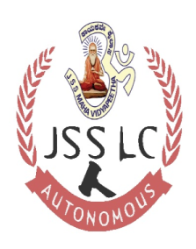
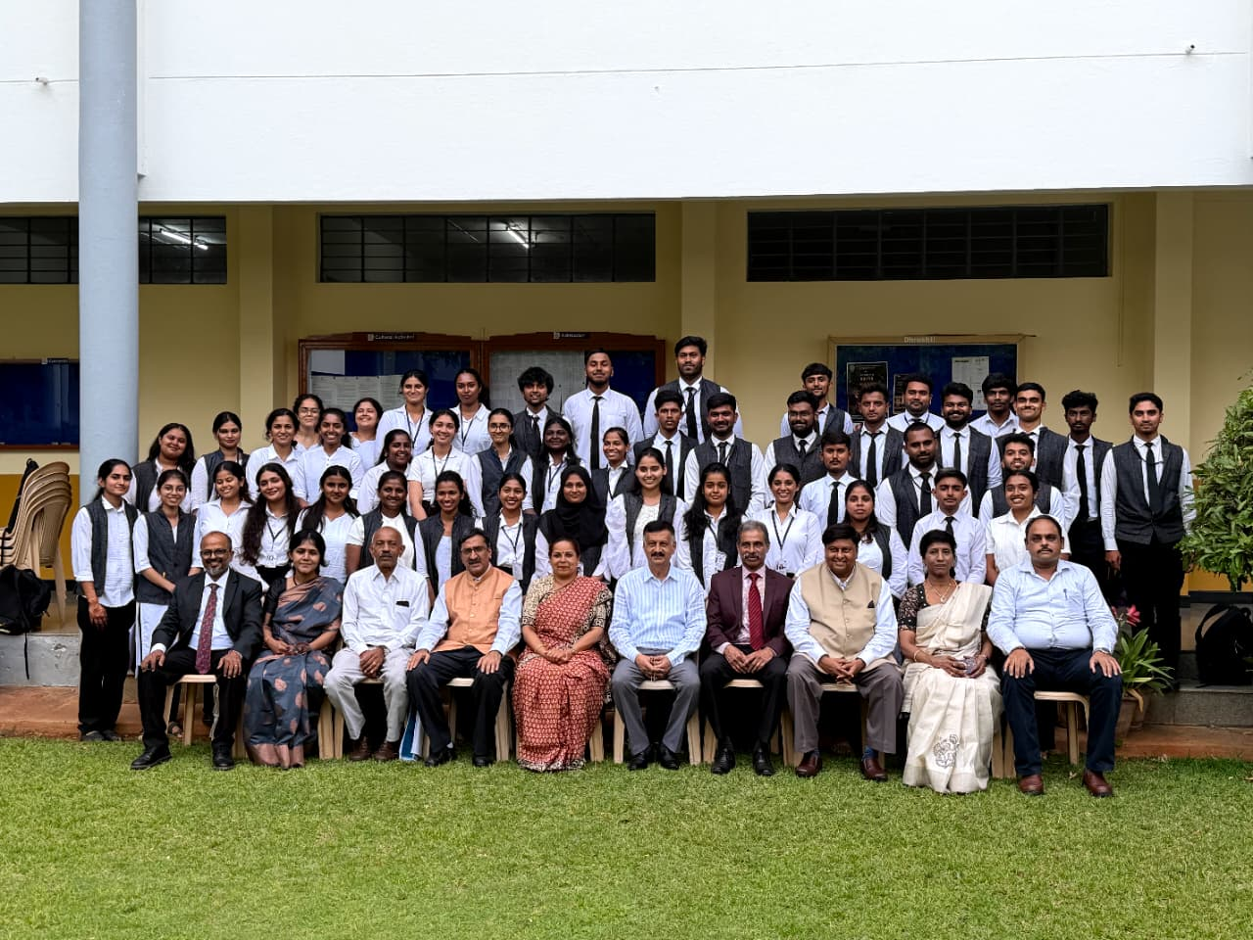
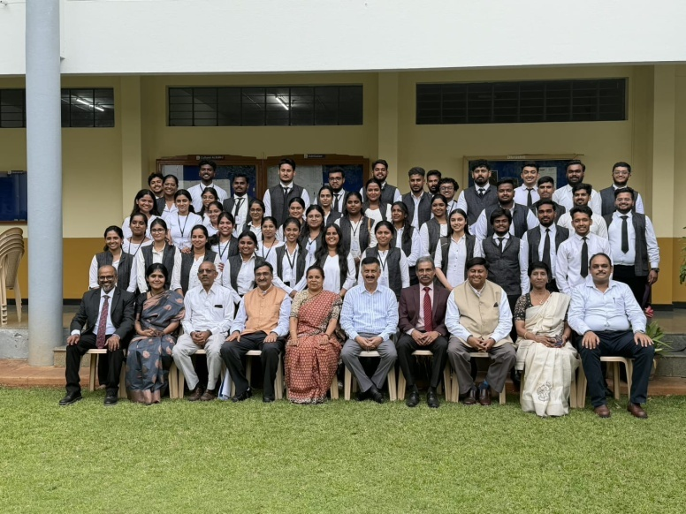
Three-Day Mediation Training Programme
Three Days (20 hours) Mediation Training Programme for Final year students was held from 02.05.2026 to 04.05.2026 with trainers from Karnataka Mediation Centre, Karnataka High Court. Coordinated by Sri. M P Nagendramurthy, Course Teacher – ADR

Slide 3
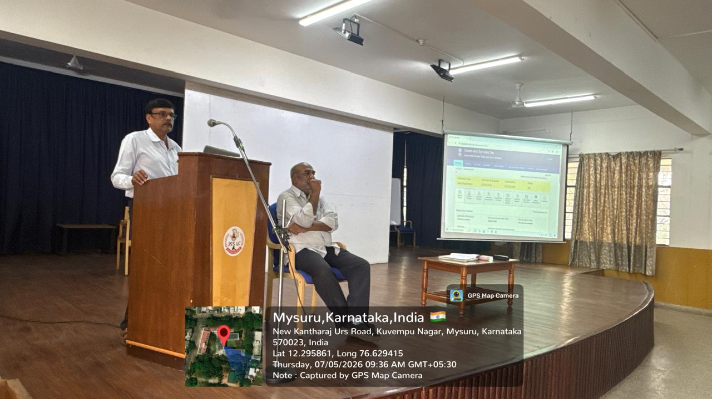
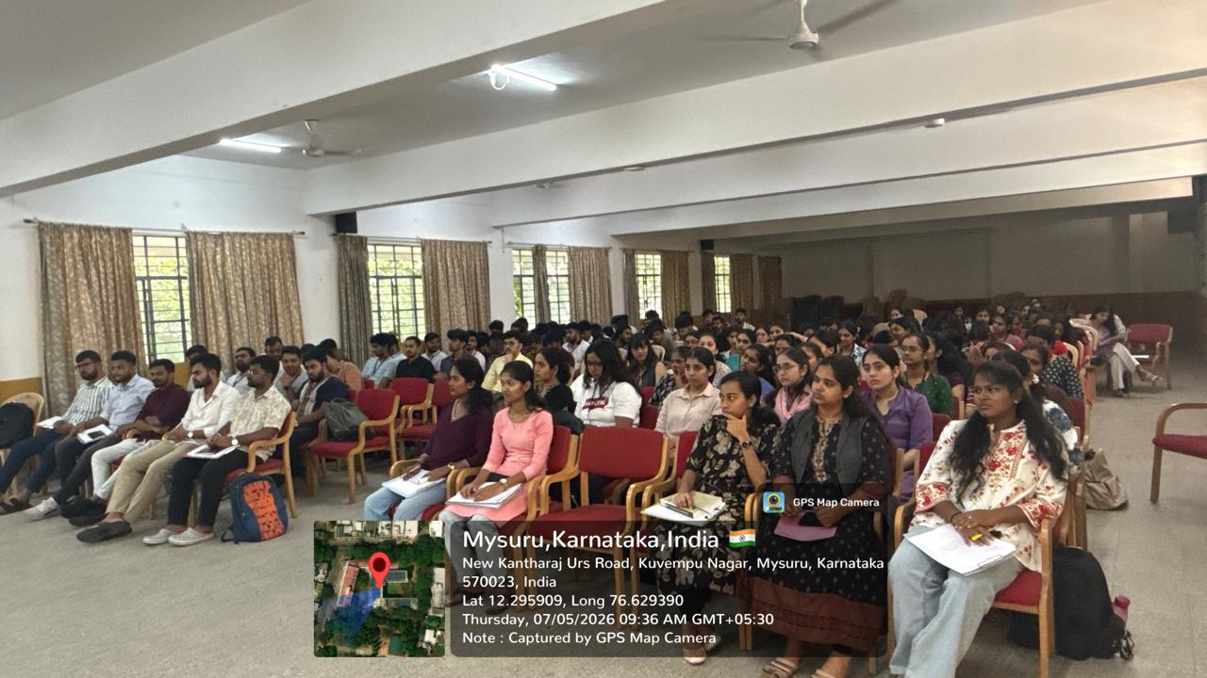
Workshop
Taxation Laws Practical Activity - Workshop on How to register under Income Tax, GST, Customs and other related taxation law was organised for students of VIII BA., LL.B (Hons.) and BBA., LL.B (Hons.) and IV semester LL.B on 06.05.2026 by CA. B N Chandrashekar and Prof. Rajashekar K, Course Teachers – Law of Taxation.

Slide 4
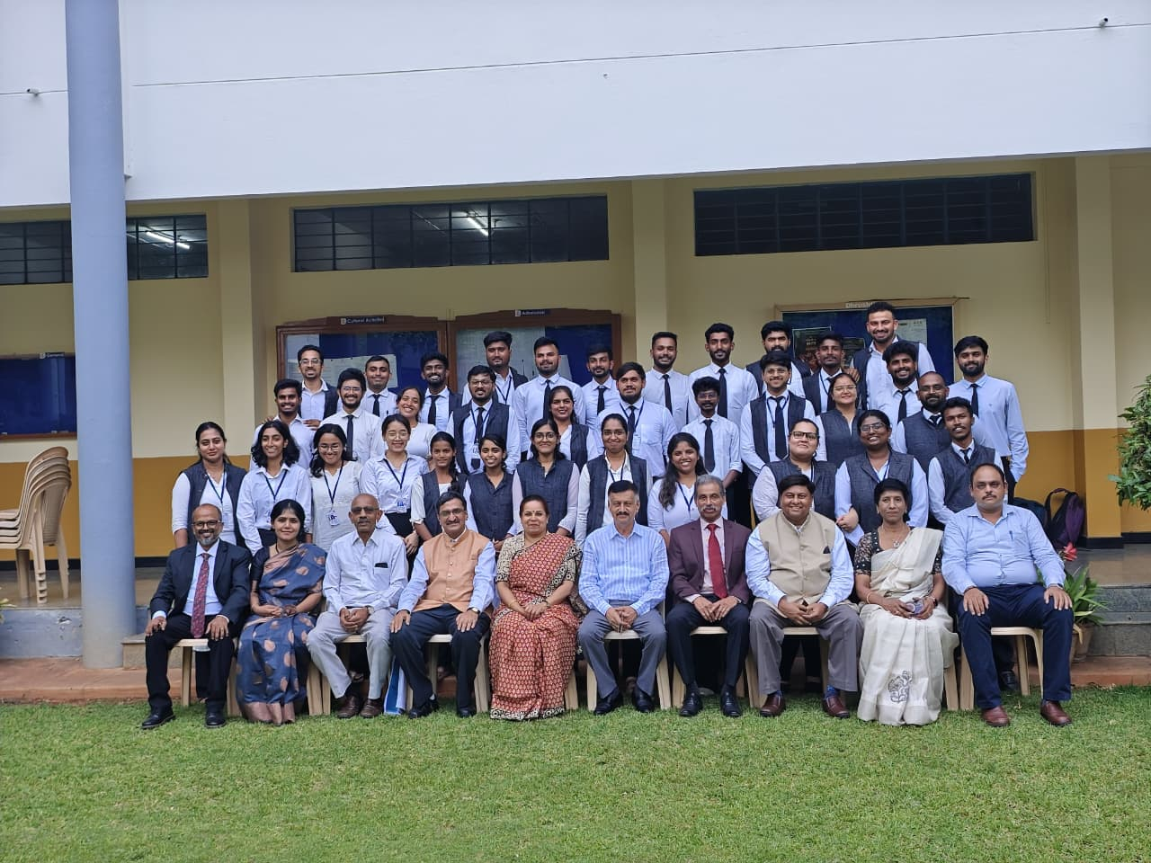
Three-Day Mediation Training Programme
Three Days (20 hours) Mediation Training Programme for Final year students was held from 02.05.2026 to 04.05.2026 with trainers from Karnataka Mediation Centre, Karnataka High Court. Coordinated by Sri. M P Nagendramurthy, Course Teacher – ADR

Slide 5
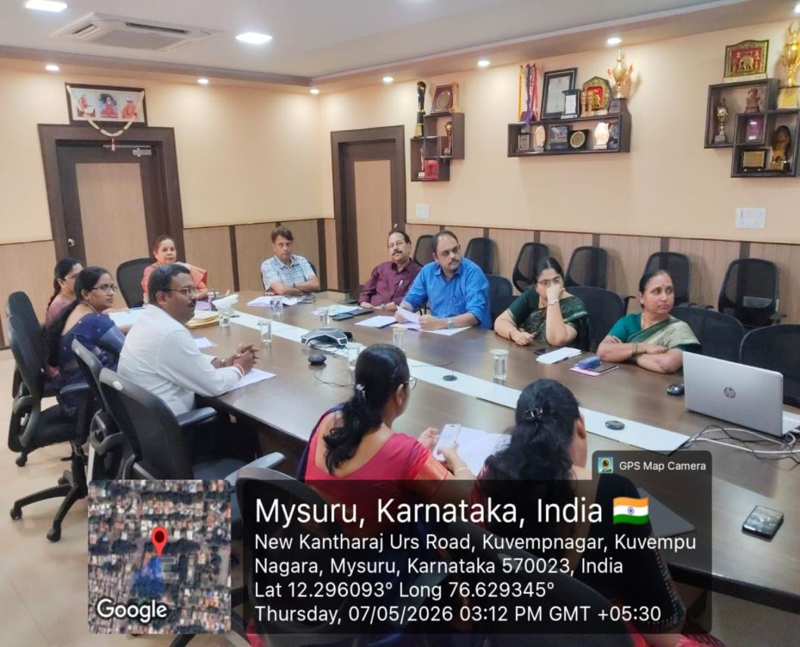
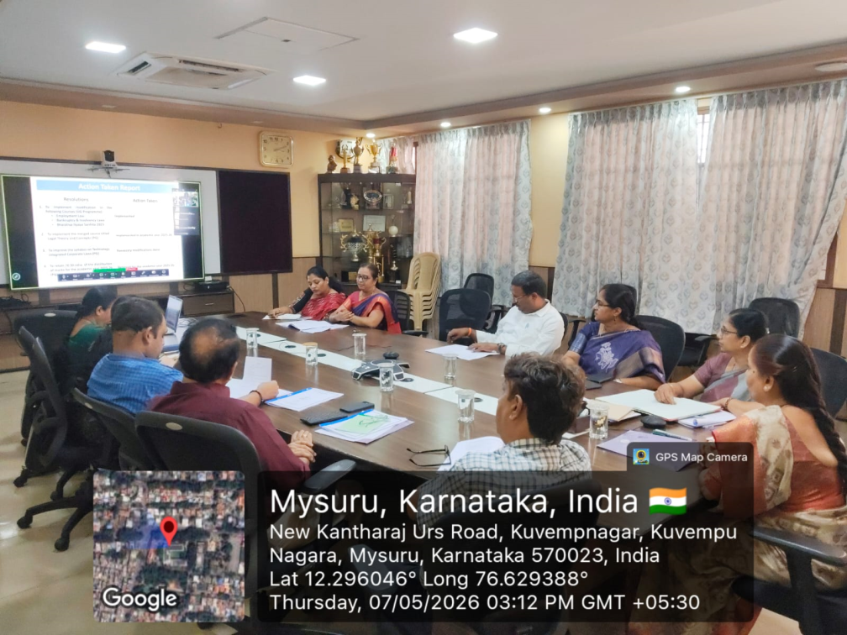
37th Academic Council Meeting
The 37th Academic Council meeting held on 07.05.2026

Slide 6
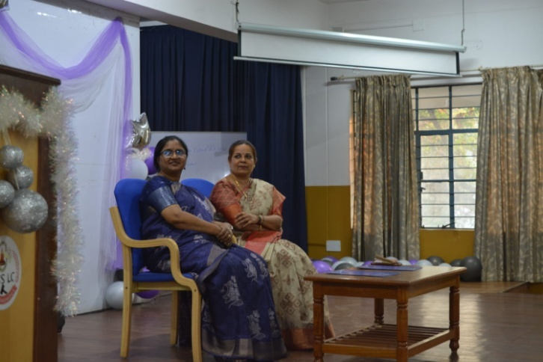
HOSTELISTA 2026
HOSTELISTA 2026 (Hostel day) was held in the Silver Jubilee Hall on 07.05.2026.

Slide 7
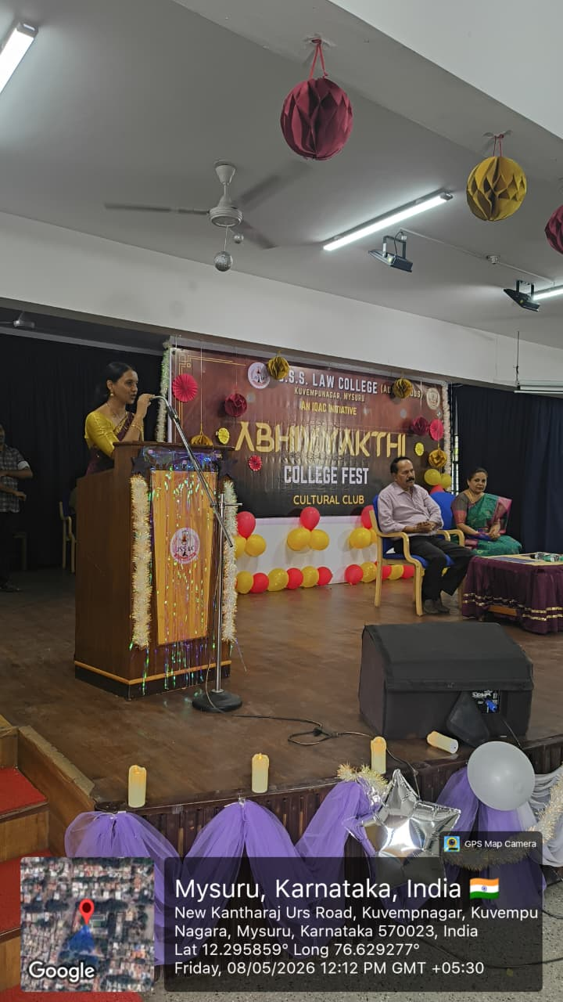
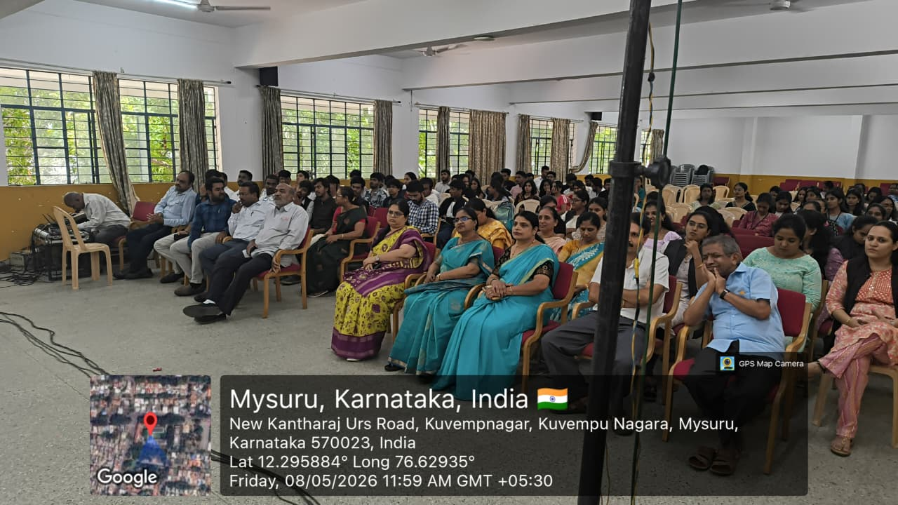
ABHIVYAKTI 2026
ABHIVYAKTI 2026 - Cultural Fest was held on 8.05.2026

Slide 8
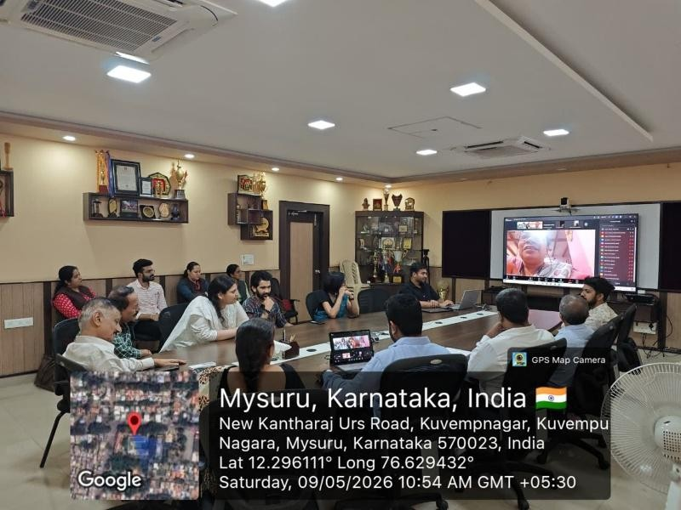
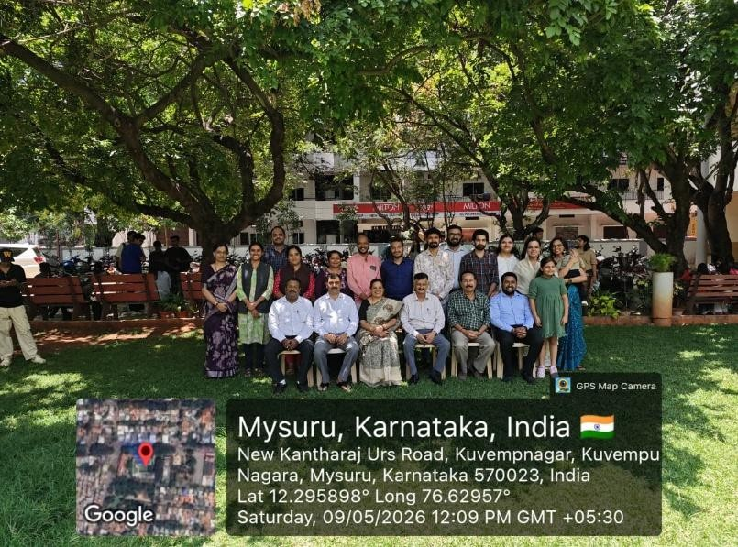
Global Alumni Meet 2026
The Global Alumni Meet 2026 of JSS Law College, Autonomous, conducted on 09.05.2026

Slide 9
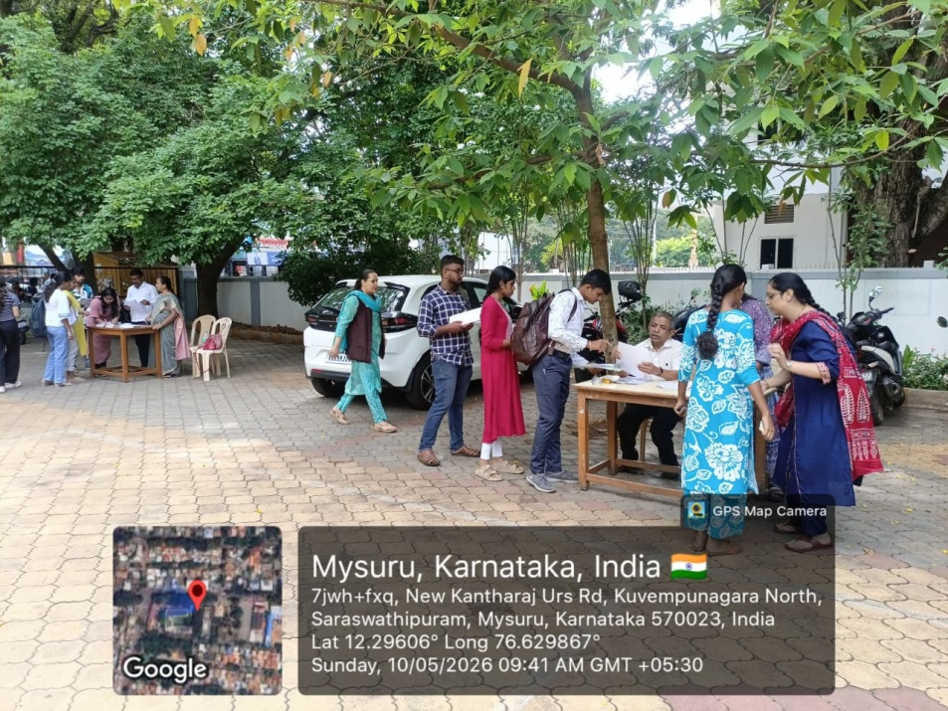
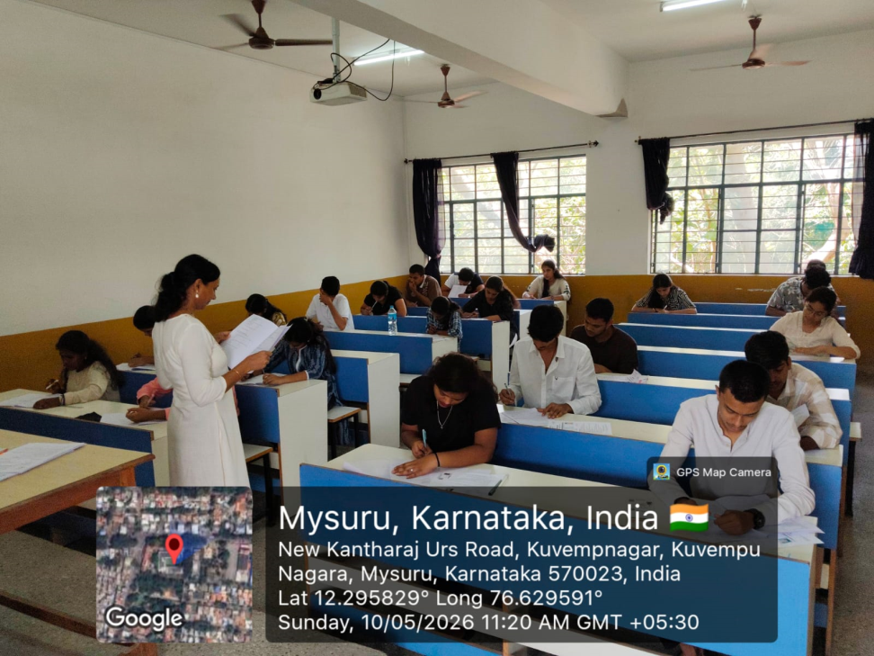
JSSLC – LAT 2026
JSSLC Law Admission Entrance Test was conducted on 10.05.2026 for BA., LL.B (Hons.) and BBA., LL.B (Hons.) programme.

Slide 10
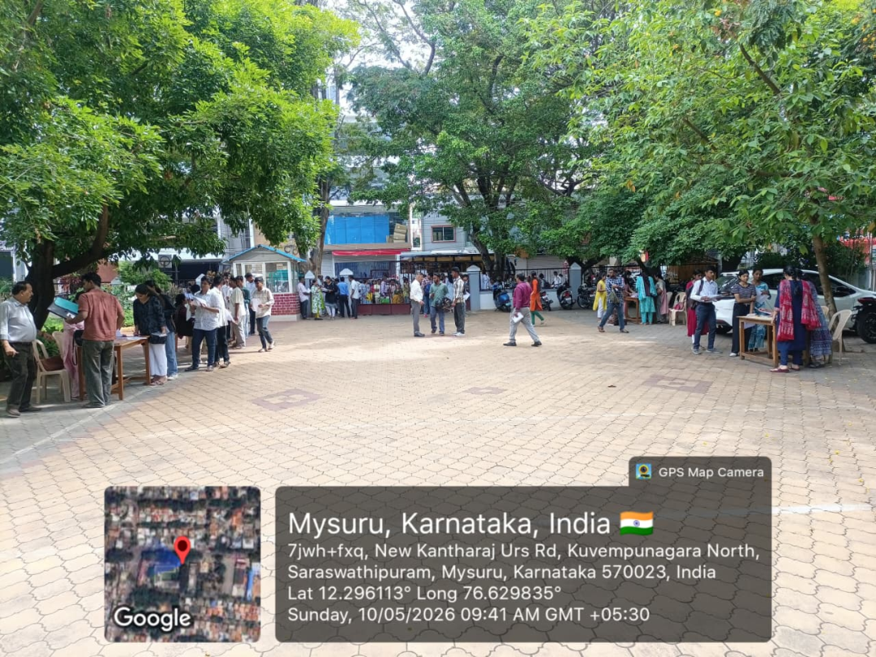
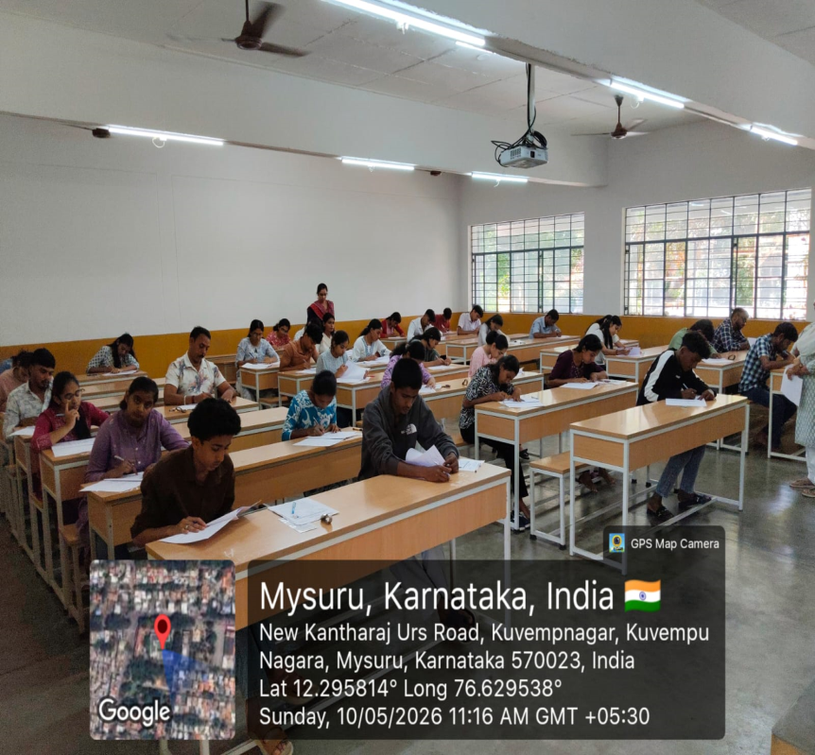
JSSLC – LAT 2026
JSSLC Law Admission Entrance Test was conducted on 10.05.2026
for BA., LL.B (Hons.) & BBA., LL.B (Hons.) programme.

Slide 11
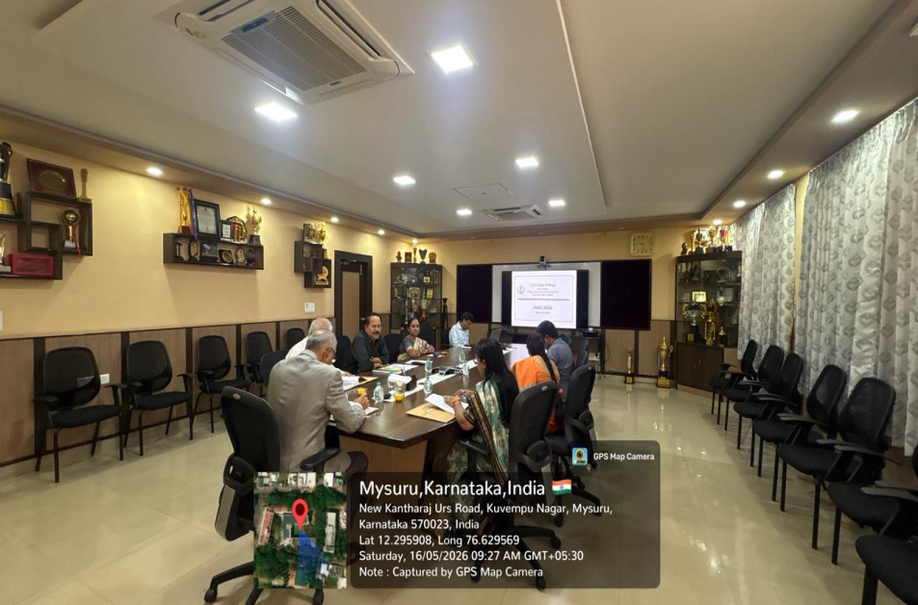
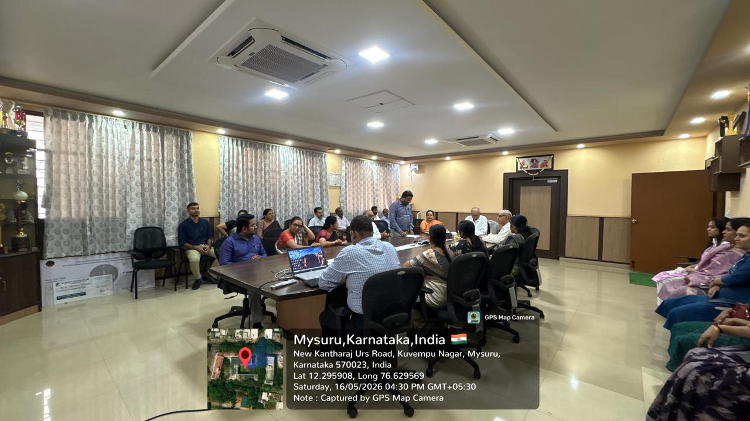
IAAC Visit 2026
The Institutional Assessment and Audit Committee (IAAC) for 2026 had visited on the 16.05.2026. The Committee comprised of the Chairman of the Committee Prof. (Dr.) P Ishwara Bhat, Former Vice Chancellor of the Karnataka State Law University, Hubballi and the West Bengal National University of Juridical Sciences, Kolkata, and Dr. G B Aravind, Associate Professor, Department of Forensic Medicine & Toxicology, JSSAHER, Mysuru, & Dr. A Nagarathna, Associate Professor, NLSIU, Bengaluru.

Slide 12
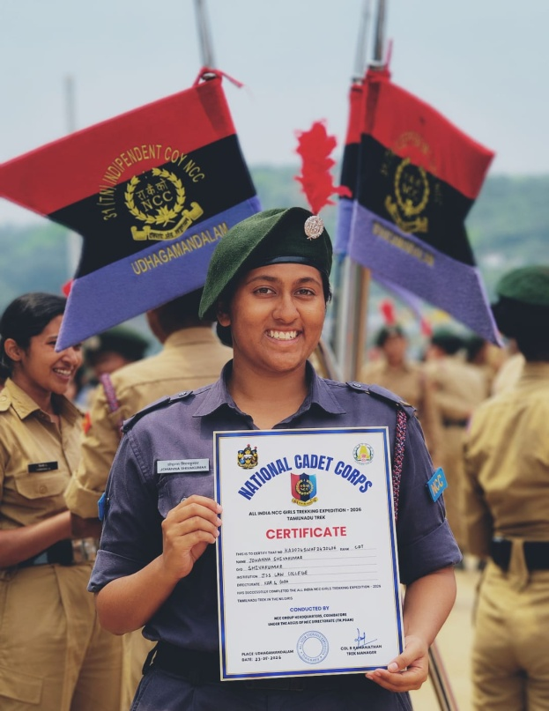
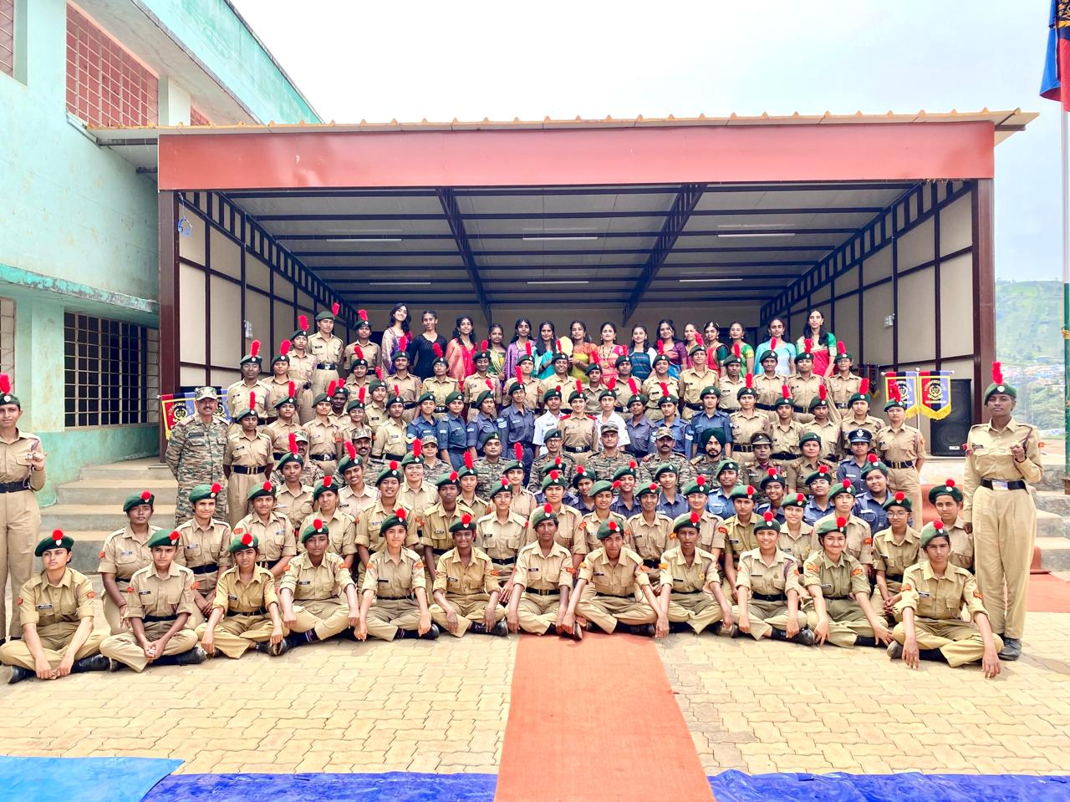
National Level Trekking Camp –
All India NCC Girls Trekking Expedition
Cdt. Johanna Sivakumar from 3rd year BA.LLB has successfully represented Karnataka & Goa Directorate at a National Level Trekking Camp - ALL INDIA NCC GIRLS TREKKING EXPEDITION conducted by the NCC in the Nilgiris.

Slide 13
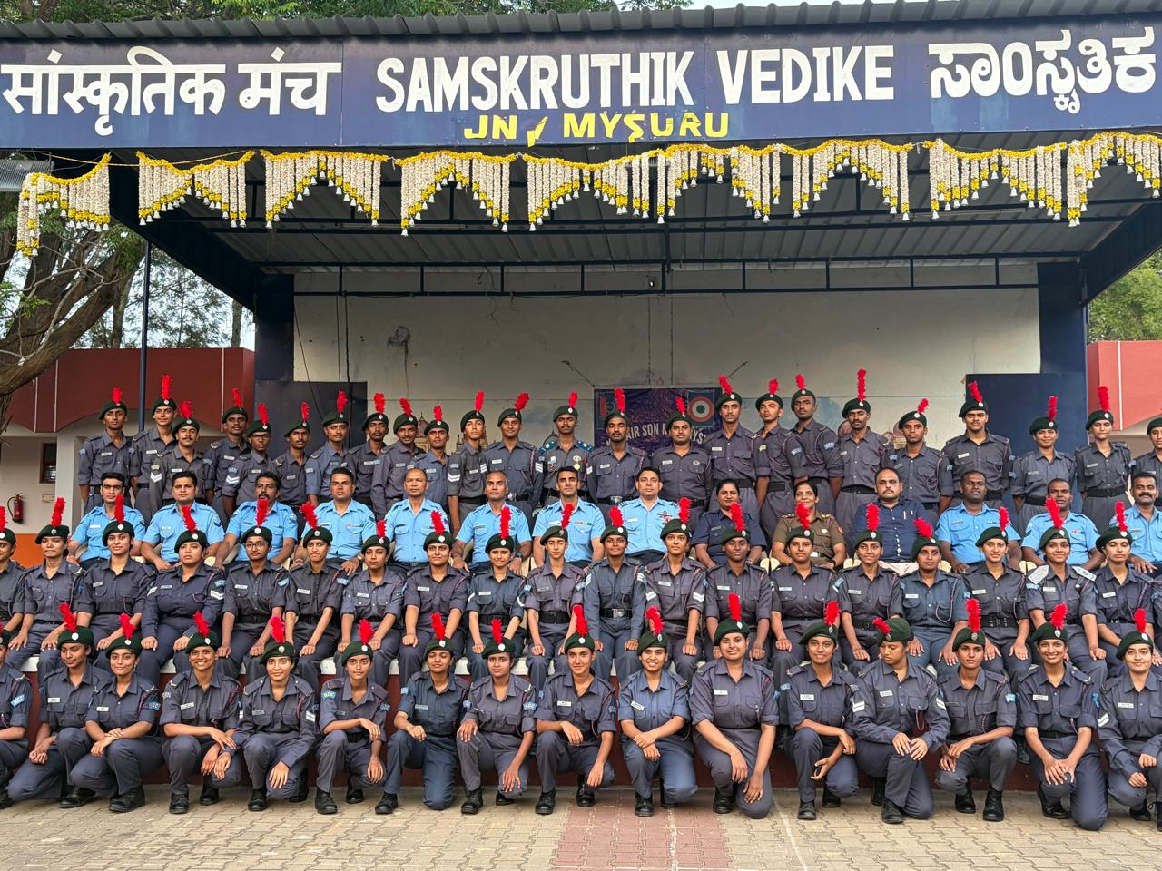
Annual Training Camp
Annual Training Camp was conducted from 17.05.2026 to 26.05.2026. The cadets of JSS Law College actively participated in various training and developmental activities conducted during the camp.

Slide 14
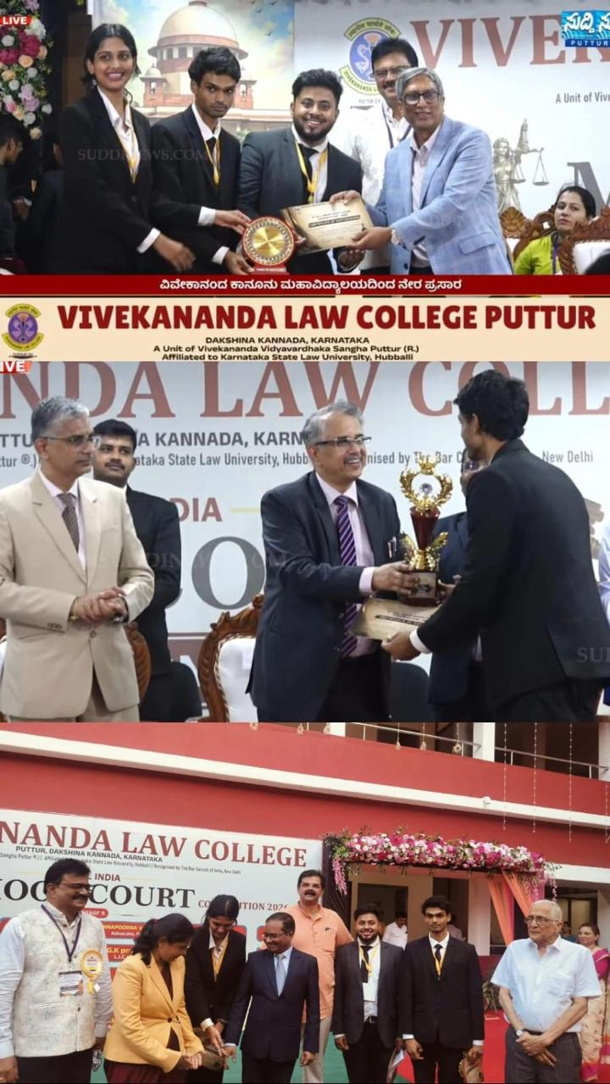
3rd All India Moot Court Competition
Mr. Vidit V, Mr. Mohammad Subhan of VIII Semester BBA., LL.B(Hons.) and Ms. Gouri Hanasoge of VI Semester BA., LL.B (Hons.) participated in the 3rd All India Moot Court Competition, held at Vivekananda Law College, Puttur, Dakshina Kannada from 09.05.2026 to 10.05.2026. Mr. Vidit V was adjudged the Best Male Mooter and was awarded a cash prize of Rs. 3000/-

Slide 15
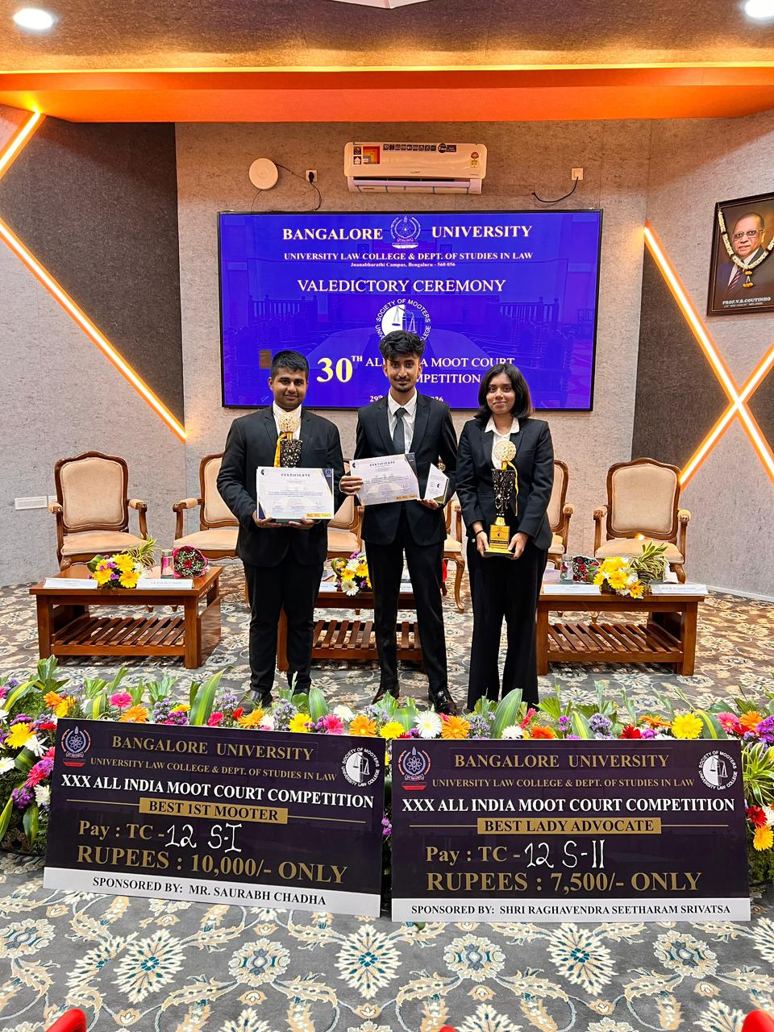
30th All India Moot Court Competition at University Law College, Bangalore University
Mr. Vaishnav Kiran, Ms. Smriti Srikanth and Mohammad Ali Fahad of VI Semester BA.,LL.B (Hons.) participated in the 30th All India Moot Court Competition, held at University Law College, Bangalore University, Bengaluru from 29.05.2026 to 31.05.2026. The team secured the First Rank in the Preliminary Qualifying Rounds, also Mr. Vaishnav Kiran was adjudged Best Mooter (Overall Category) and was awarded a cash prize of Rs. 10000/-. Ms. Smriti Srikanth was adjudged Best Lady Advocate and was awarded a cash prize of Rs. 7500/-.

