Slide 1

Monthly Report – April 2026

Slide 2
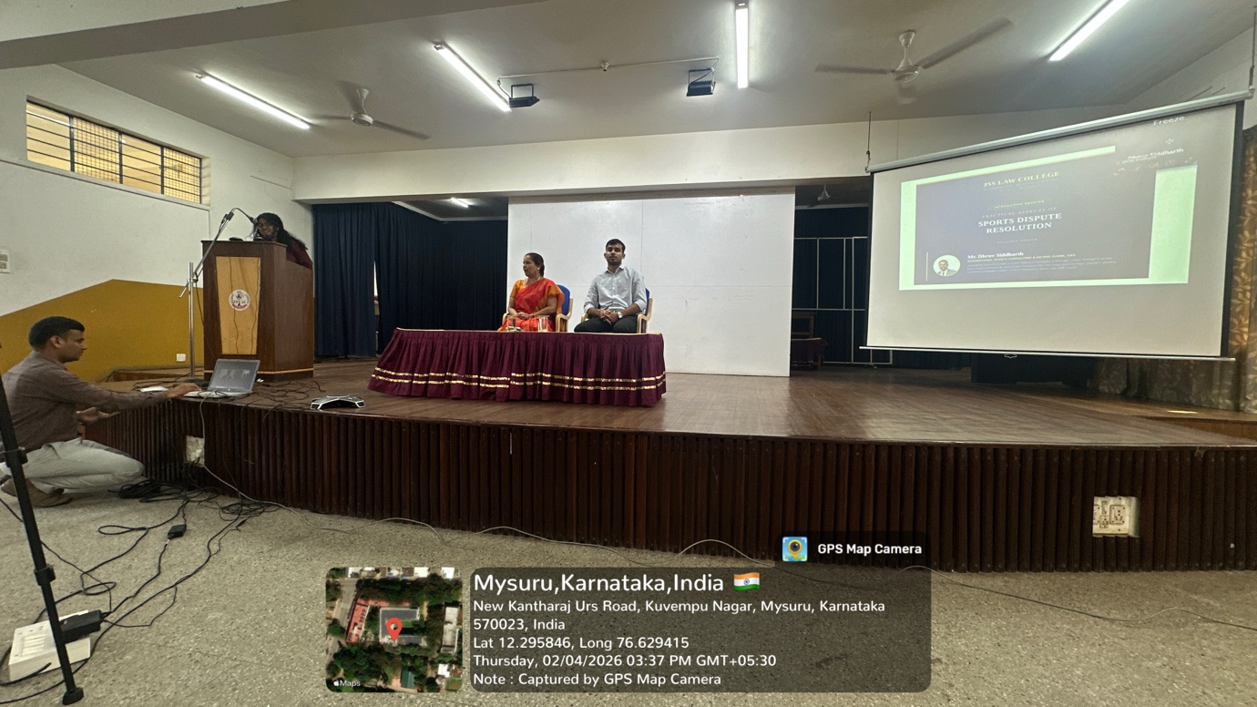
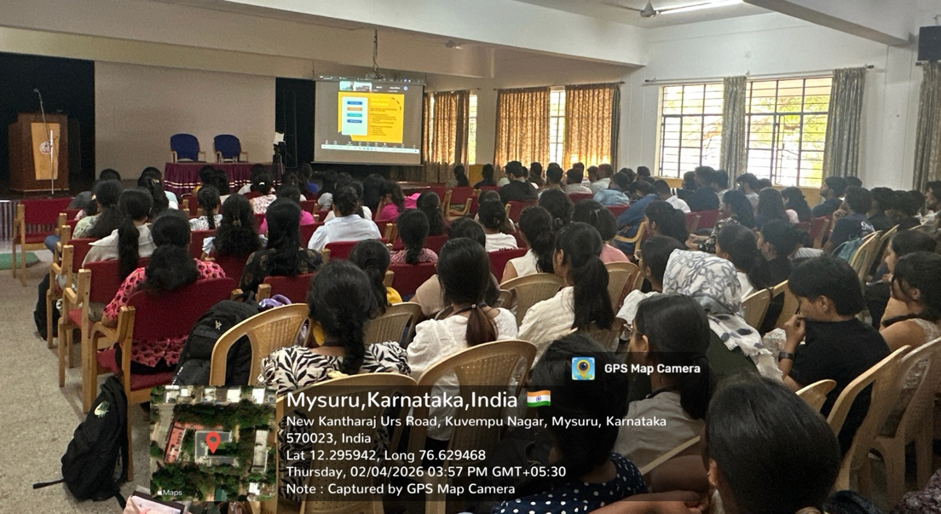
A Virtual Interactive Session on ADR by Mr. Dhruv Siddharth, International Sports Consultant and Ad Hoc Clerk at the Court of Arbitration for Sport, (Sports Law) held on 2.4.2026

Slide 3
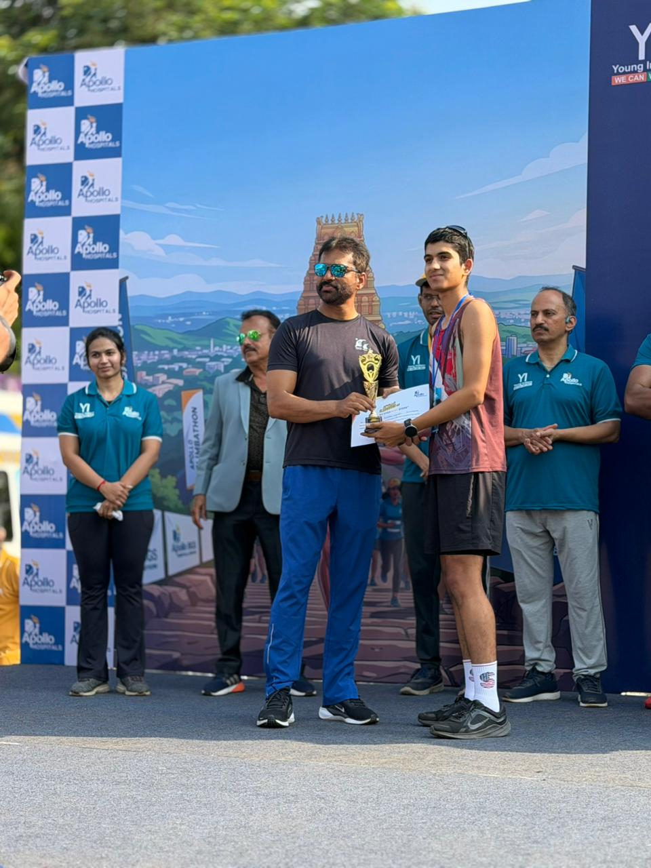
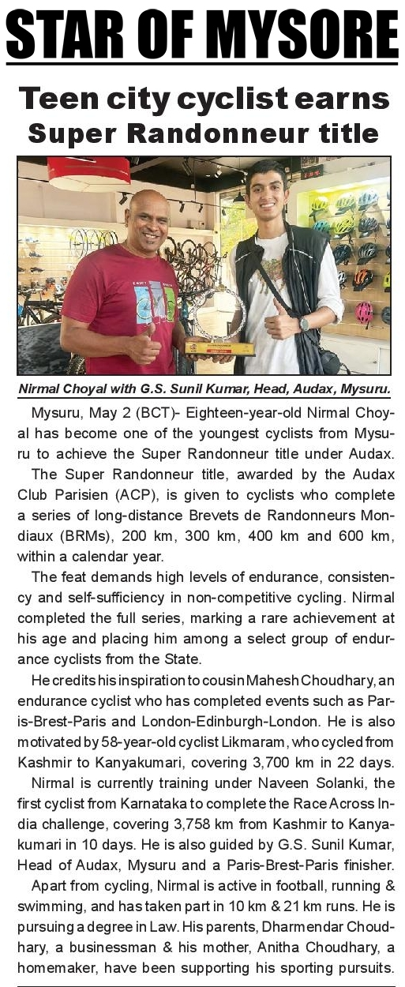
Nirmal Choyal, a student of 1st Year BBA. LL.B- The youngest rider from Karnataka successfully completed the prestigious Super Randonneur Series

Slide 4
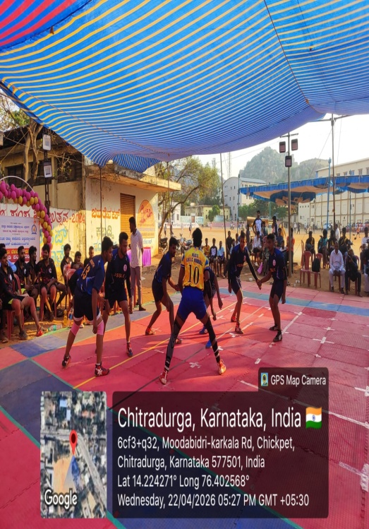
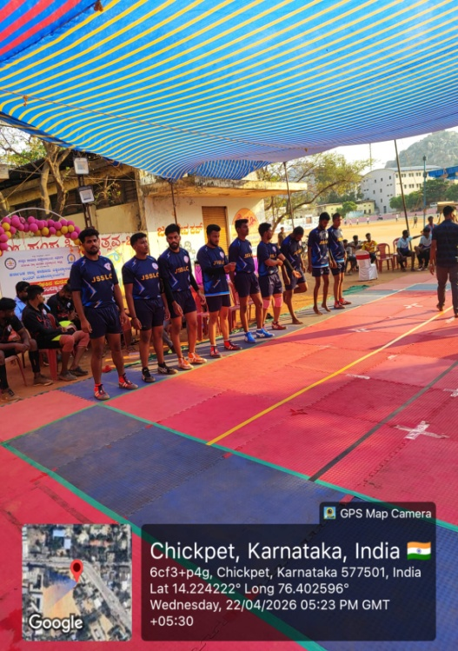
Kabaddi Mens team has participated in the Karnataka State Law University Inter Collegiate Kabaddi Tournament organized by Saraswathi Law College, Chitradurga, held on 22.04.2026 and 23.04.2026

Slide 5
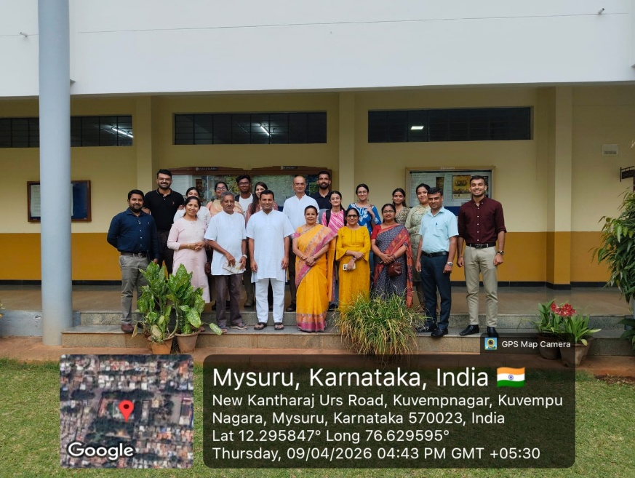
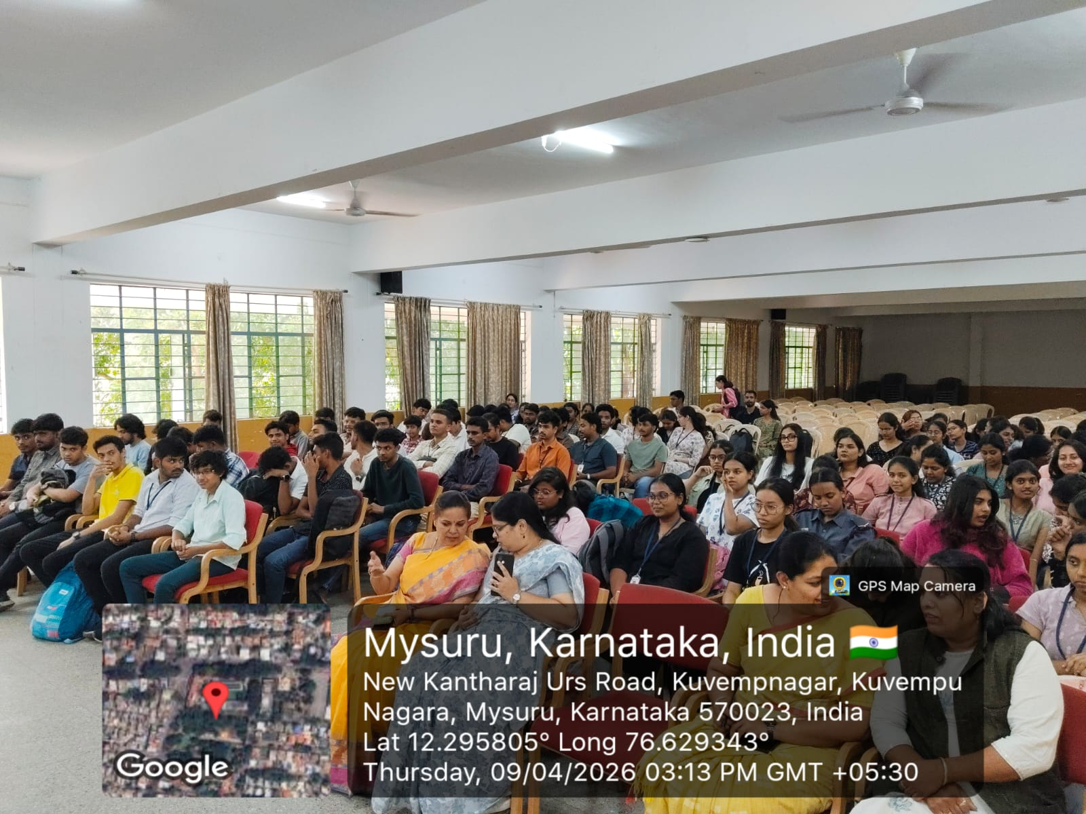
Youth Empowerment Programme in association with The Art of Living (NGO) team from Bengaluru, was organized under the theme “Goals and Spread a Smile” on 09.04.2026

Slide 6
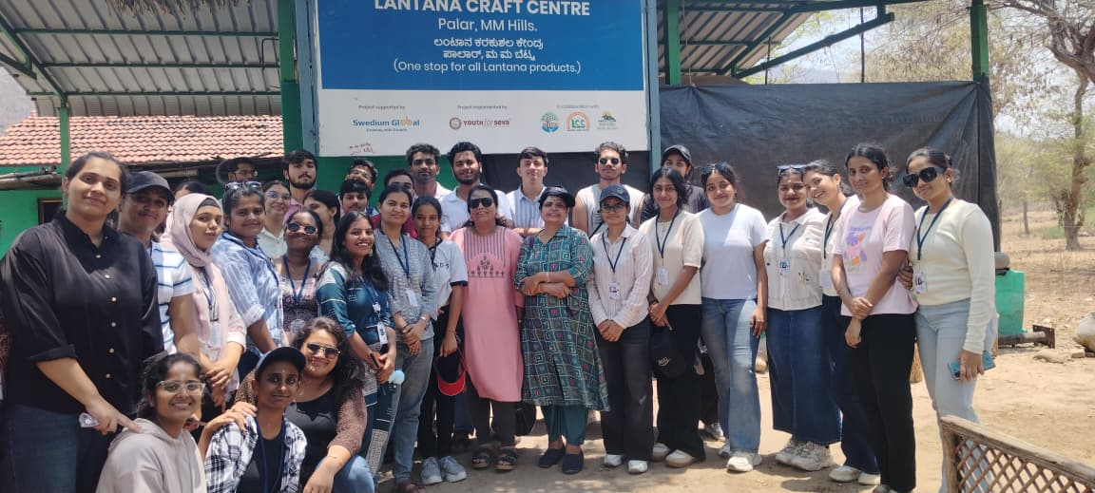
Practical Visit to Tribal village at Male Mahadeshwara Hills on

Slide 7
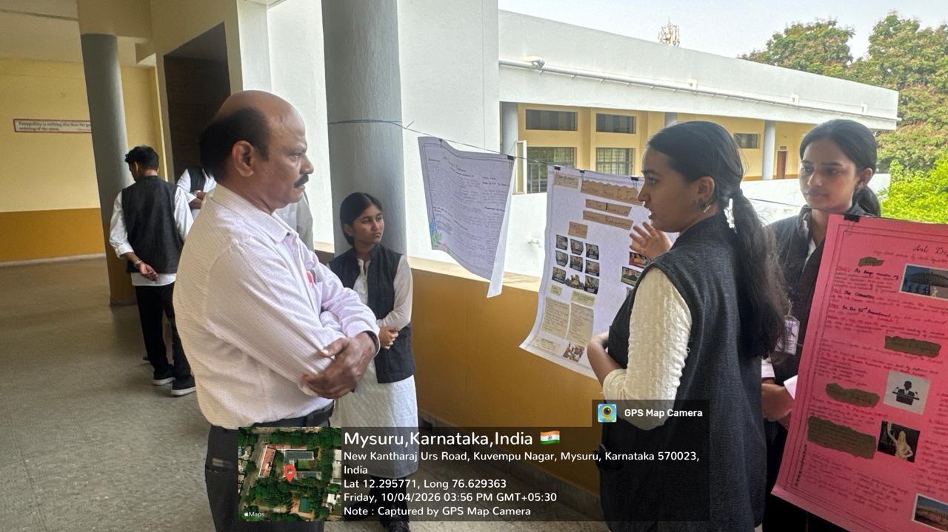
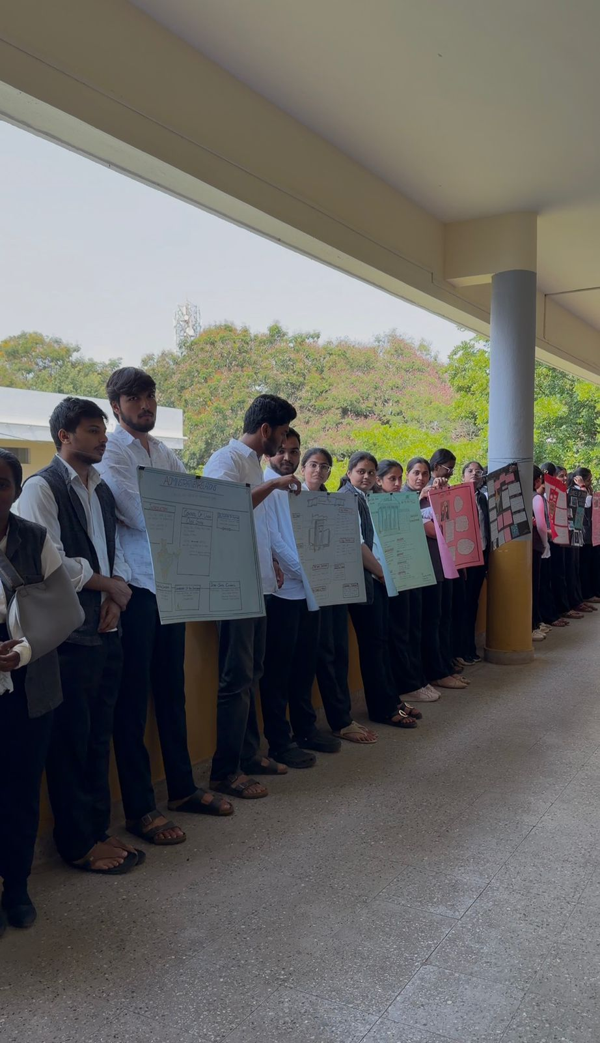
Samvidhan Darshan- An exhibition on Constitutional Law organized by IV Semester B.A., LL.B (Hons.) and BBA. LL.B (Hons.) students on 10.04.2026 Guided by-Ms. Soujanya G. K.,Course Teacher

Slide 8
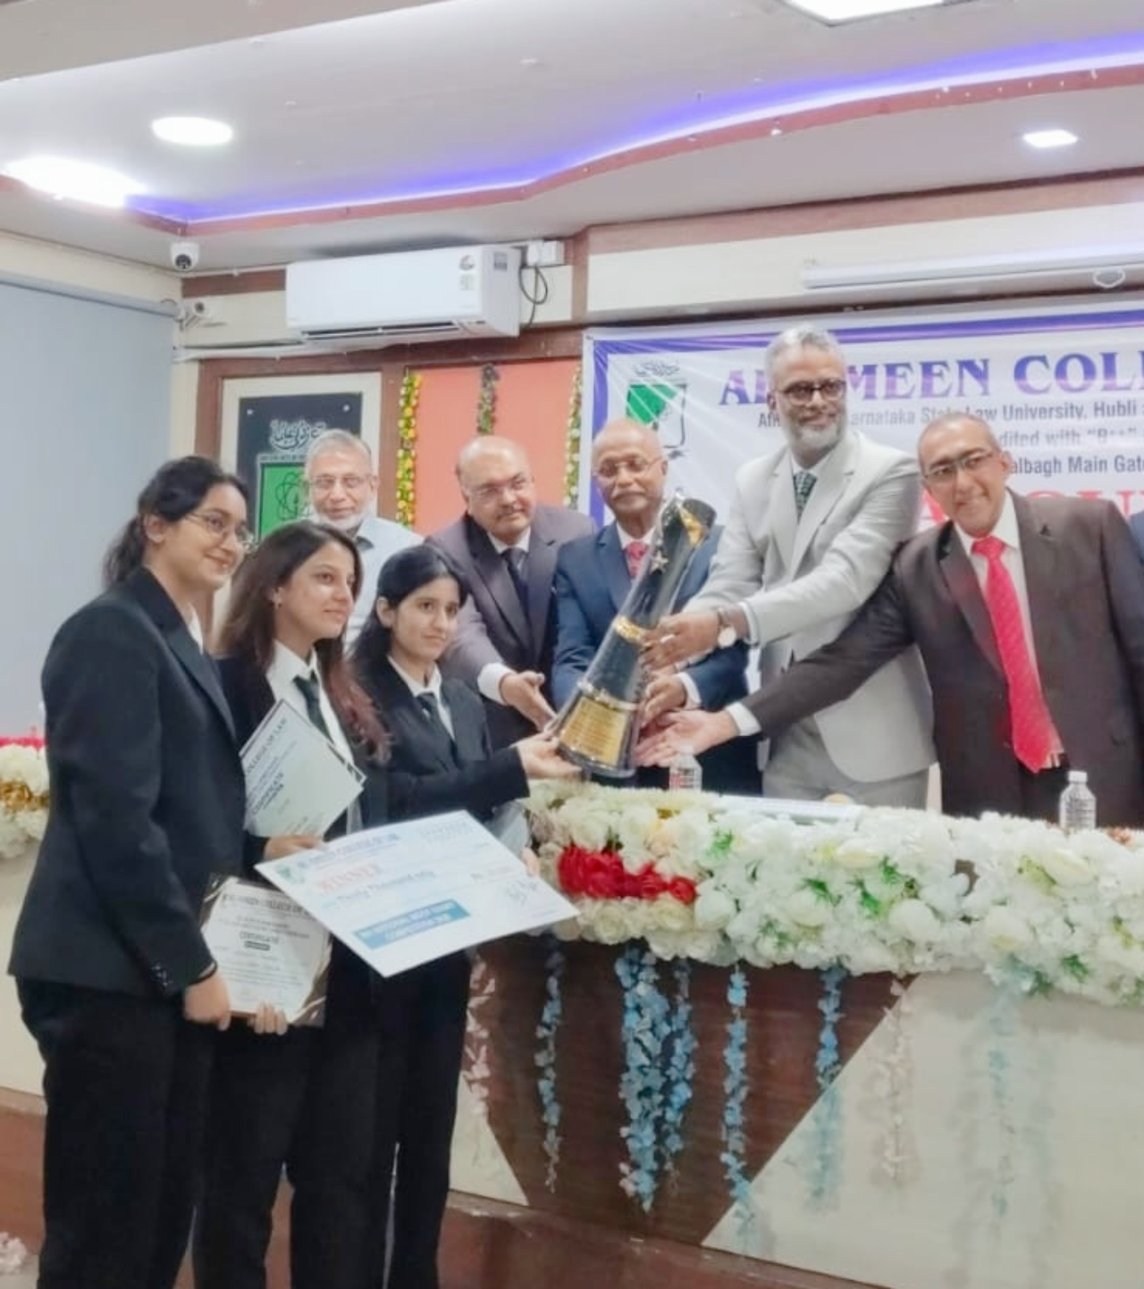
9th All India Moot Court Competition organized by Al-Ameen College of Law from 24th to 26th of April, 2026- Winners
1. Aamina Ahmedi (6th Semester, BBA LL.B.)
2. Vangmayi (6th Semester, BBA LL.B.)
3. Renuka (6th Semester, BBA LL.B.)
Vangmayi of 6th Semester, BBA LL.B. has won the Best Mooter Award with a cash prize of Rs. 5,000.

Slide 9
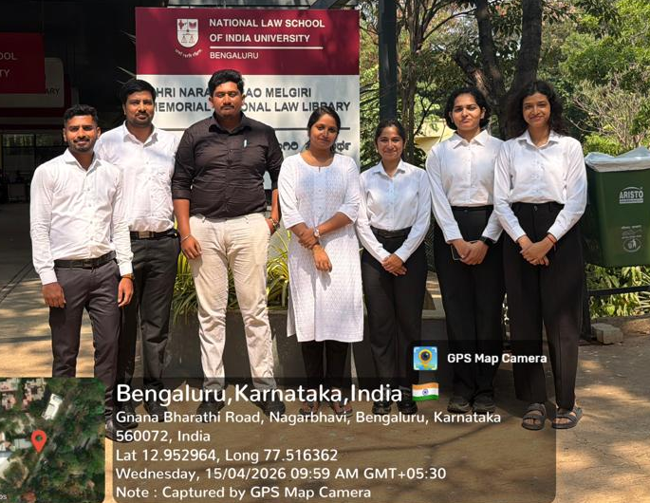
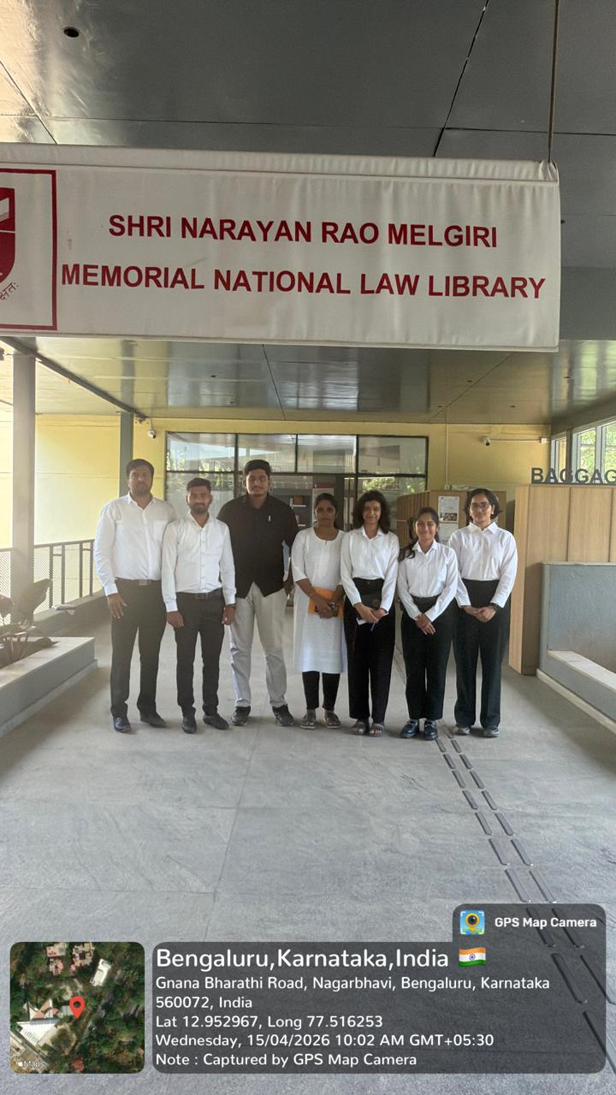
LL.M Students’ visited the Library at NLSIU,Bengaluru, on 15.04.2026 for Data Collection

Slide 10
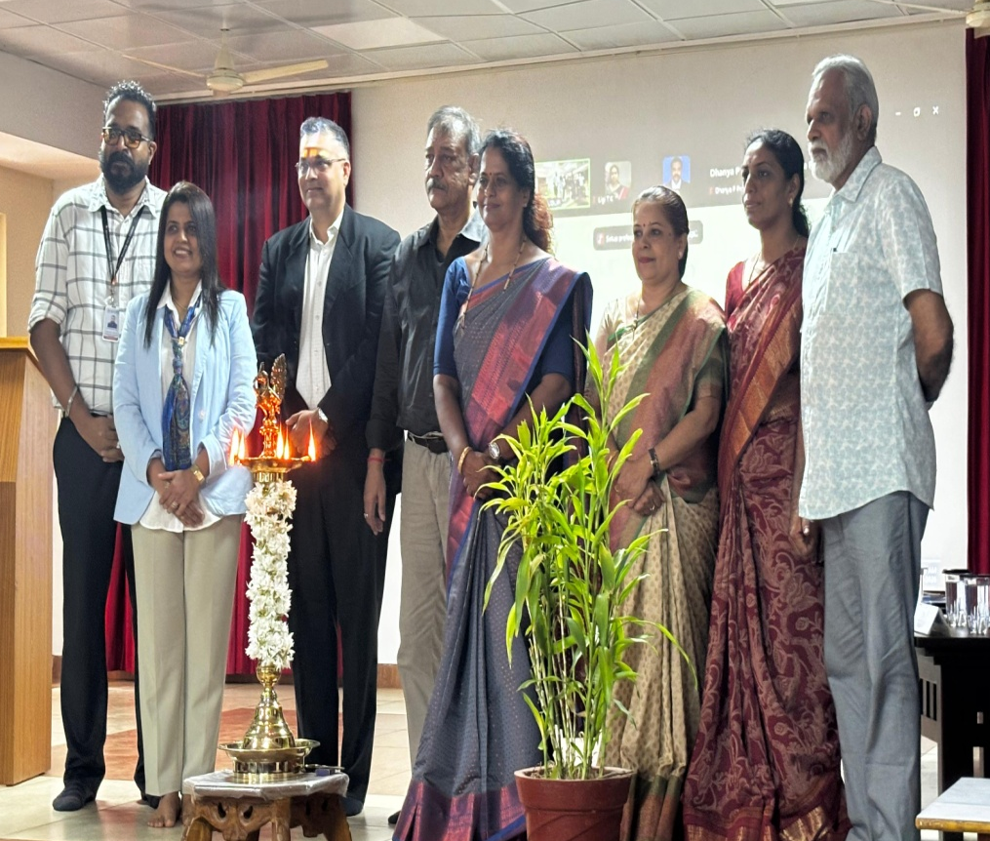
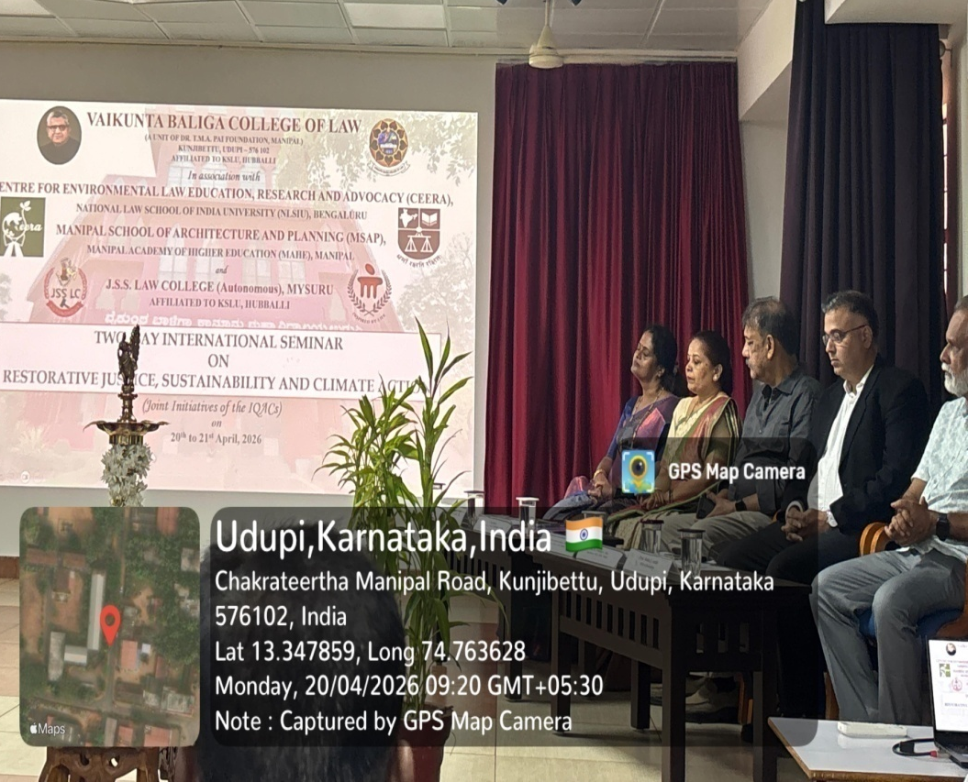
Two-Day International Seminar on
“Restorative Justice, Sustainability and Climate Action” Organized by Vaikunta Baliga College of Law, Udupi, in Association with CEERA, NLSIU and MAHE, JSS Law College (Autonomous) ,Mysuru on 20.04.2026-21.04.2026

Slide 11
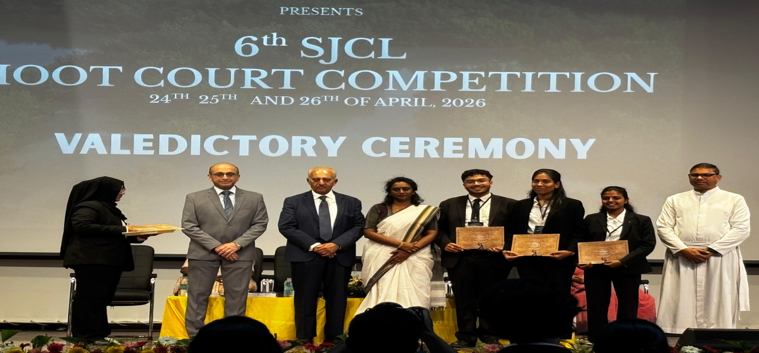
6th SJCL National Moot Court Competition, 2026 organised by St. Joseph's College of Law, Bengaluru- Winners
Team: 1. Abhijith Koundinya G R - 8th Sem BBA LLB
2. Nanda Hattikal - 8th Sem BBA LLB
3. Bhoomika Jain S N- 8th Sem BBA LLB won a cash prize of Rs. 50,000/-

Slide 12
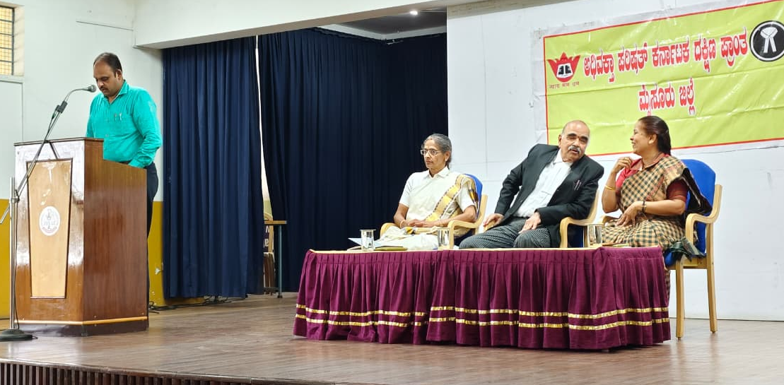
“Campus to Court” was organized by the Adhivakta Parishad, Mysuru Unit in association with Placement Cell of JSSLC on 08.04.2026

Slide 13
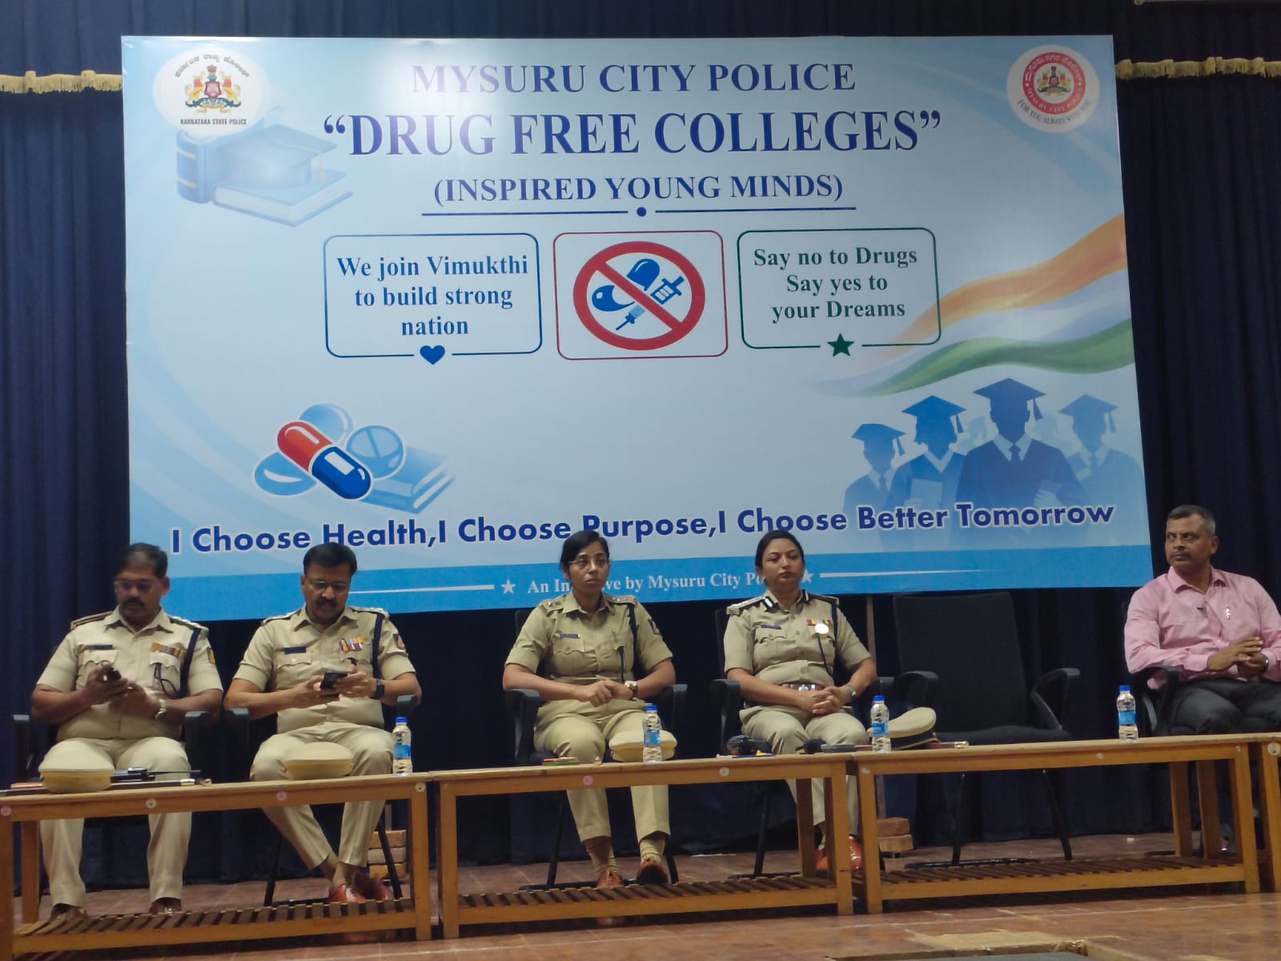
Drug Free Colleges (Inspired Young Minds) and awareness on Vimukthi App, organised by Mysuru City Police
Dr. N. Vani Shree attended the meeting convened by Smt. Seema Latkar, CIty Police Commissioner and Smt. Harsha Priyamvada , DCP

Slide 14
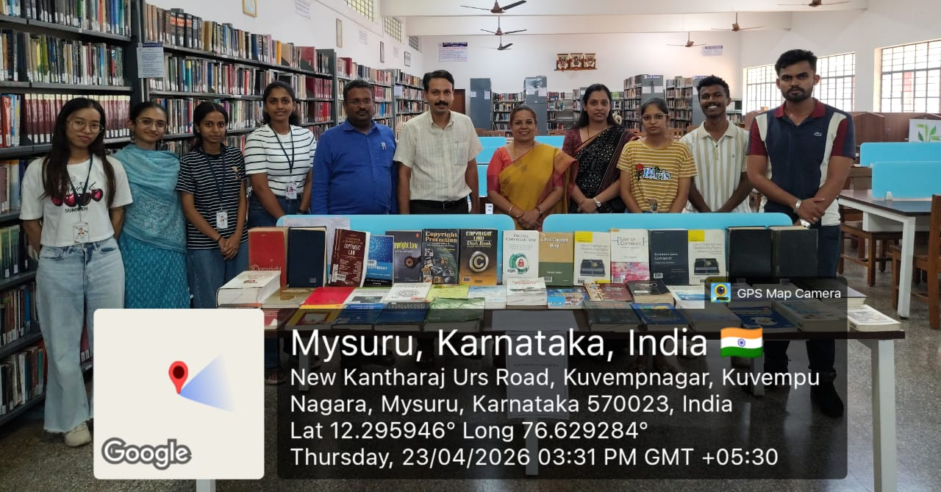
World Book Day & World Copyright Day was observed on 23.04.2026

Slide 15
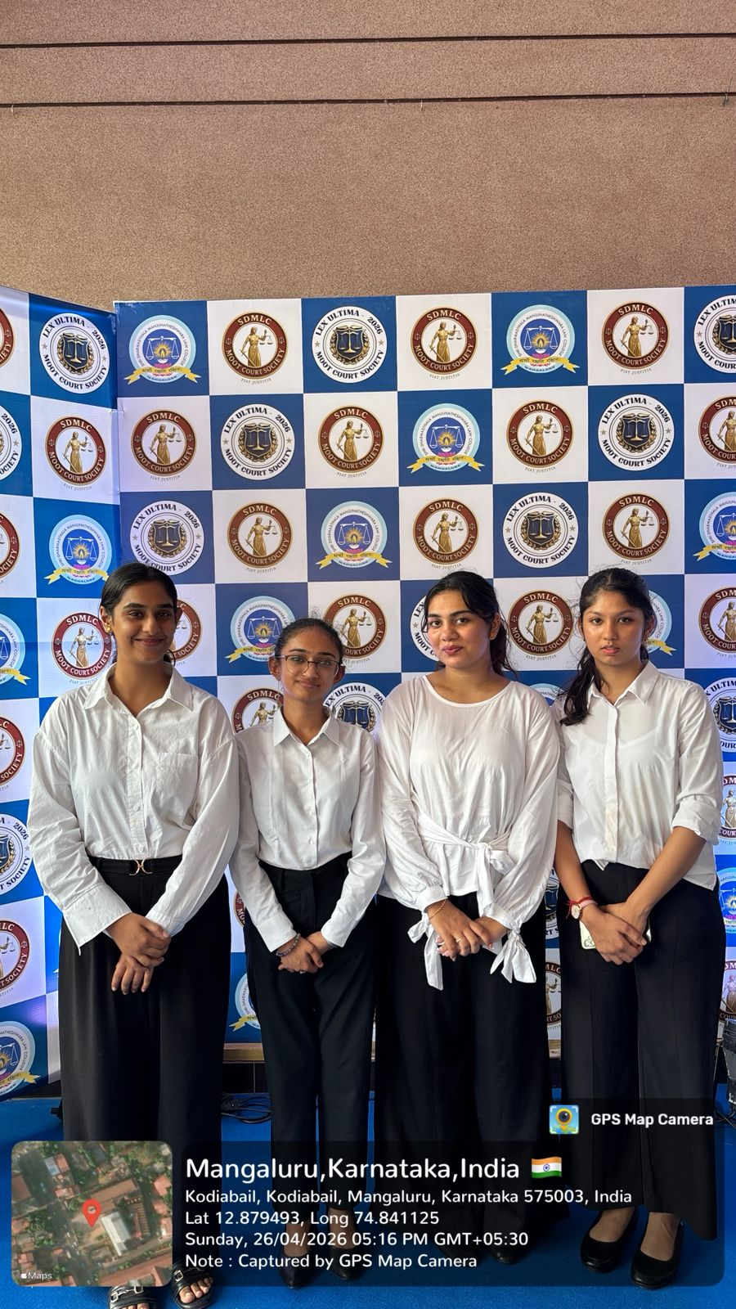
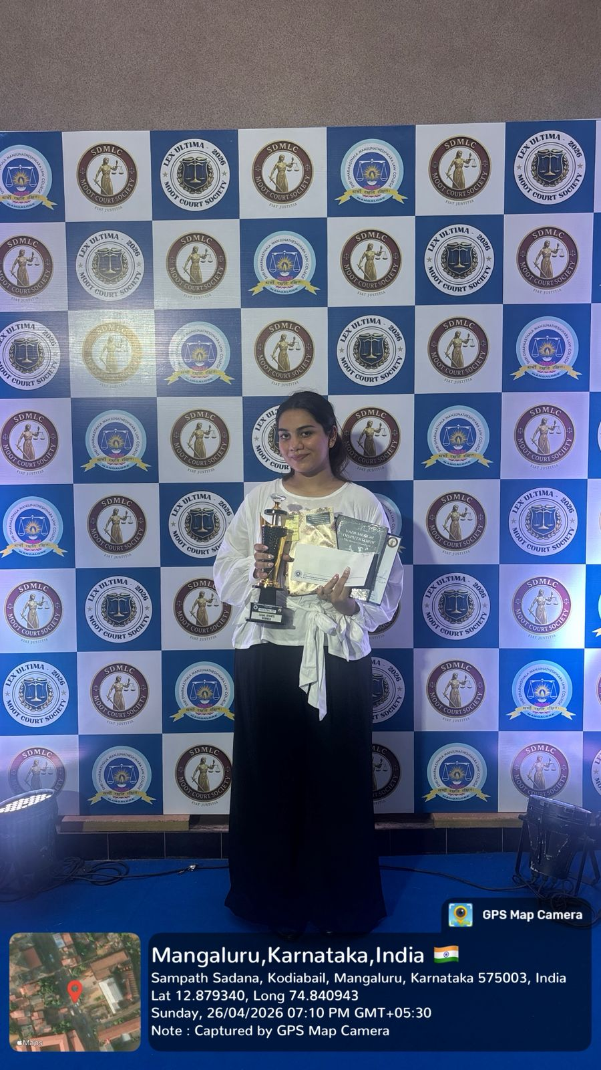
Students of JSS Law College, Autonomous, Mysuru participated in various competitions held at SDM Law College, Mangaluru

Slide 16
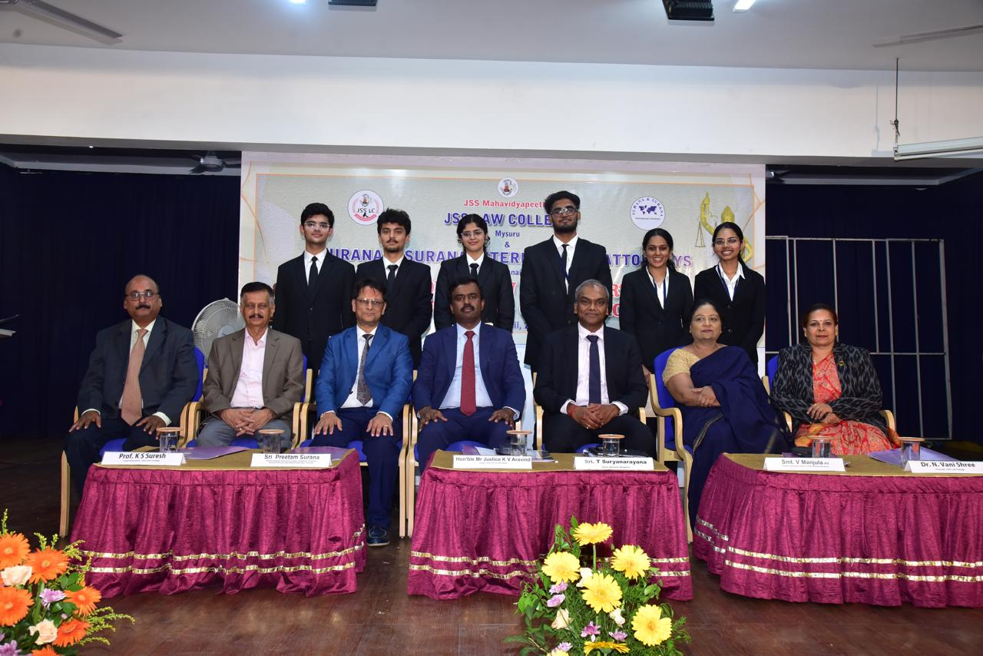
23rd Surana & Surana & JSSLC Corporate Law Moot Court Competition, 2026
Distinguished Dignitaries: Hon’ble Justice S. G. Pandit
Hon’ble Justice K. V. Aravind
Sri Preetam Surana, Smt. V.Manjula, Prof K.S.Suresh, Dr. N Vani Shree , Sri. Karthik Ranganathan , Sri Achutha
Winning Team-School of Law, SASTRA Deemed University, Thanjavur
Runners-up Dr. Ram Manohar Lohia National Law University, Lucknow

Slide 17
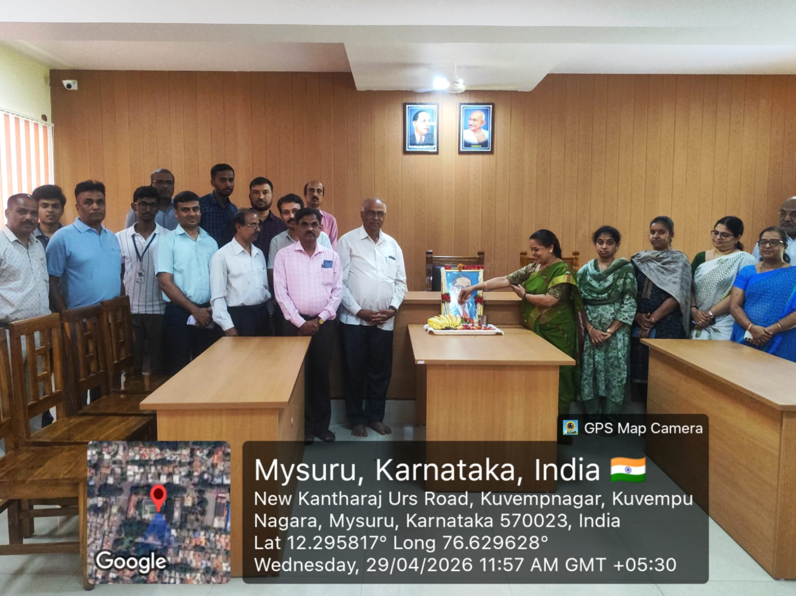
135th Ambedkar Jayanthi was celebrated on 29.04.2026

Slide 18
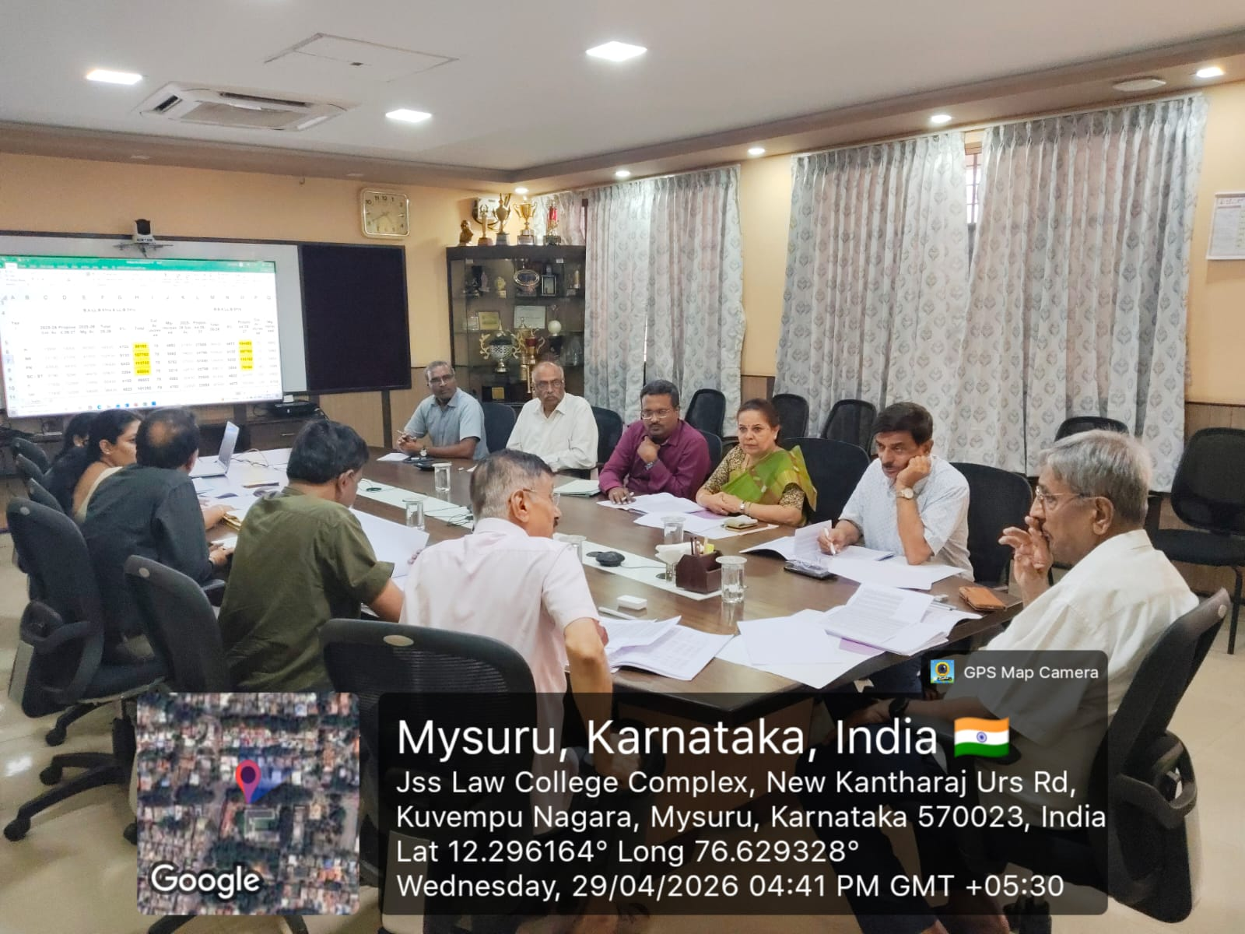
The Finance Committee meeting was held on 29.04.2026

