Slide 1

Monthly Report – November 2025

Slide 2
Academic Activities

Slide 3
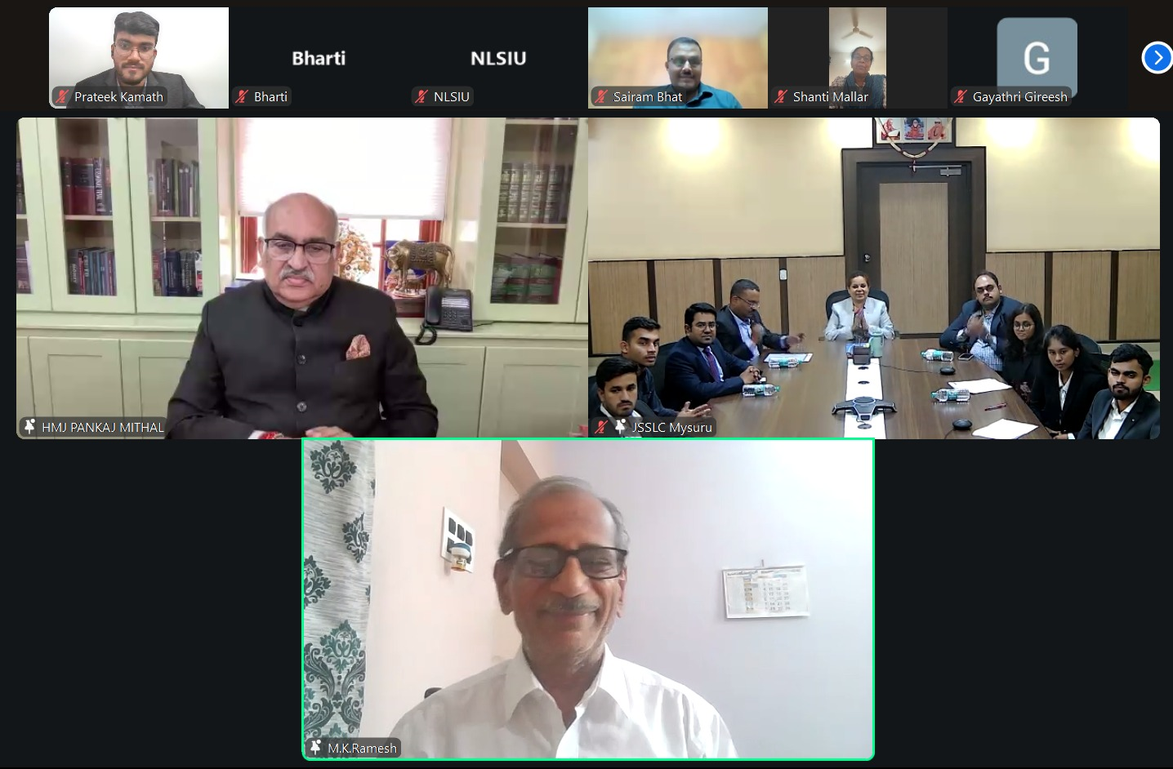
4th Edition Prof. V S Mallar Memorial Legal Aid Competition
On 8.11.2025 - Virtual inauguration – a joint initiative by JSSLC, Mysuru & CEERA, NLSIU, Bengaluru in collaboration with Department of Justice, Ministry of Law and Justice, GoI.
Chief Guest: Hon’ble Mr. Justice Pankaj Mithal, Judge, Supreme Court of India, Guest of Honour: Prof. (Dr.) M K Ramesh

Slide 4
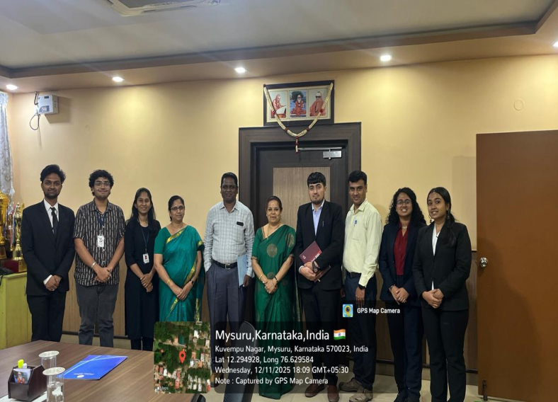
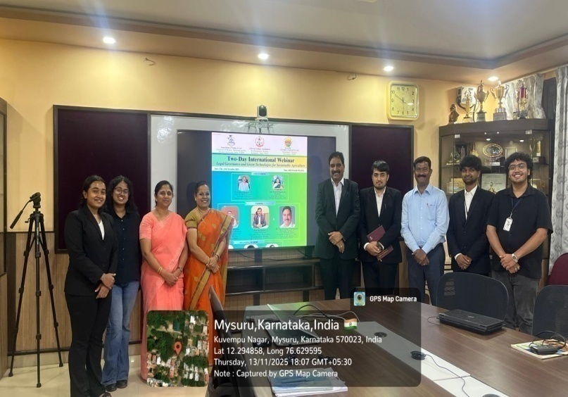
Two Day International Webinar
Two Day International Webinar on ‘Legal Governance and Green Technologies for Sustainable Agriculture’ a joint collaboration between Department of Studies in Law, University of Mysore, Mysuru, J.S.S. Law College, Autonomous, Mysuru and Greenlife Croptech Pvt. Ltd, Mysuru on 12.11.2025 and 13.11.2025.

Slide 5
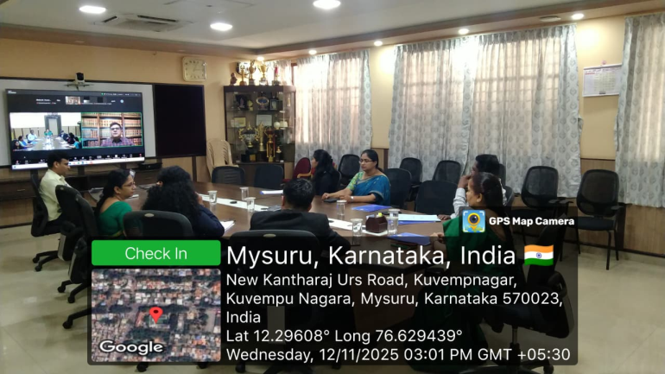
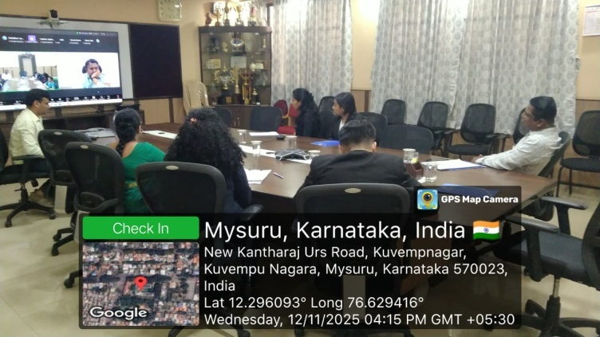
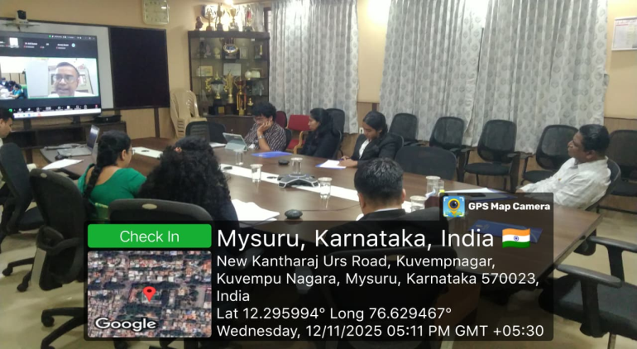
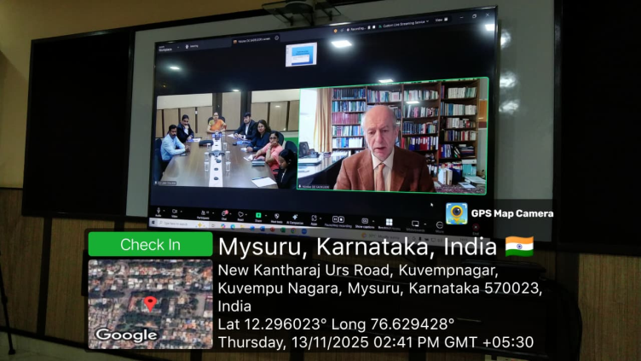
Two Day International Webinar
Two Day International Webinar on ‘Legal Governance and Green Technologies for Sustainable Agriculture’ – Day 11 (12.11.2025) – Resource Persons: Prof. (Dr.) Shaiwal Satyarthi, Prof. (Dr.) Sreenivasulu N. S, Prof. (Dr.) M. Vishwanath and Prof. (Dr.) Sanjit Kumar Chakraborty. Day 2 (13.11.2025) – Prof. (Dr.) Nicolas de Sadeleer from Belgium, Dr. Vasanth Kumar Thimakapura, Dr. S. Chandra Nayaka and Mr. Deepak Ghadge.

Slide 6
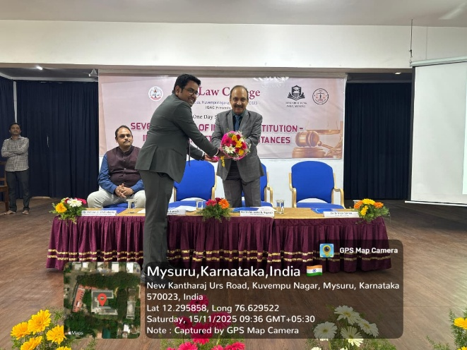
One Day National Seminar
One-Day National Seminar on ‘Seven Decades of the Indian Constitution: Ideologies, Facts and Substances’, inaugurated by Chief Guest, Hon’ble Justice N. Nagaresh, Judge, High Court of Kerala on On 15.11.2025.

Slide 7
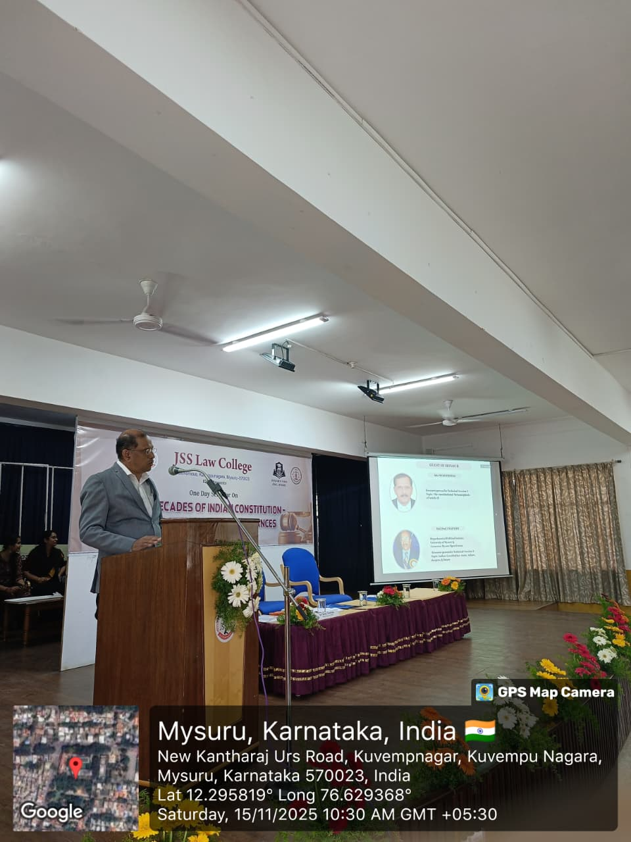
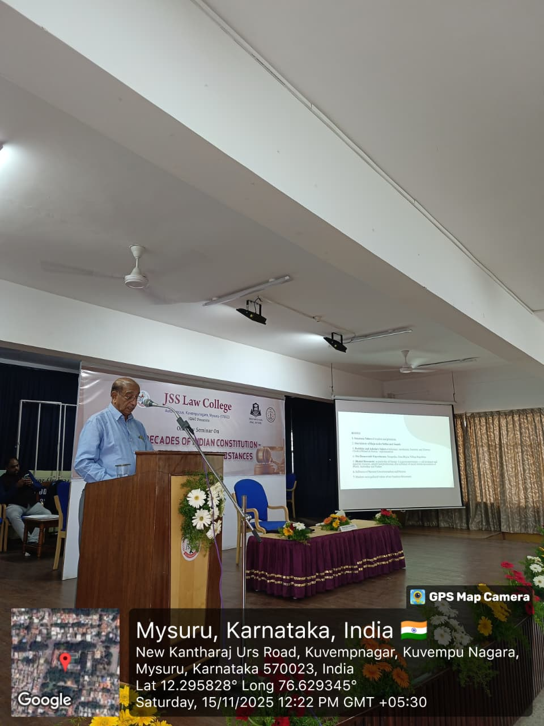
One Day National Seminar
One-Day National Seminar on ‘Seven Decades of the Indian Constitution: Ideologies, Facts and Substances’, Technical Session I by Mr. Shaji Thomas, Advocate, Kerala; Technical Session II by Prof. (Dr.) Umapathy, Retd. Professor, Department of Political Science, University of Mysore, Mysuru

Slide 8
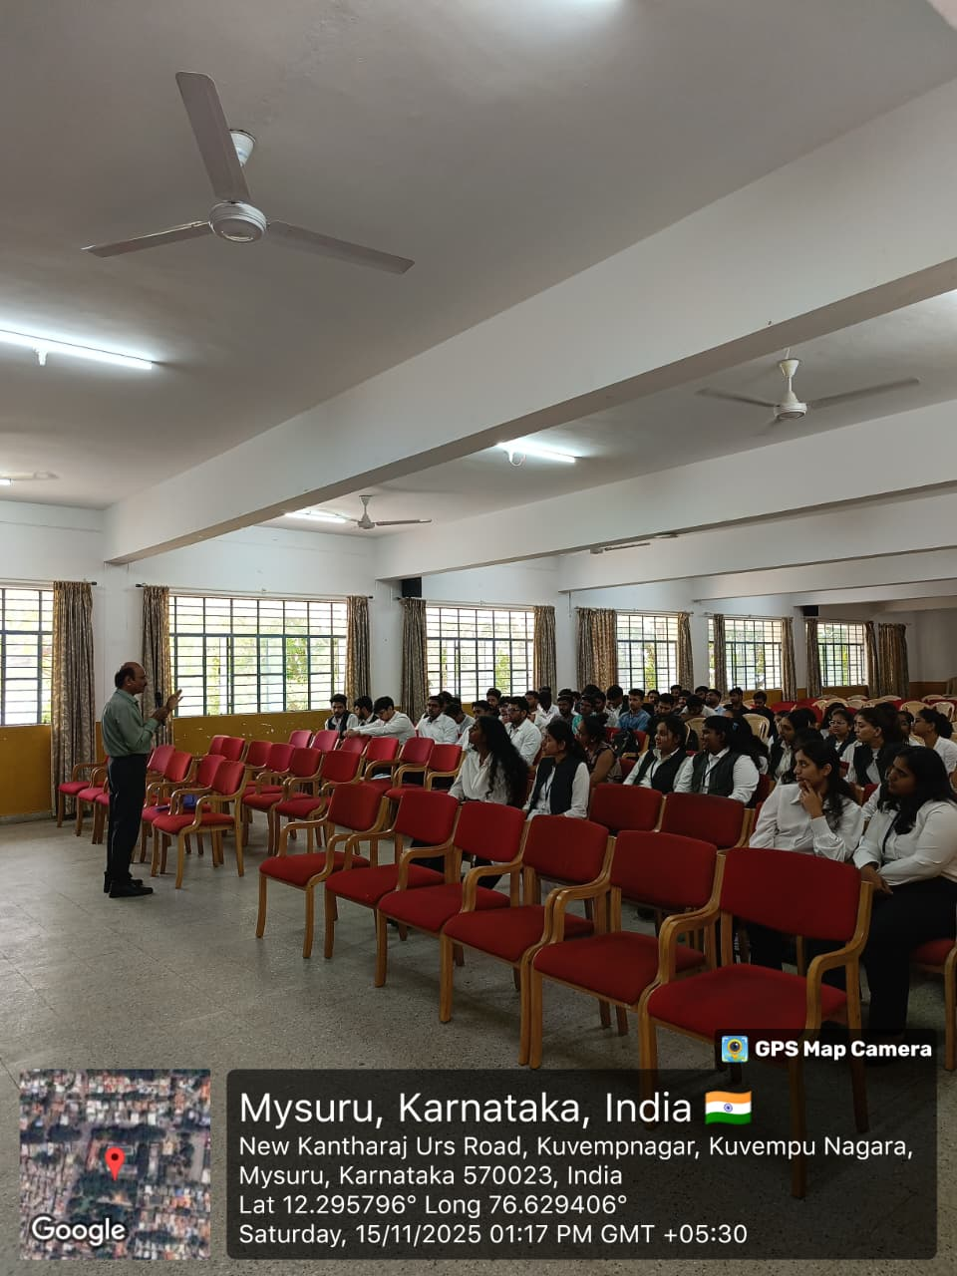
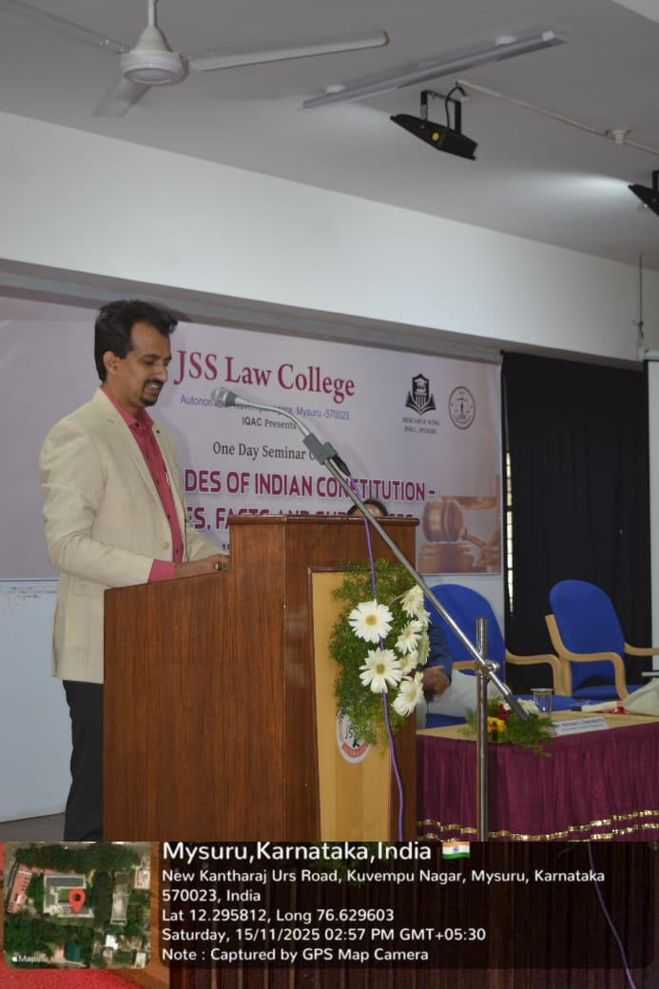
One Day National Seminar
One-Day National Seminar on ‘Seven Decades of the Indian Constitution: Ideologies, Facts and Substances’, Technical Session III by Mr. S. Nagendra, Guest Faculty, J.S.S. Law College and Valedictory Address by Dr. Manoj Kumar Hiremath, Assistant Professor, K.L.E. Law College, Bengaluru

Slide 9
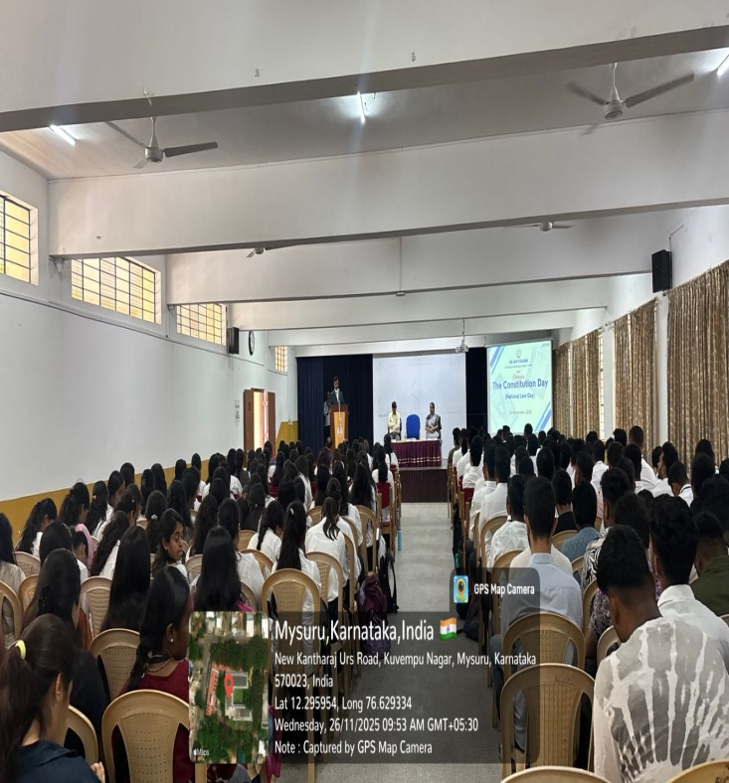
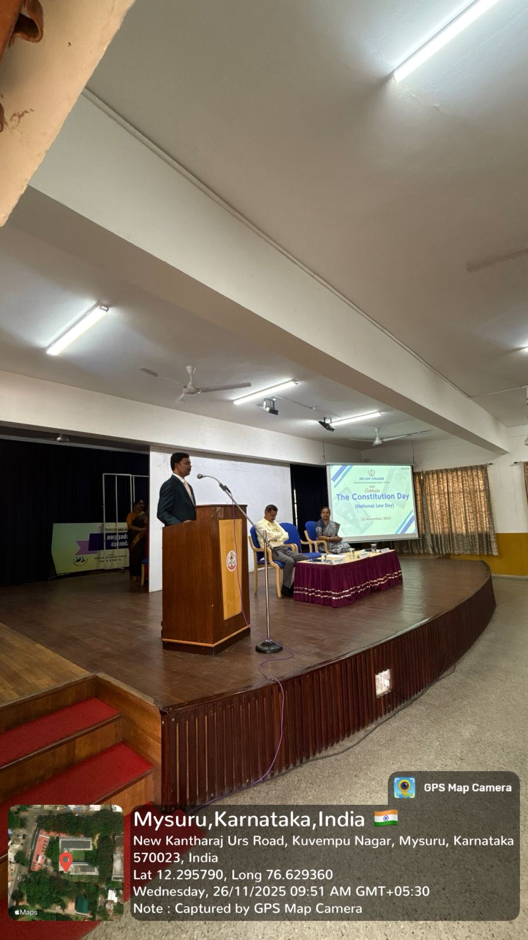
Constitution Day
On 26.11.2025 the Constitution Day (National Law Day), Chief Guest: Mr. Prakash V the Judge of II ACJ (Sr. Div) & CJM Mysuru

Slide 10
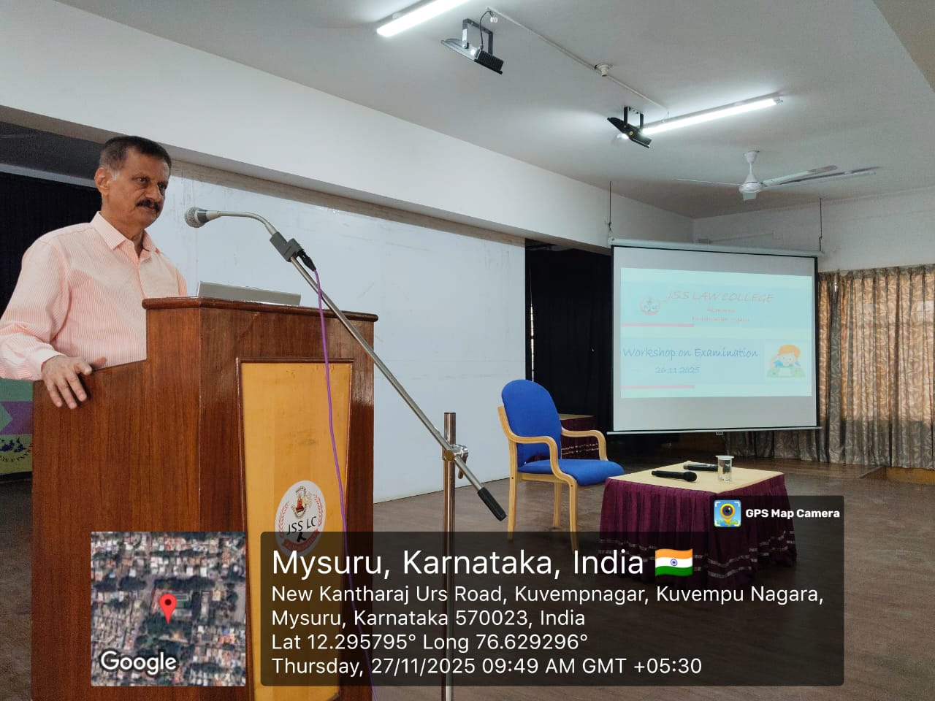
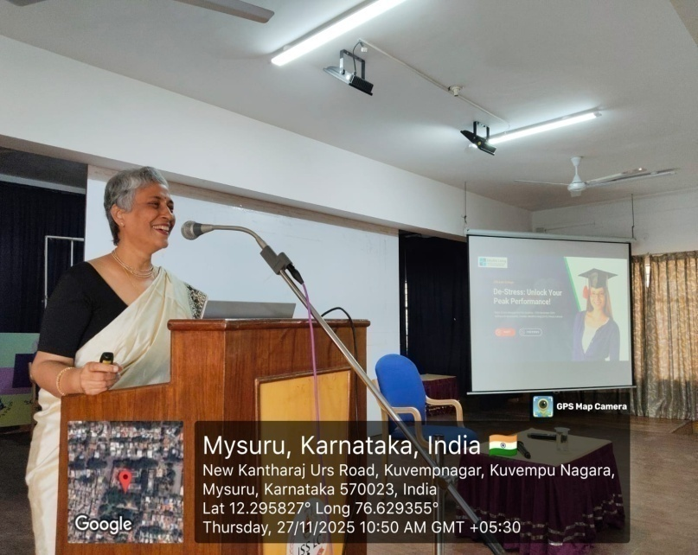
Workshop on Examination
One-Day Workshop on on ‘Breathe, Balance, Believe: Managing Examinations’ on 27.11.2025 Prof. K S Suresh & Ms. Archana Krishnamurthy Director of Mindful Living Pvt, Ltd, Founder, Conscious Living Centre

Slide 11
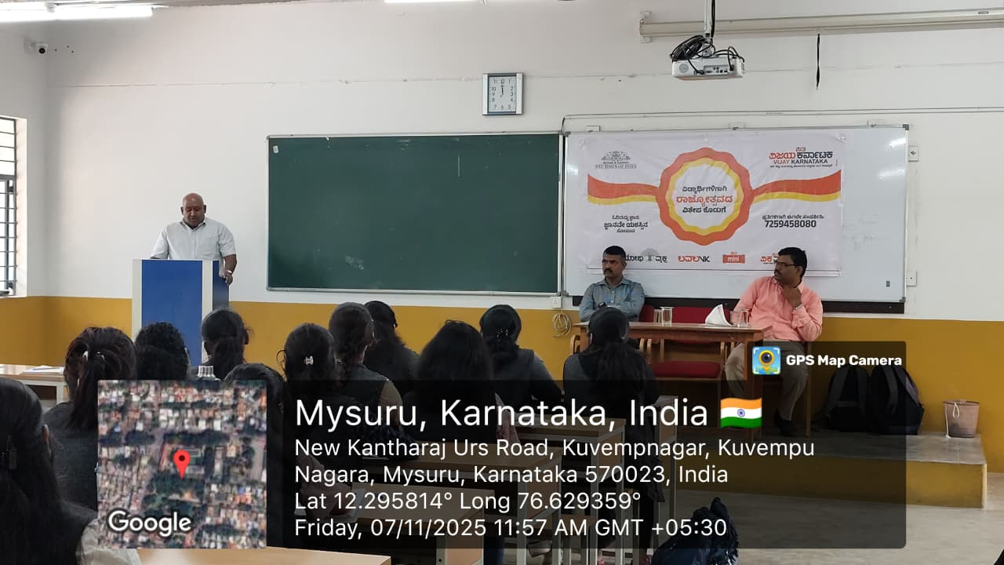
Educative Session
‘Improving the habit of reading Newspaper’ by Vijaya Karnataka & The Times of India

Slide 12
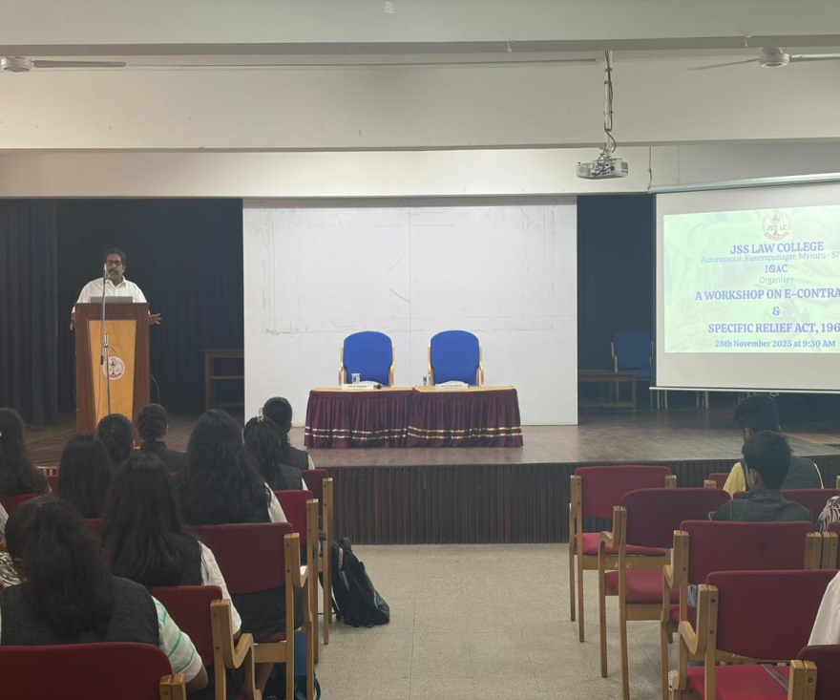
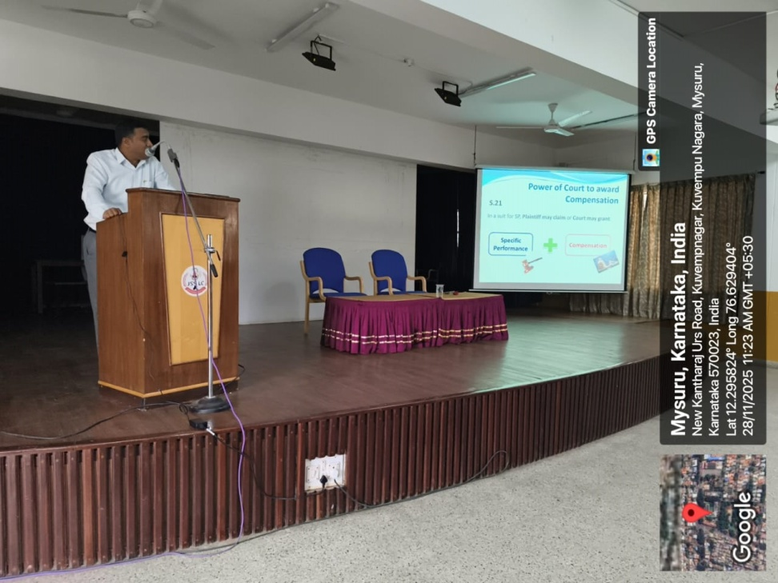
Workshop on E-Contracts
On 28.11.2025 Workshop on E-Contracts and Specific Relief Act, 1963 by Sri. S Harsha, Advocate, Mysuru and Sri. Karthik Santhakumar, Corporate Counsel and Guest Faculty

Slide 13
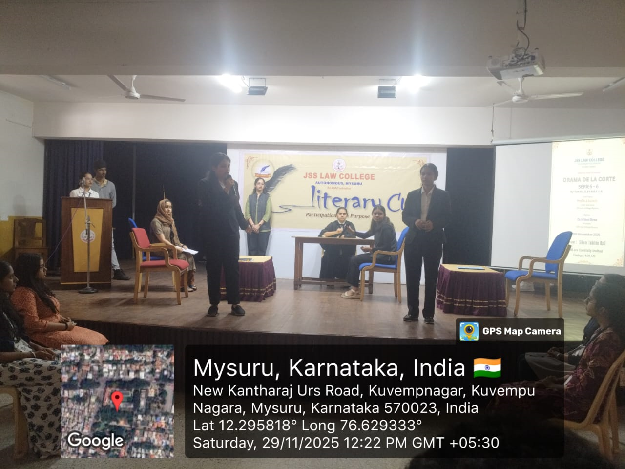
Drama De La Corte
By Literary Club & IQAC – organized Drama De La Corte’ Courtroom Drama (Series - 6)
on 29.11.2025

Slide 14
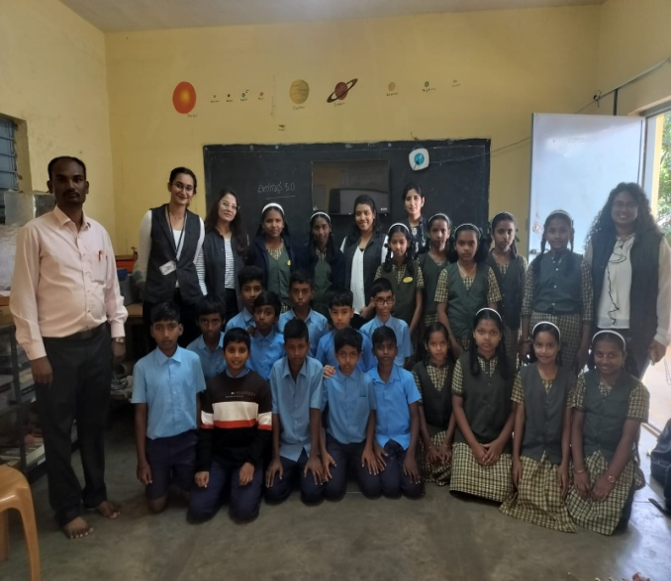
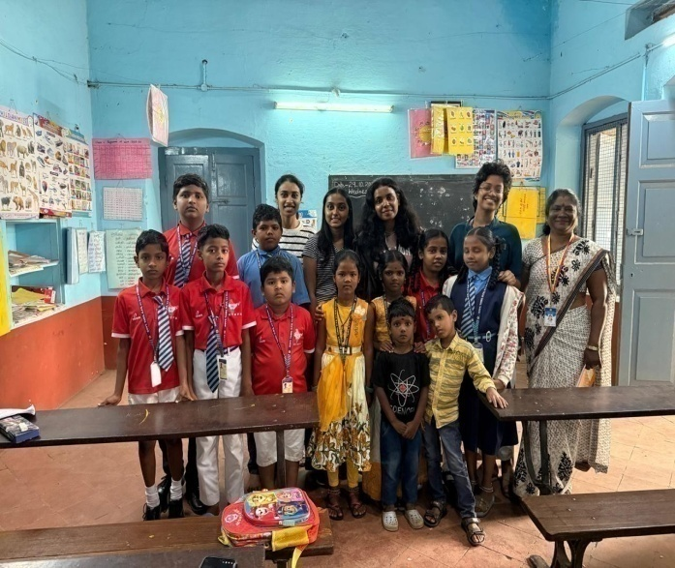
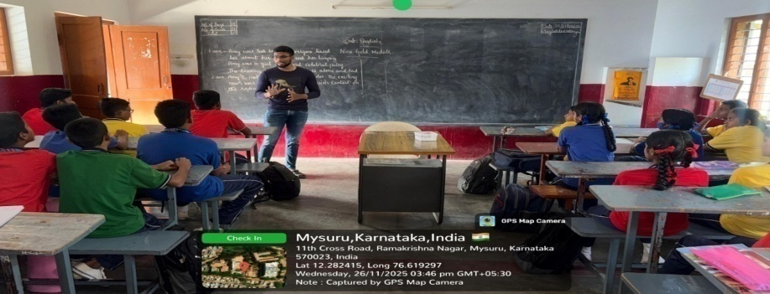
Community Teaching Initiative
During November 2025 as part of experiential learning activity for Jurisprudence

Slide 15
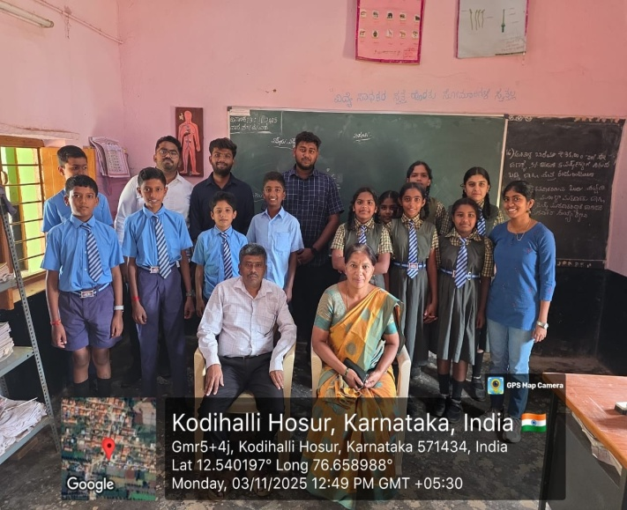
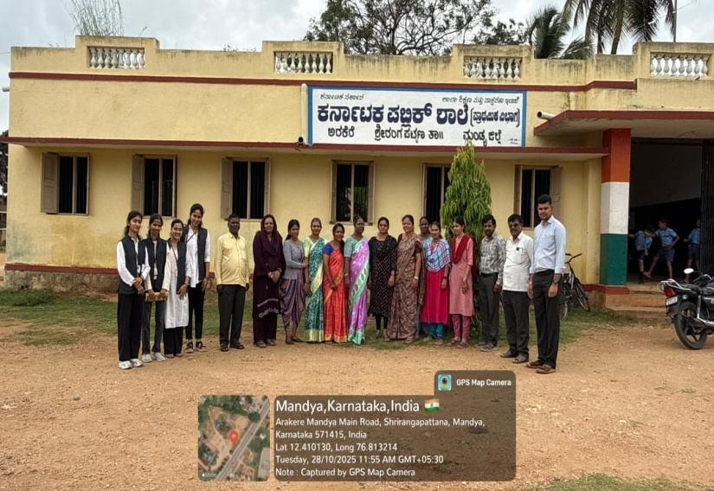
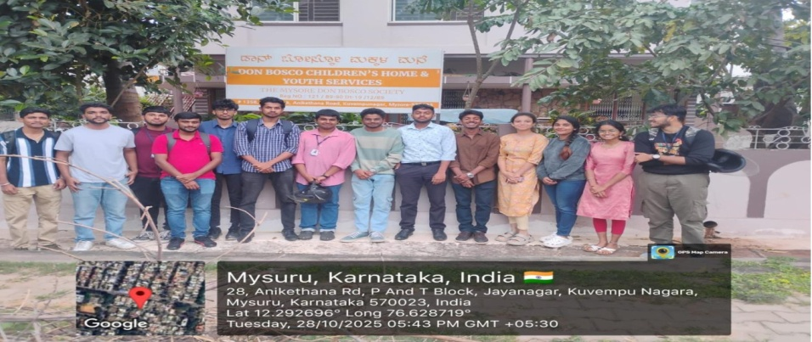
Community Teaching Initiative
During November 2025 as part of experiential learning activity for Jurisprudence

Slide 16
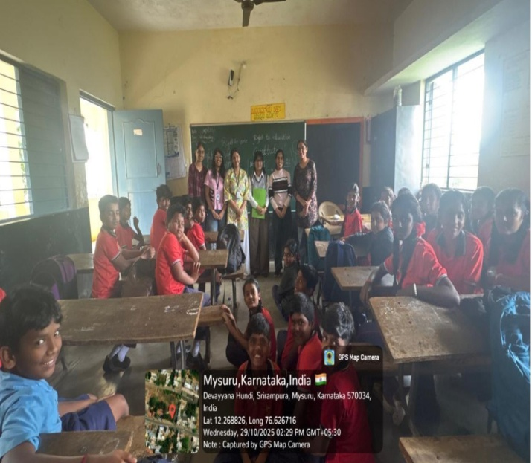
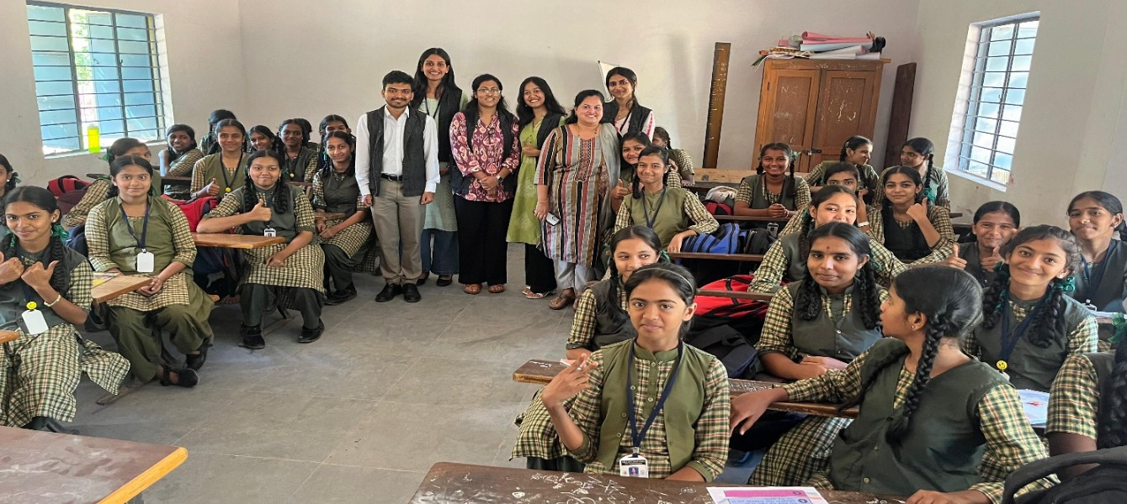
Community Teaching Initiative
During November 2025 as part of experiential learning activity for Jurisprudence

Slide 17
Allied Activities

Slide 18
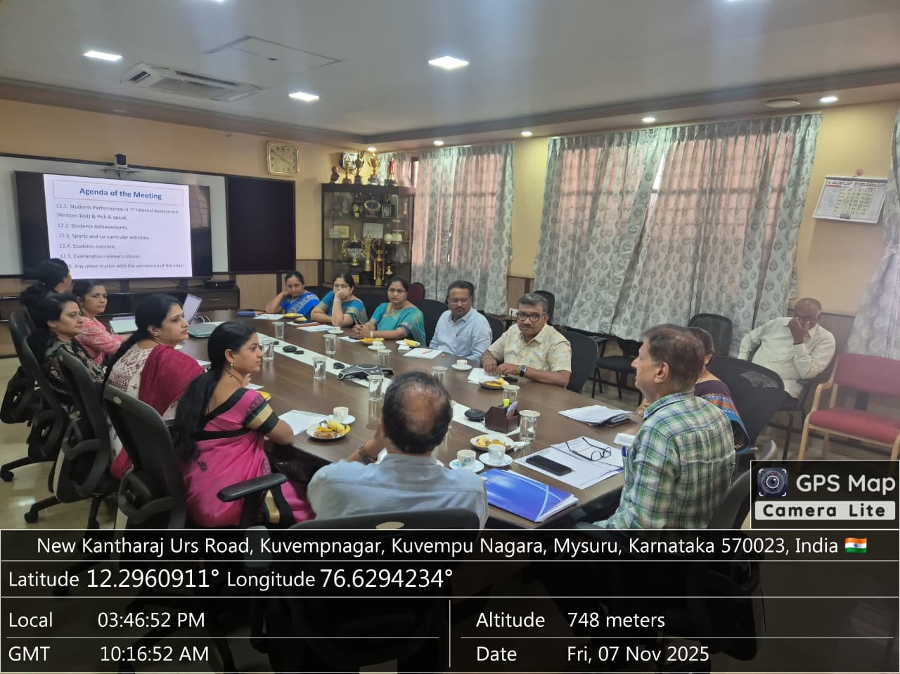
Parents Committee Meeting
On 7.11.2025

Slide 19
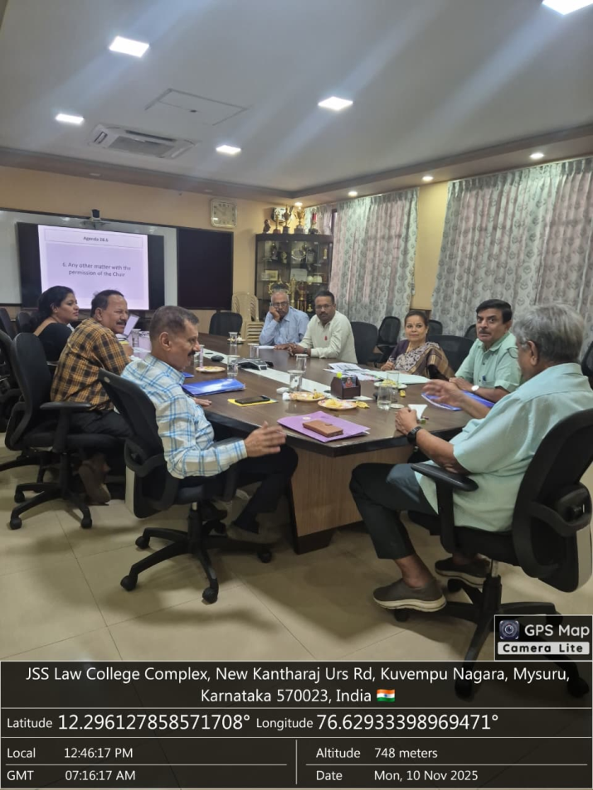
Finance Committee Meeting
On 10.11.2025

Slide 20
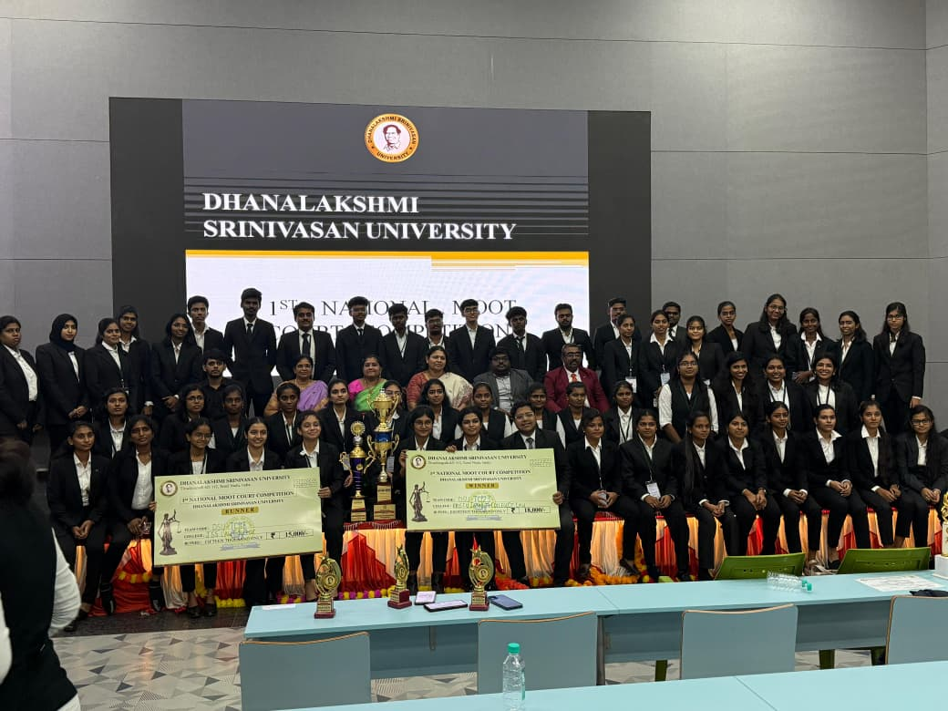
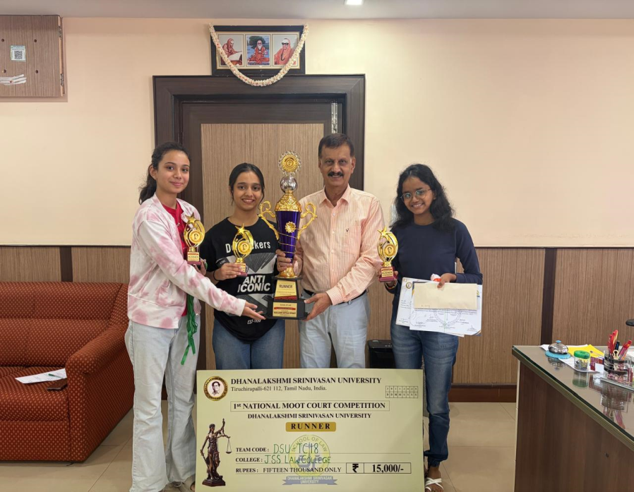
Moot Court Competition
Dhanalakshmi Srinivasan University 1st National Moot Court Competition, held at Tiruchirappalli, Tamil Nadu, from 28.11.2025 to 30.11.2025.
Ms. Prarthana A.R , Ms. Kopika Saravana Moorthy of V Semester BA., LL.B (Hons.) and Ms. Afreen Taj N – adjudged the Runner-Up, securing a cash prize of ₹15,000, along with a trophy, certificates, and medals

Slide 21
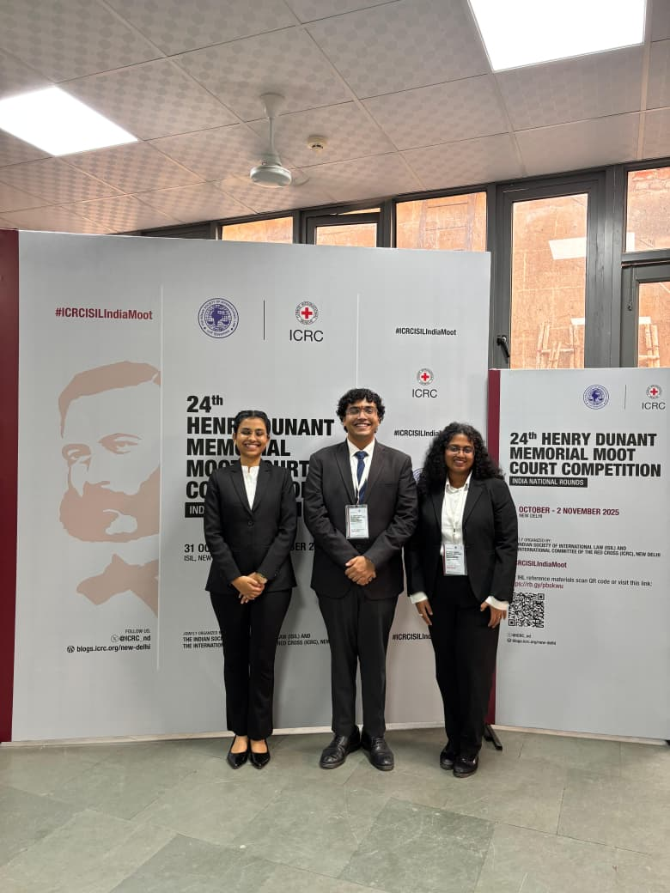
Moot Court Competition
24th Henry Dunant Memorial Moot Court Competition organized by the Indian Society of International Law and International Committee of Red Cross, New Delhi held from 31.10.2025 to 2.11.2025.
Mr. Abhijith Koundinya R, Ms. Jhanvi Suresh and Ms. Amrutha Laxmi K M - team qualified till the Quarter-Final Rounds

Slide 22
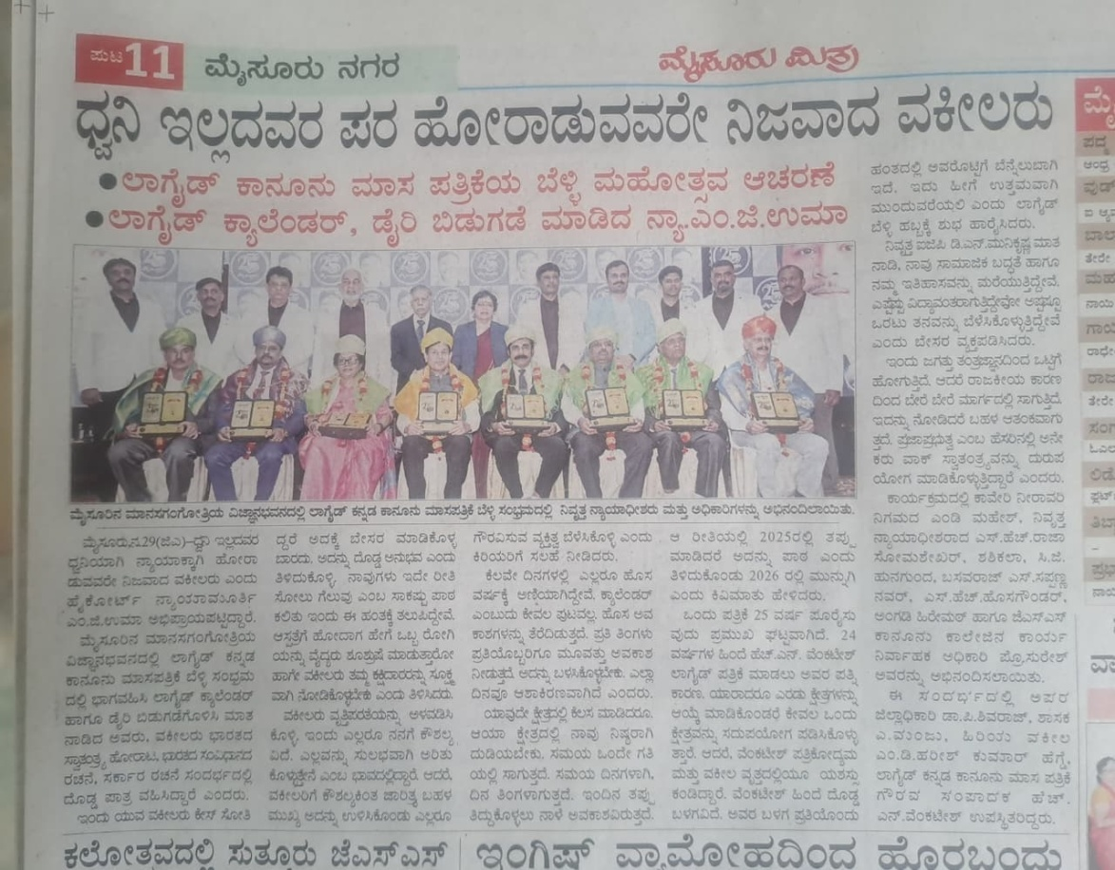
Felicitation to Prof. K S Suresh
Silver Jubilee Celebrations of Law Guide Magazine, and Felicitation Ceremony For Achievers And Contributors, and Release of Calendar and Diary was held on 29.11.2025 at Vignan Bhavan, Manasagangothri, Mysuru.

Slide 23
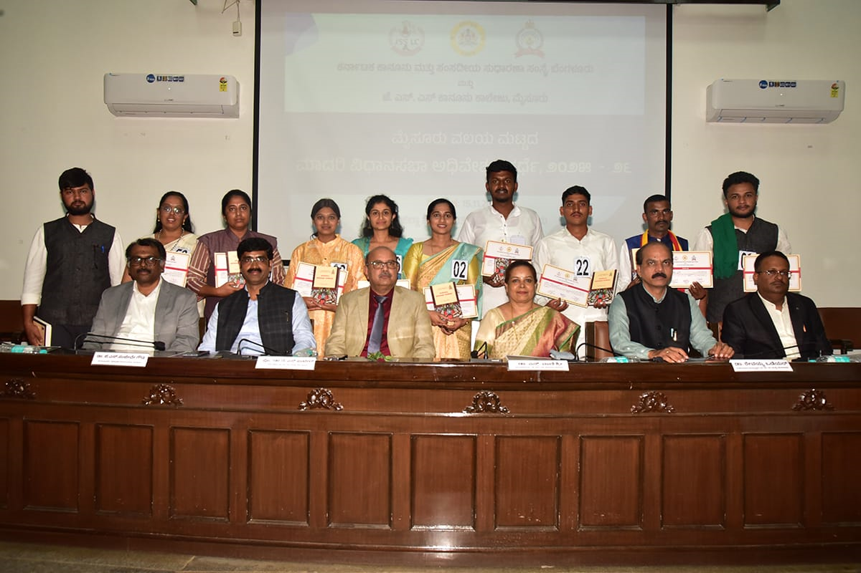
Mysuru Zonal Level Model Assembly Session Competition Vidanasabha Adiveshana Sparde 2025-26
Organized by JSSLC & KILPAR on 15.11.2025 at Zilla Panchayat Hall, Mysuru.
Mr. Shivaprasad M P of VII Semester BA., LL.B (Hons.) secured First place for representing Chief Minister. Mr. Basanth D of VII Semester BA., LL.B (Hons.) secured Sixth place as Speaker and
Ms. Varsha B of I Semester LL.B secured eight place as Member of Opposition

Slide 24
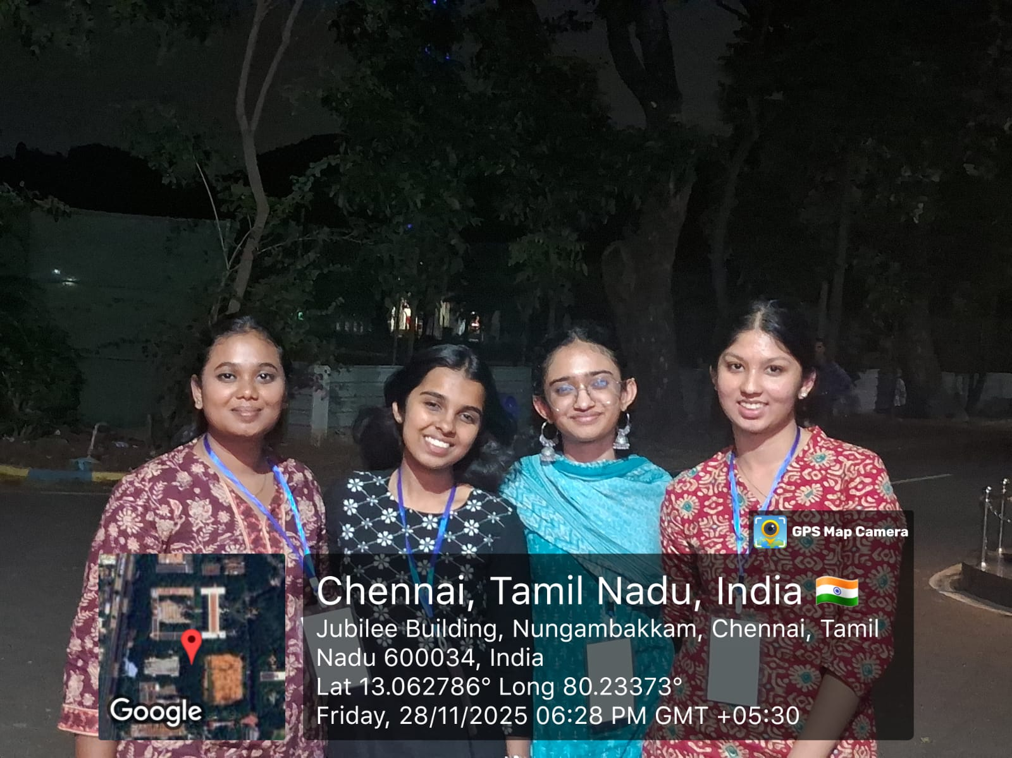
MUN Conference
Participated as Delegates in the MUN Conference organized by Loyala Collage, Chennai held from 28.11.2025 to 30.11.2025

Slide 25
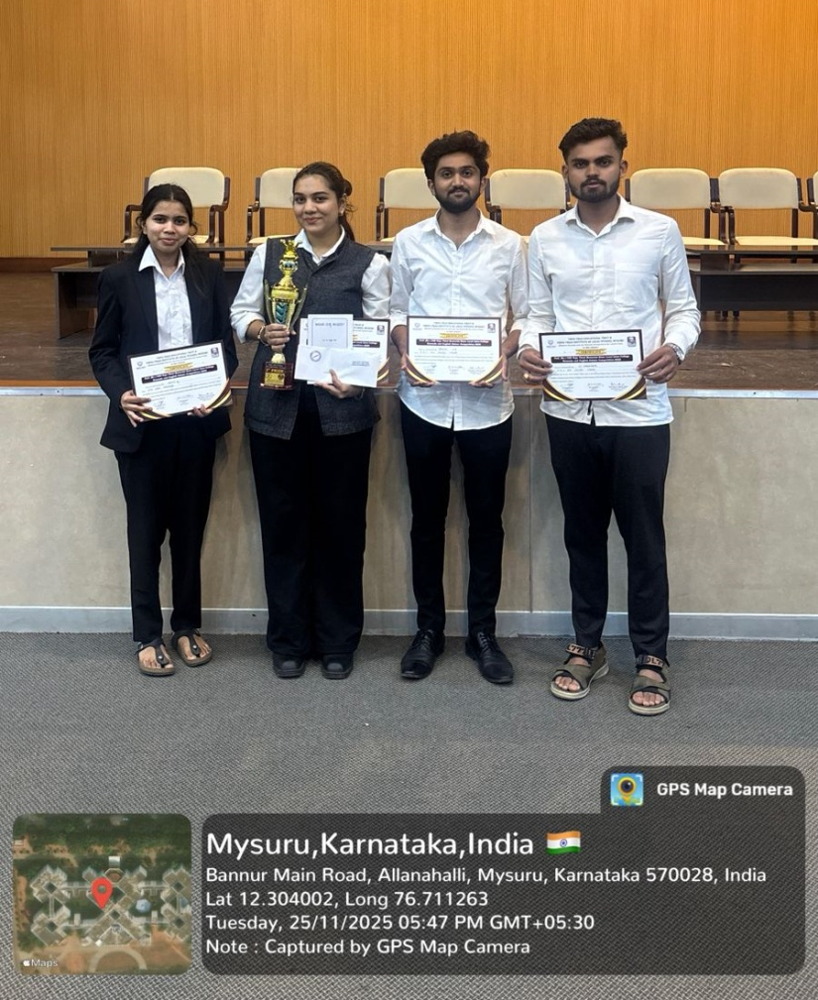
CKN Raja Memorial Debate Competition
CKN Raja Memorial Debate Competition organized by Vidya Vikas Institute of Legal Studies, Mysuru on 25.11.2025. Miss. Bi Bi Nida Fathima won First place in English debate competition with trophy, certificate and a cash prize of Rs. 7000/-.

Slide 26
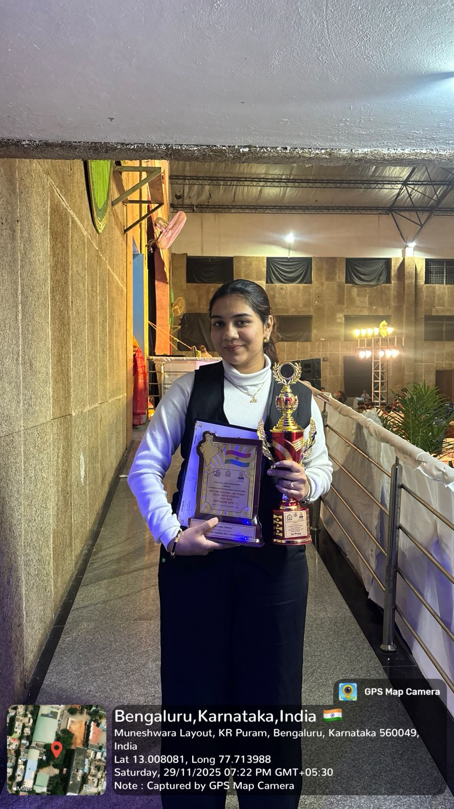
Elocution and Debate Competition
Zonal Youth Festival 2025 organised by SEA Law College in association with Karnataka State Law University, Hubballi on 28.11.2025 and 29.11.2025 - Ms. Bibi Nida won first place in elocution.

Slide 27
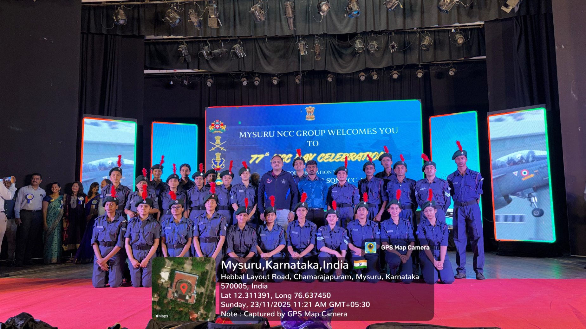
77th NCC Day Celebrations
4 KAR Air Sqn NCC Mysuru alumni organized an event at Kala Mandir, Mysuru on 23.11.2025

Slide 28
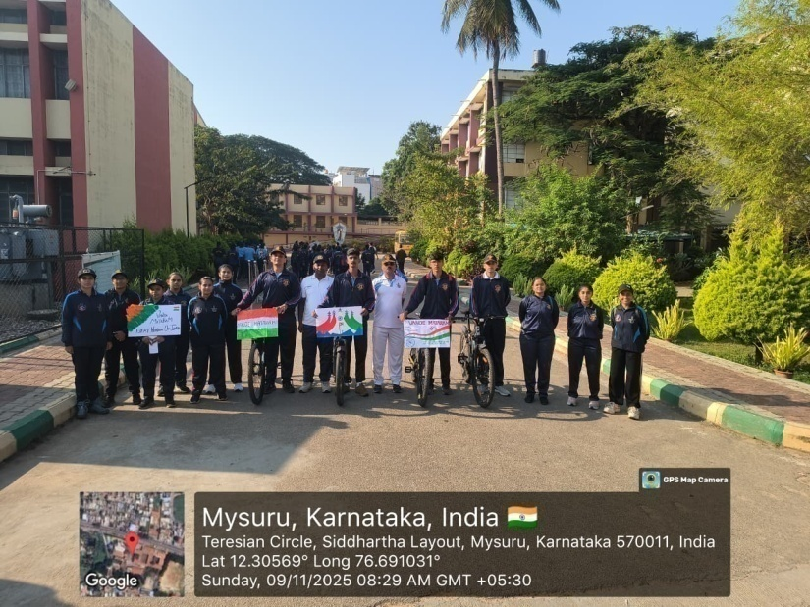
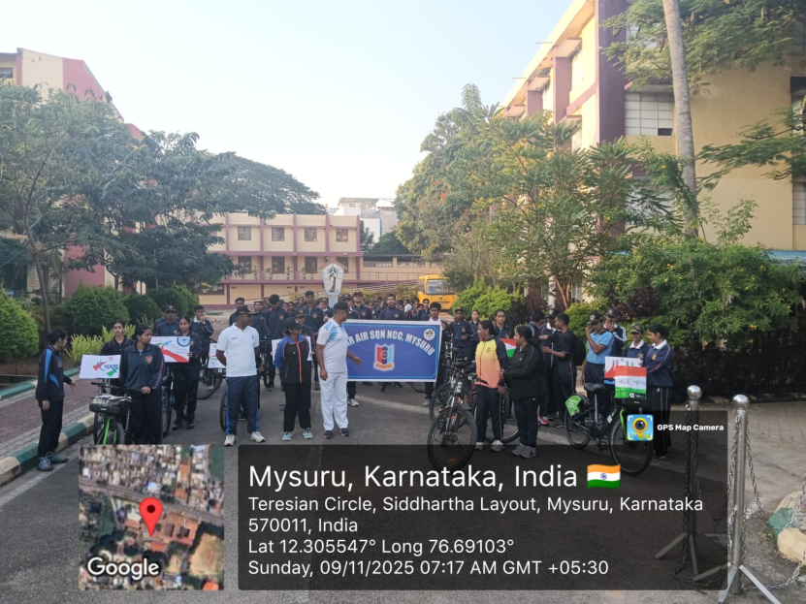
Commemoration of 150 years of Vande Maataram
Commemoration of 150 Years of Vande Maataram on 9.11.2025

Slide 29
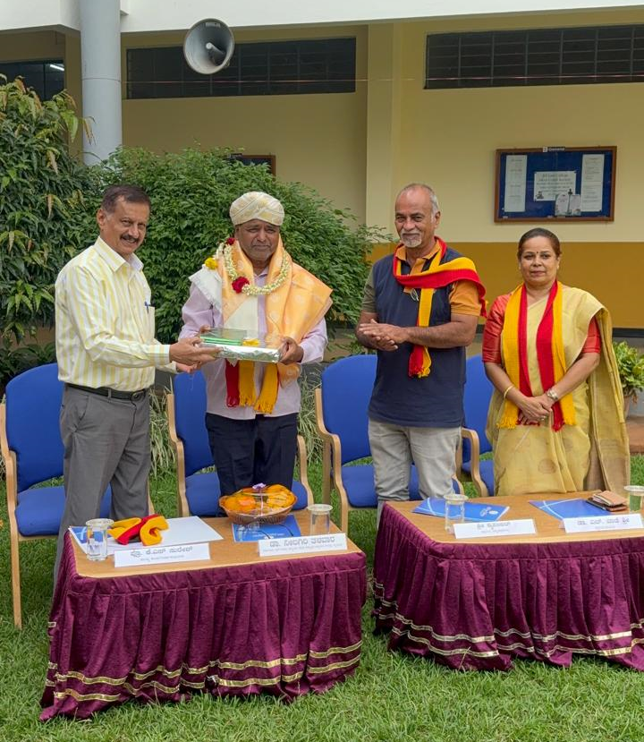
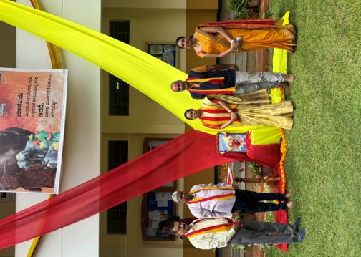
Kannada Rajyotsava Celebrations
‘Sambanjagala Samagama’ – Chief Guests: Dr. Nilagiri Talavara Project Director, Center of Excellence for Studies in Classical Kannada, Bhartiya Bhasha Kendra, Mysuru and Sri. Krupakar, Indian Wildlife Filmmaker and Conservationist

Slide 30
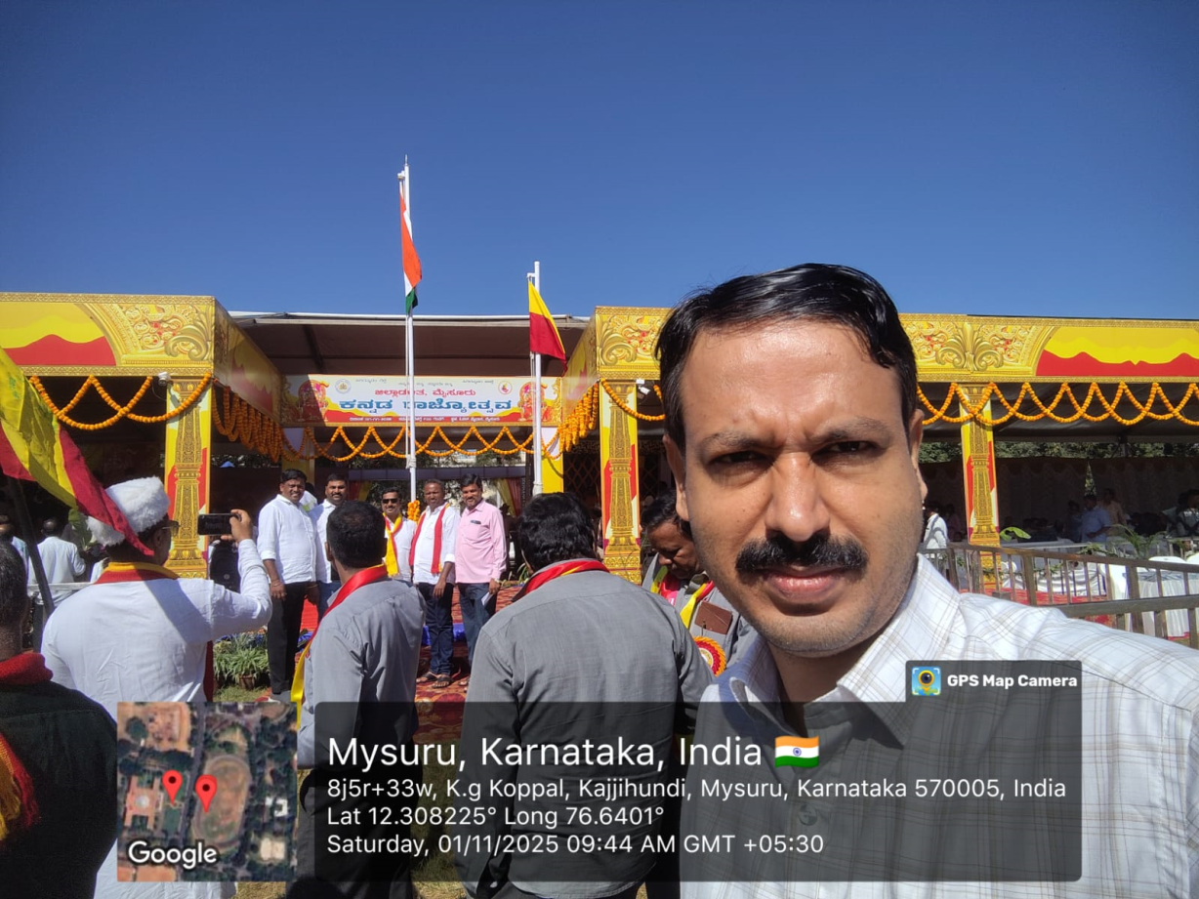
Kannada Rajyotsava
At J D Office, Mysuru

Slide 31
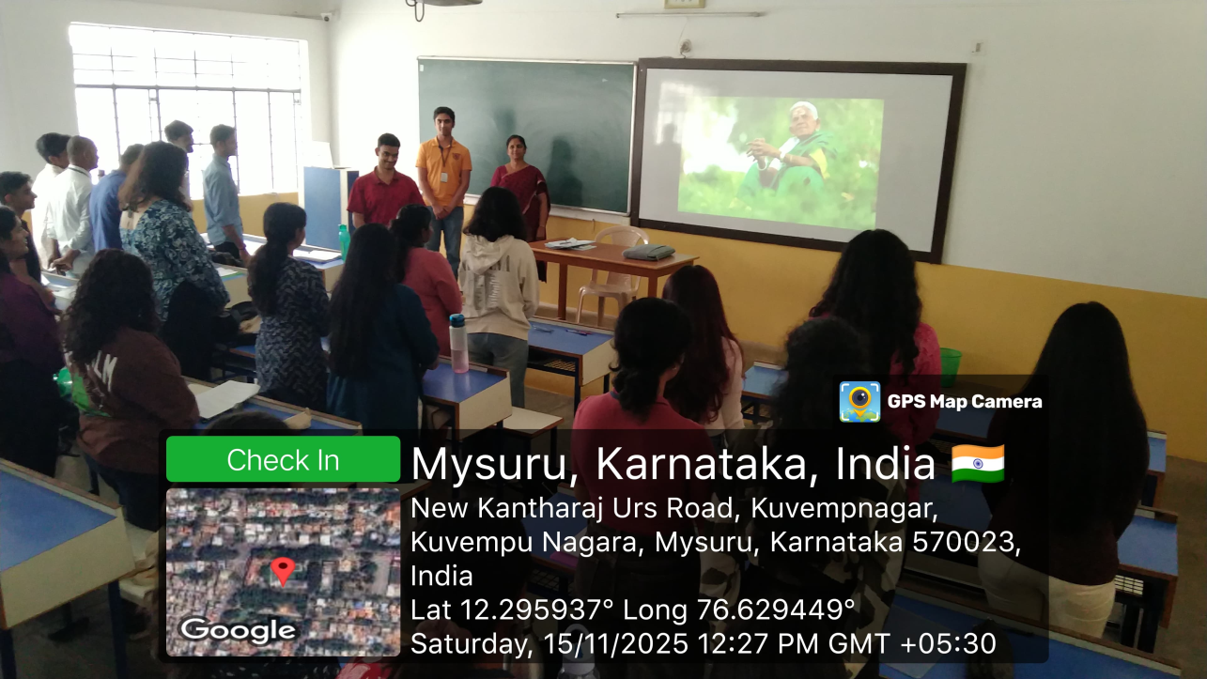
Tribute to late Saalumarada Thimmakka
Gesture of mourning to late Mother of Trees by students of Law of Environment course
on 15.11.2025

Slide 32
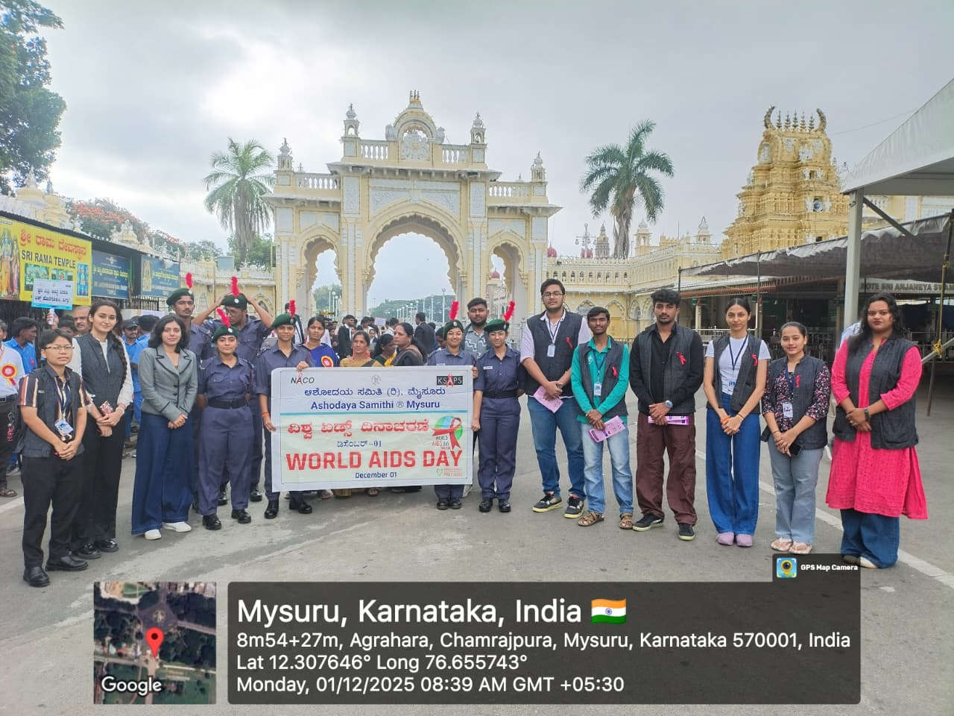
Awareness Rally
State Level World Aid Day Awareness Rally organized by District Aids Prevention and Control Unit, Mysuru and also District Health and Family Welfare Office, Mysuru held at J K Grounds, Mysuru – Participated by Public Health Law students and NCC Cadets

Slide 33
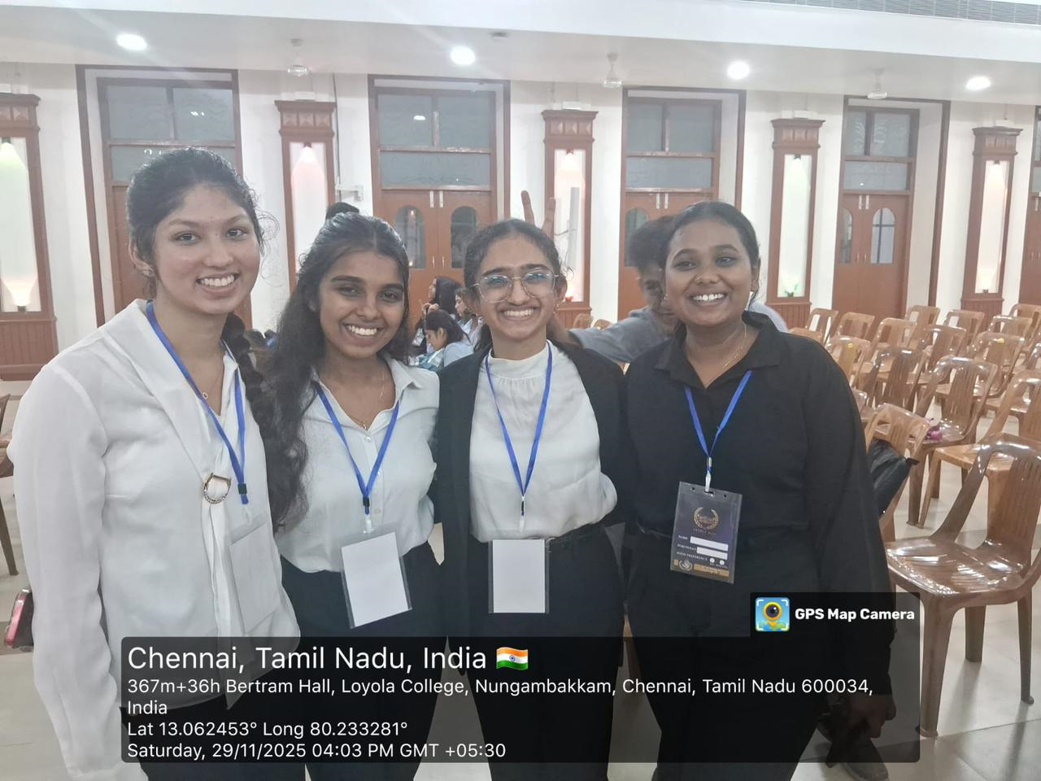
MUN Conference
Participated as Delegates in the MUN Conference organized by Loyala College, Chennai, held from 28.11.2025 to 30.11.2025.
Verbal mention to Ms. Deeptha Viswanathan (in UNDP) and Ms. Rajasree Jain (in IP)

Slide 34
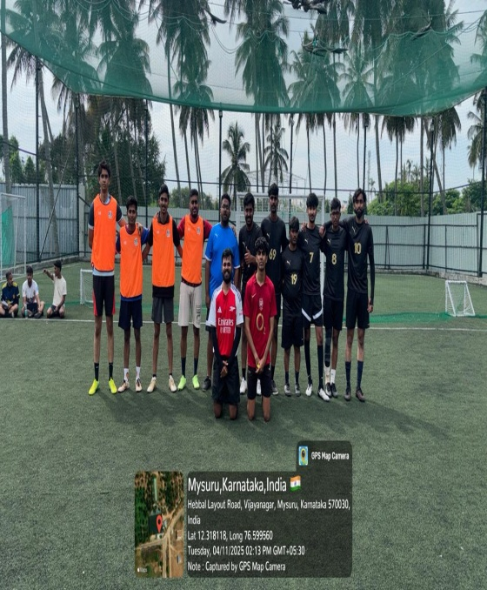
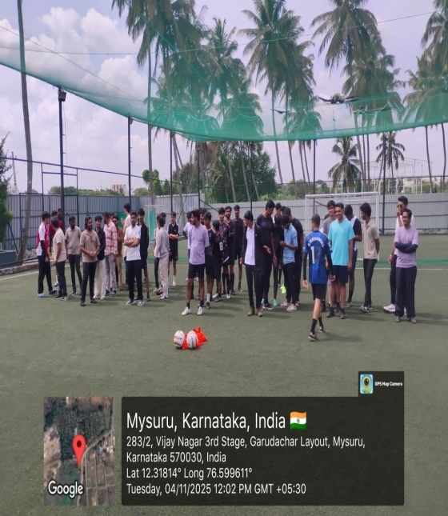
Annual Inter Class Football Competition
On 4th & 5th November 2025 – more than 8 teams participated

Slide 35
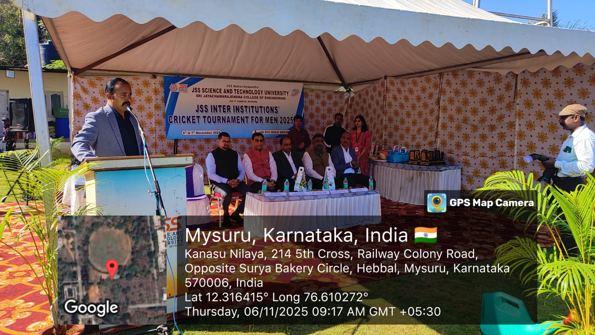

JSS Inter Institutions Tournament
Participation by Cricket Team - on 6th to 8th November 2025 held at SJCE campus
organized by JSS S&T University, Mysuru

Slide 36


Annual Inter Class Competition
Annual Inter Chess Competition for Men & Women held on 11.11.2025

Slide 37


9th Mysore Zonal KSLU Inter Collegiate Athletic Meet
On 21.11.2025 organised by SBRR Mahajana Law College Mysore. Our College Athletics teams secured 4 gold medals,4 Silver medals, 2 Bronze medals and 2 IV place

Slide 38


JSS Inter Institutions Sports Meet
Participation by Volley Ball, Throw Ball and Athletics Teams - from 24.11.2025 to 27.11.2025 at Sutur Sriksetra. District Ms. Desika - (Bronze medal in 100mtrs. Running Race) and Mr. Yathish Gowda (Bronze medal in Shot Put Throw)

