Slide 1

Monthly Report – July 2025

Slide 2
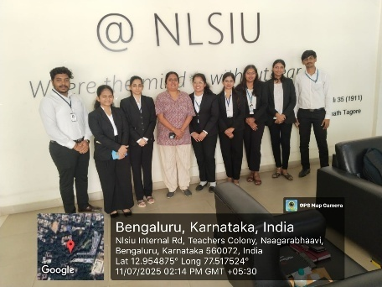
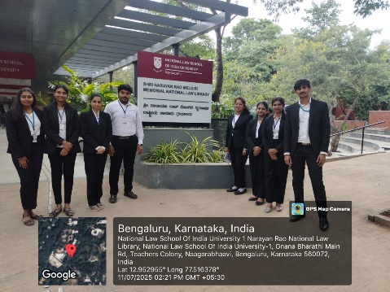
Internship at NLSIU
Batch of 8 students from the PG Department of Studies in Law completed their internship from 08.07.2025 to 11.07.2025 on Research Methodology at National Law School of India University, Bengaluru.

Slide 3
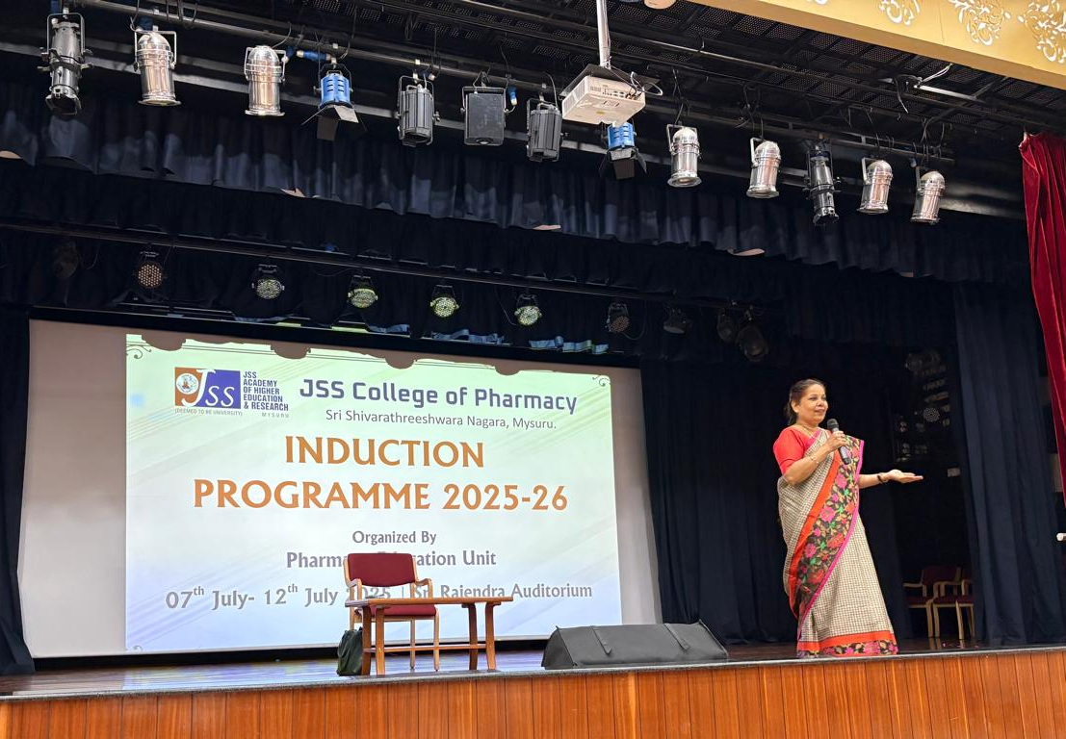
Dr. N. Vani Shree as Resource Person
Induction Programme at JSS Pharmacy College, Mysuru on 10.07.2025

Slide 4
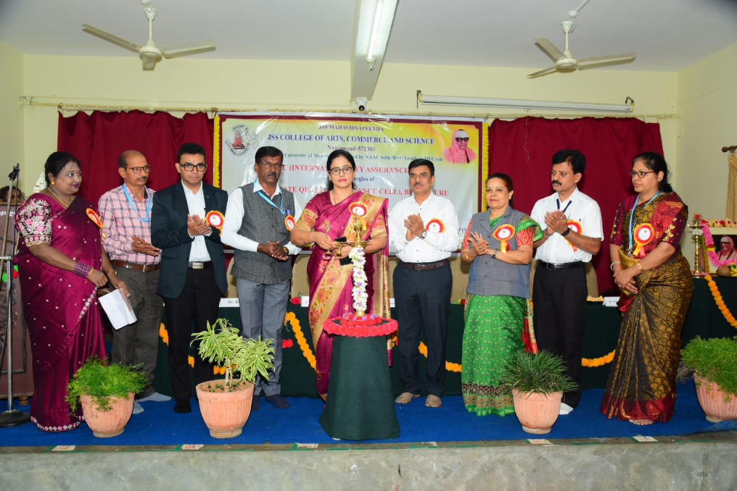
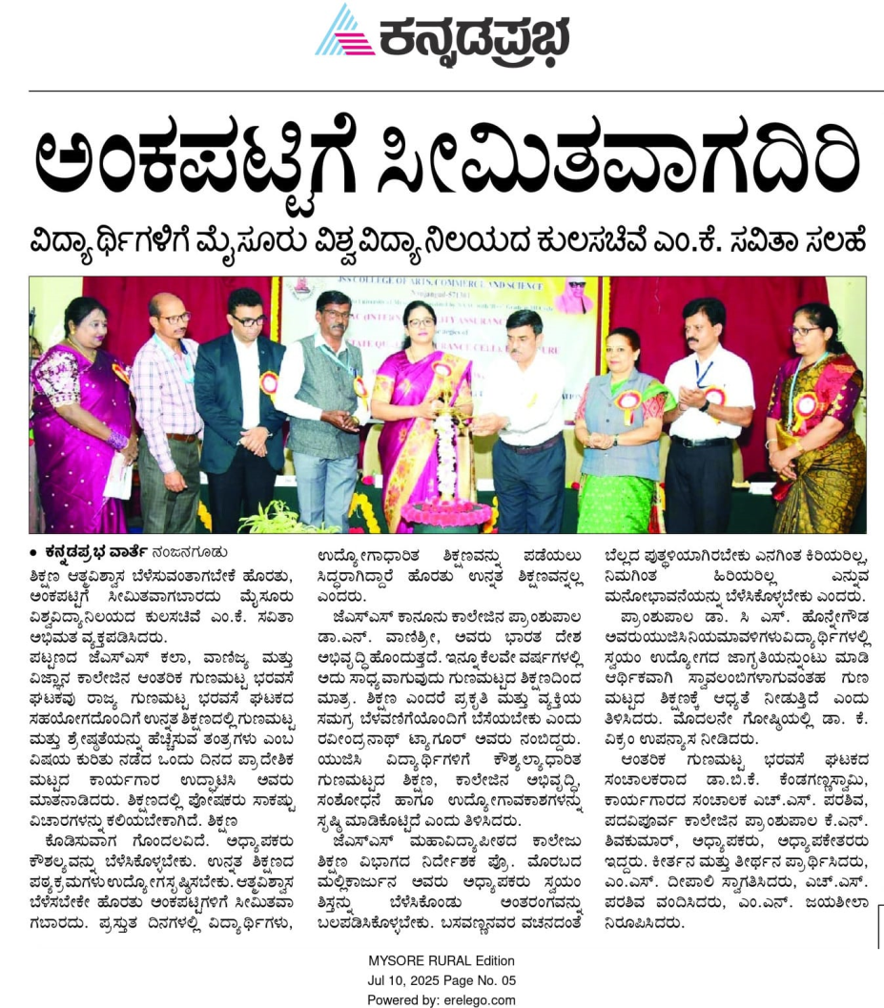
Key Note Address by Dr. N. Vani Shree
At JSS Nanjangud College on 09.07.2025

Slide 5
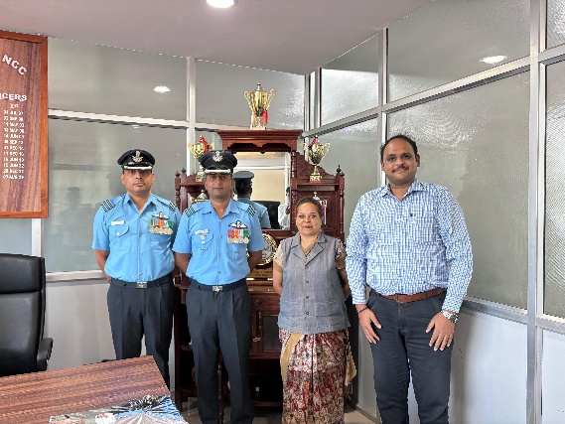
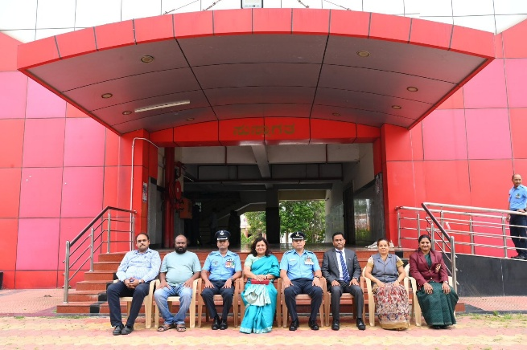
Farewell Programme – 14.07.2025
To Wg Cdr G S Asish, Commanding Officer

Slide 6
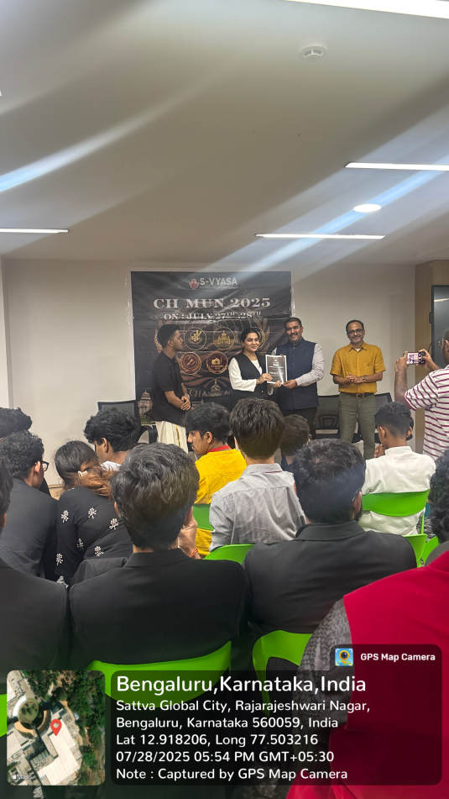
CHMUN 2025
Ms. Bibi Nida Fathima received High Commendation Award along with a cash prize of Rs. 12,000/- held on 26.07.2025 & 27.02.2025

