Slide 1

Monthly Report – August 2025

Slide 2
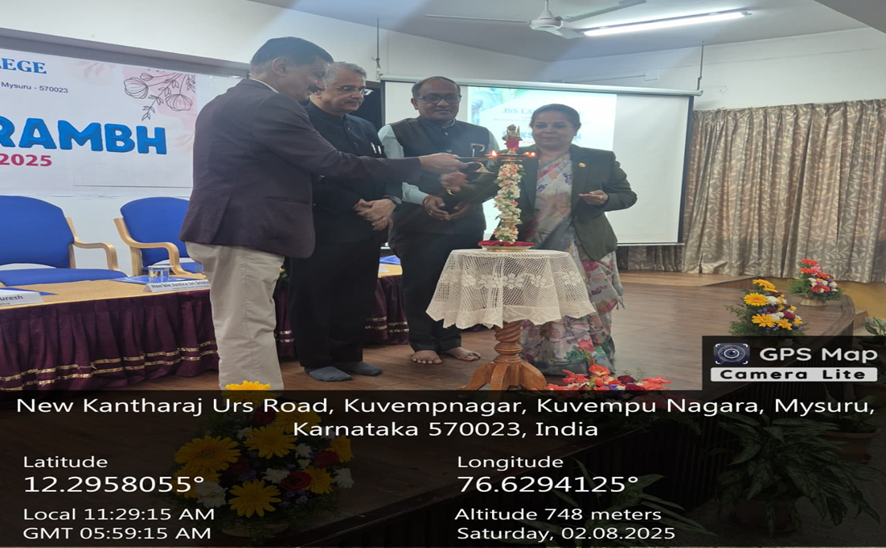
Deeksharambh – 25 Orientation Programme for Freshers’ – 02.08.2025 to 14.08.2025
Inauguration of Deeksharambh-25 by Honourable Justice Sri Srishananda, Judge, High Court of Karnataka and Sri. Mittalakod SS, Chairman, Karnataka State Bar Council on 02.08.2025

Slide 3
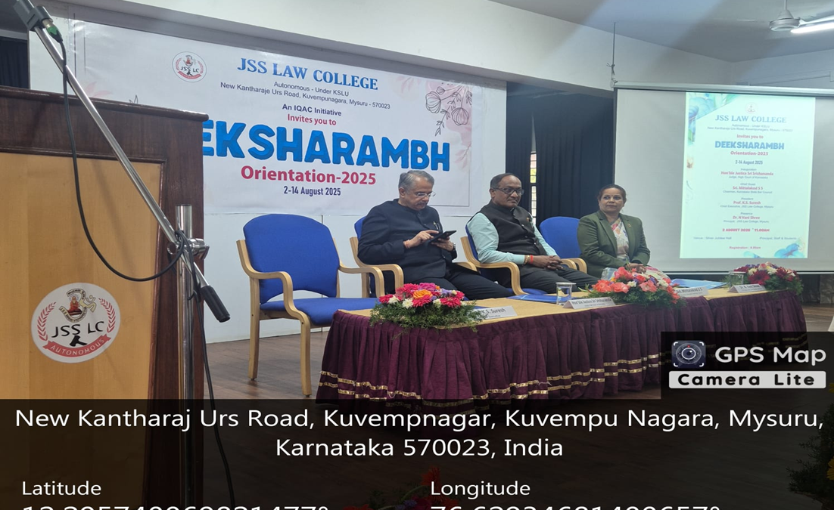
Deeksharambh – 25 Orientation Programme for Freshers’ – 02.08.2025 to 14.08.2025
Orientation Programme for Freshers’ from 02.08.2025 to 14.08.2025 - Inauguration of Deeksharambh-25 by Honourable Justice Sri Srishananda, Judge, High Court of Karnataka and Sri. Mittalakod SS, Chairman, Karnataka State Bar Council on 02.08.2025

Slide 4
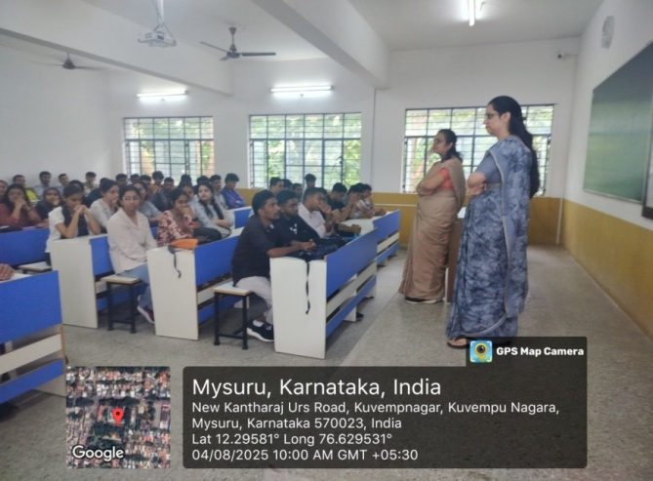
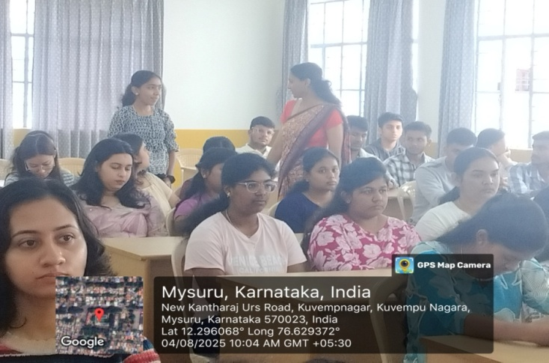
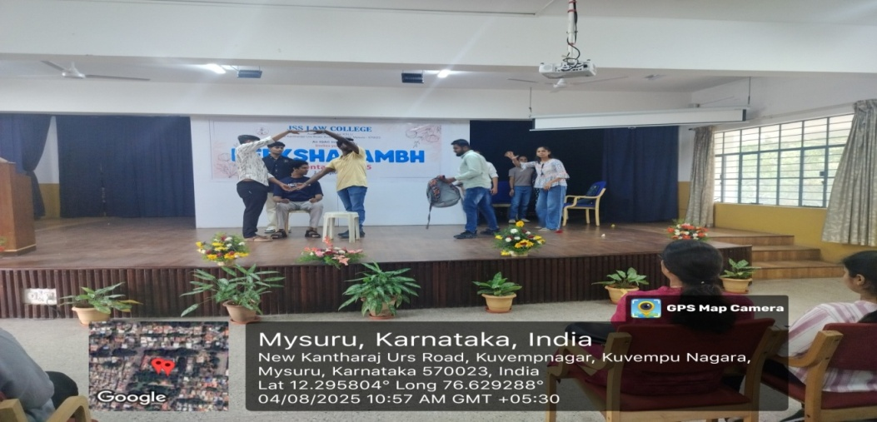
Deeksharambh – 25
Day 2: Ice Breaking Session on 04.08.2025

Slide 5
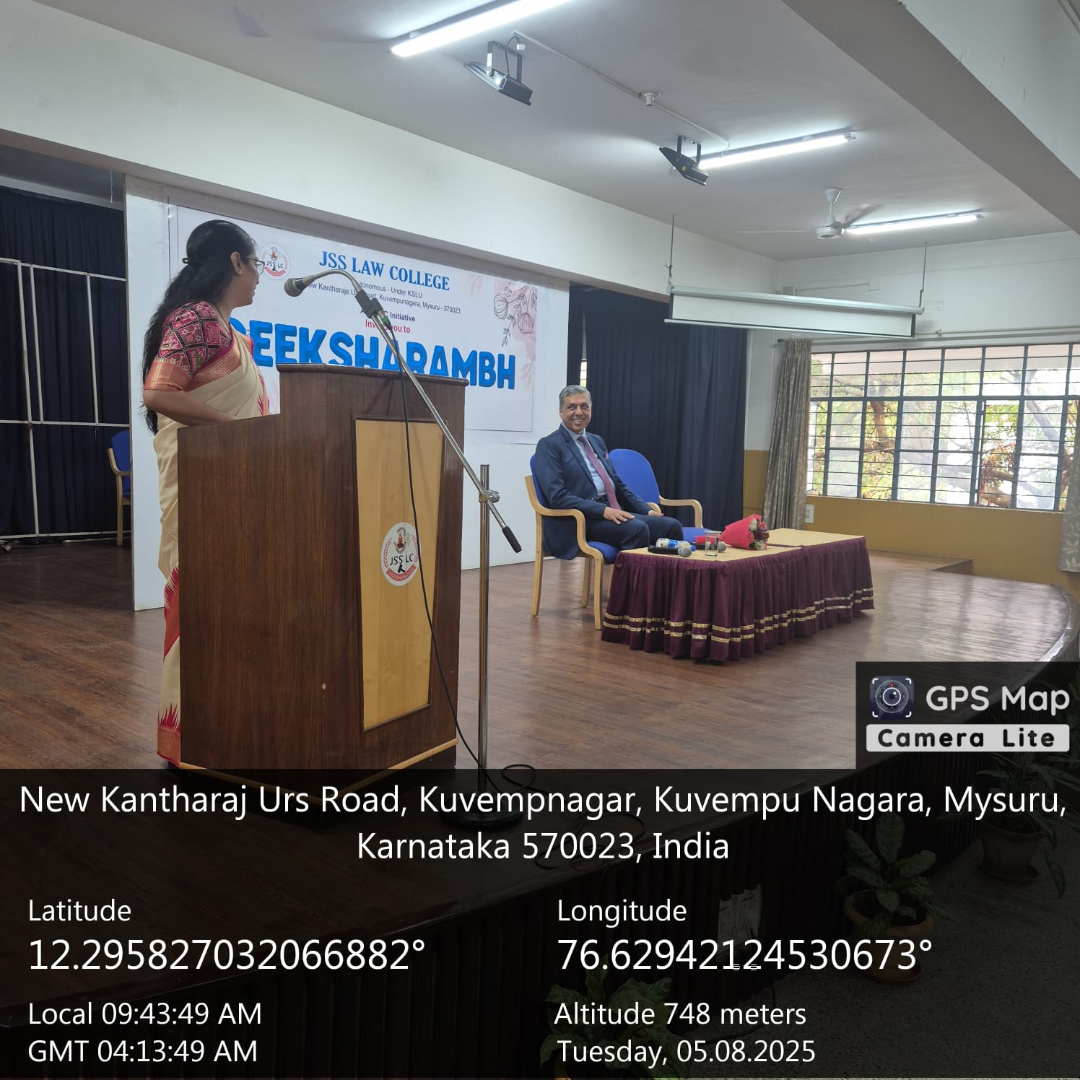
Deeksharambh – 25
Day 3: Motivational Speech by Dr. Prof. Sayeed Akeel Ahmed on 05.08.2025

Slide 6
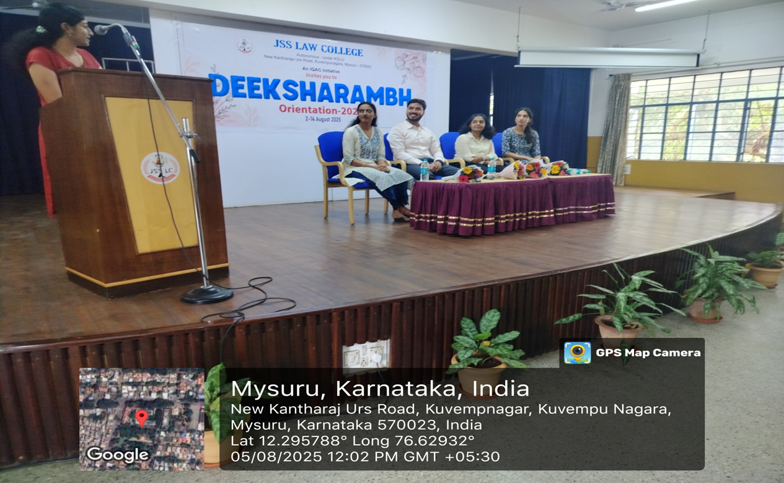
Deeksharambh – 25
Day 3: Alumni Interaction on 05.08.2025

Slide 7
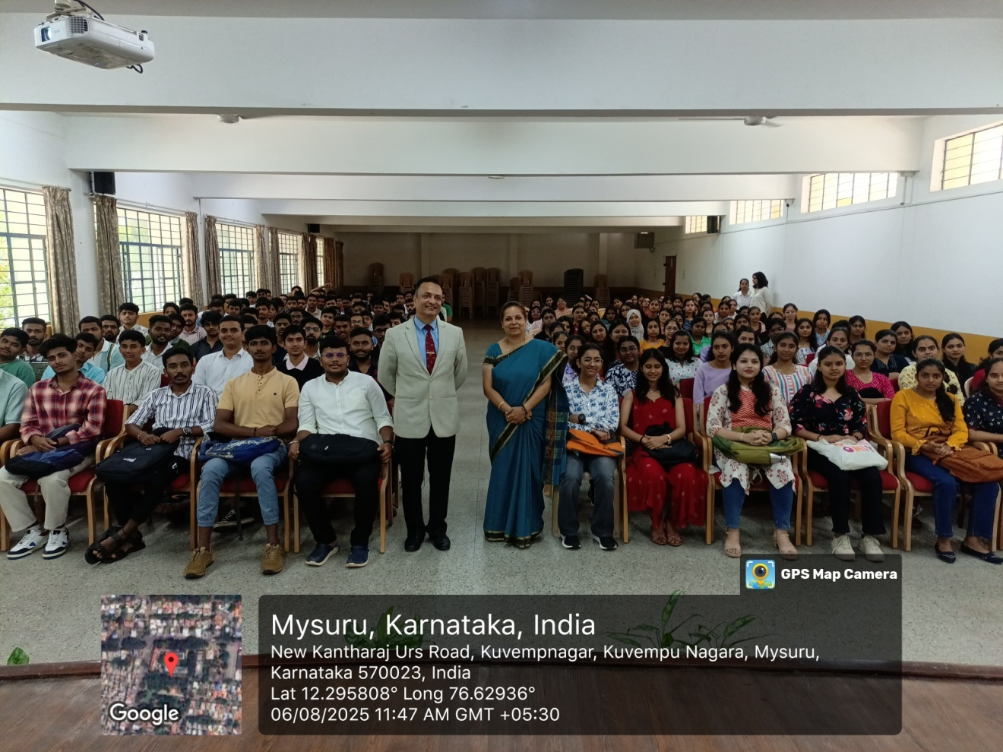
Deeksharambh – 25
Day 4: Talk on JAG and Opportunities in Defence by Group Captain Retd. Abhinav Chaturvedi, Founder Alpha Lead, Mysuru on 06.08.2025

Slide 8
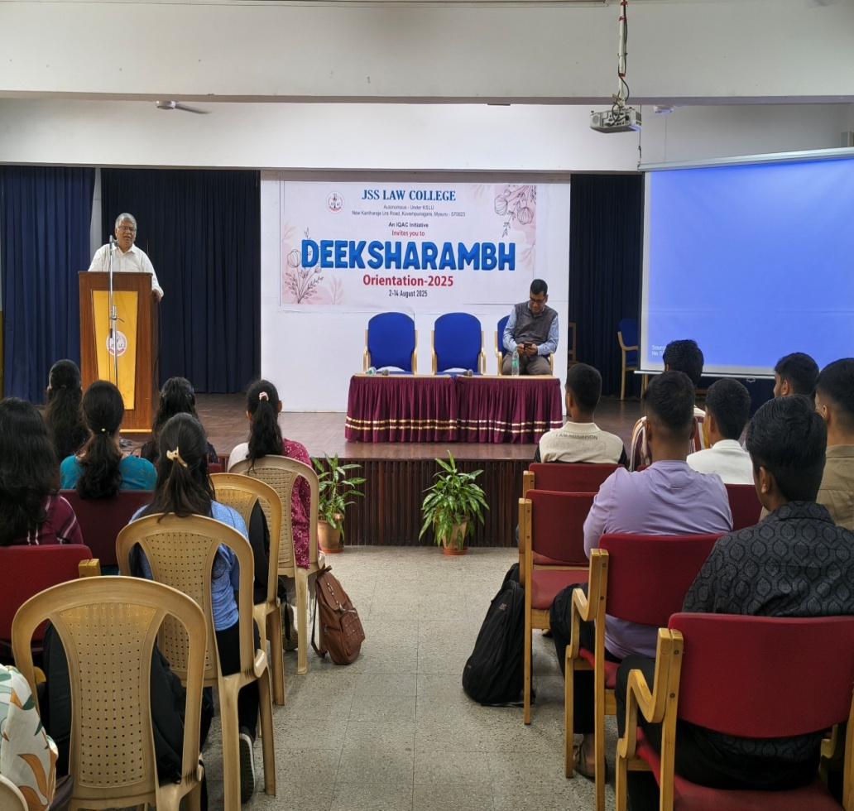
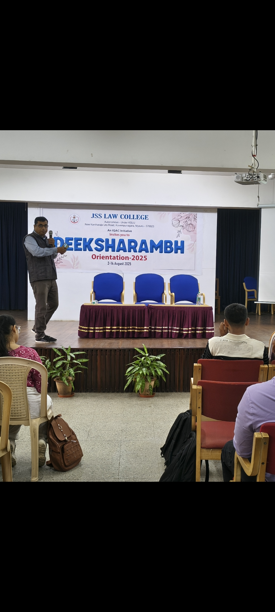
Deeksharambh – 25
Day 5: Talk on A I and Law by Sri Vijayanand Gurudev and Sri Sathish Venkatasubbu, Vigyanlabs, Mysuru on 07.08.2025

Slide 9
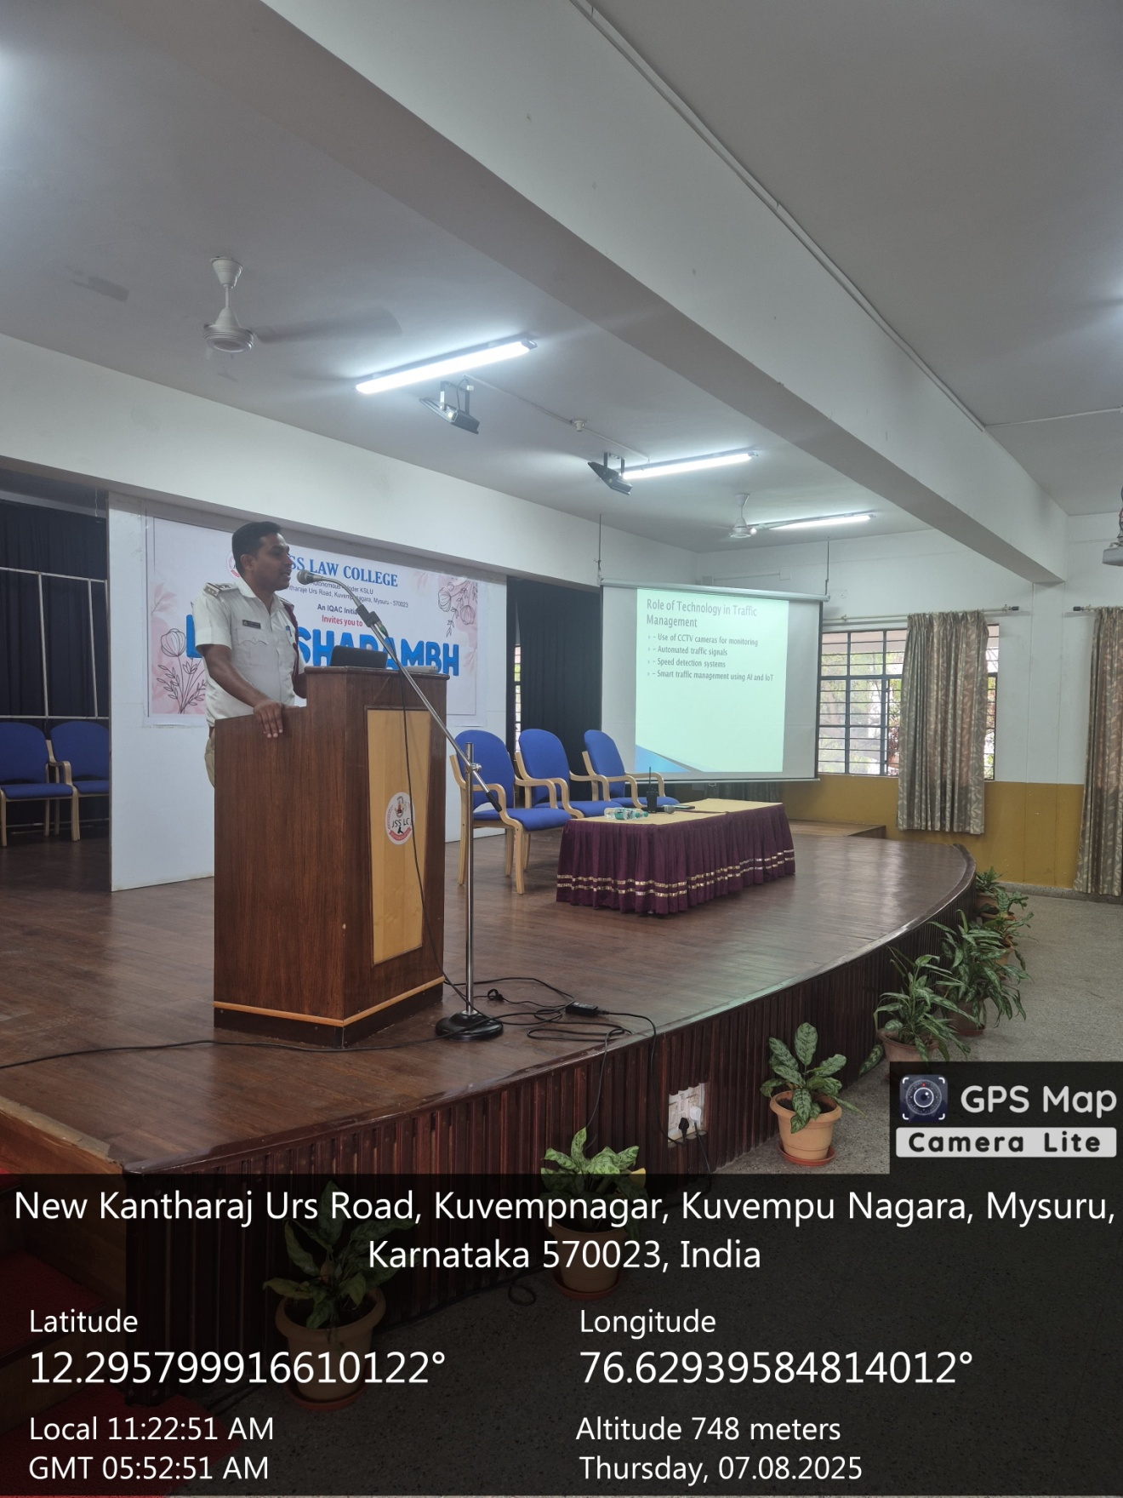
Deeksharambh – 25
Day 5: Awareness on Traffic Rules and Public Conduct by Sri. M L Siddesh, Sub- Inspector, N R Traffic Police Station, Mysuru on 07.08.2025

Slide 10
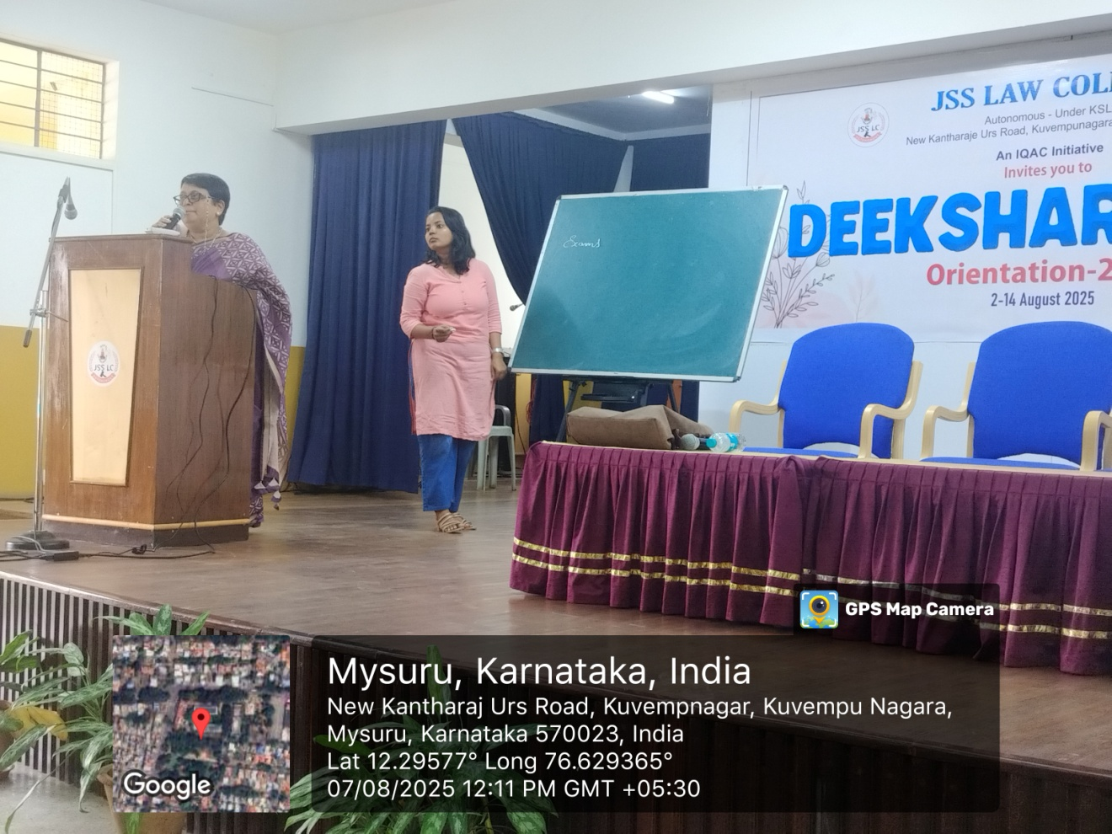
Deeksharambh – 25
Day 5: Smt. Shanthala Ganesh , Psychologist on
Problems in Adolescence and Mental Well-being - 07.08.2025

Slide 11
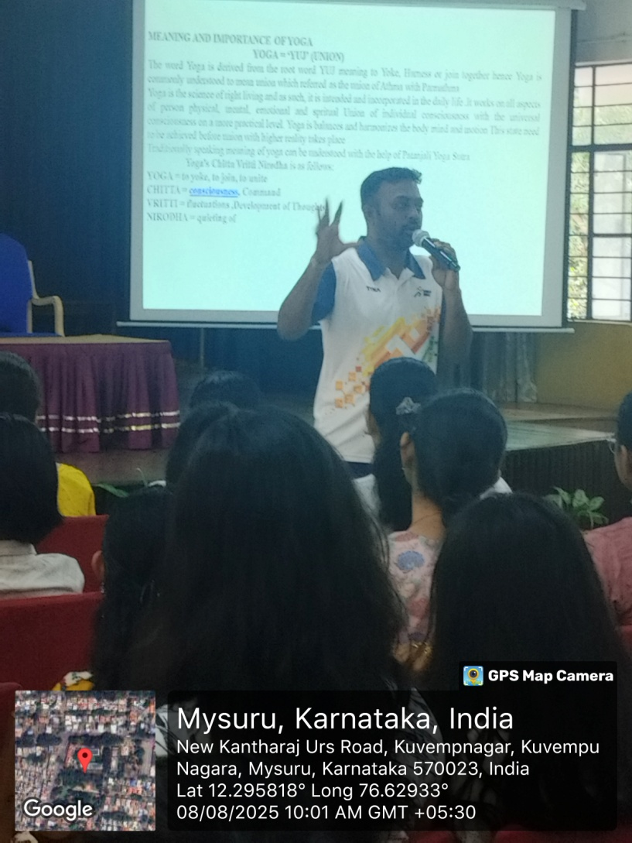
Deeksharambh – 25
Day 6: Sri. Kishore M R, Yoga Coach and National Level Refree, University of Mysore on Importance of Yoga and Pranayama - 08.08.2025

Slide 12
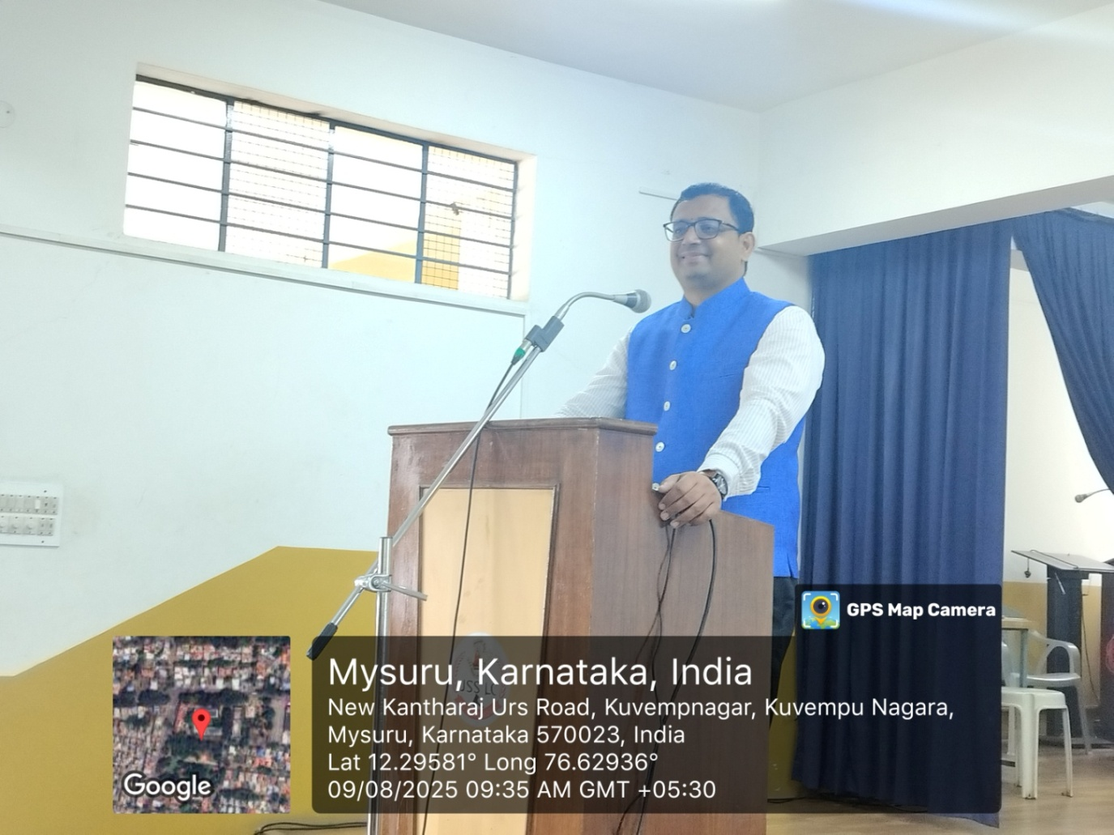
Deeksharambh – 25
Day 7: Sri. C N Chandan, IV Additional Civil Judge, Senior Division, CJM on Career Opportunities in Judiciary - 09.08.2025

Slide 13
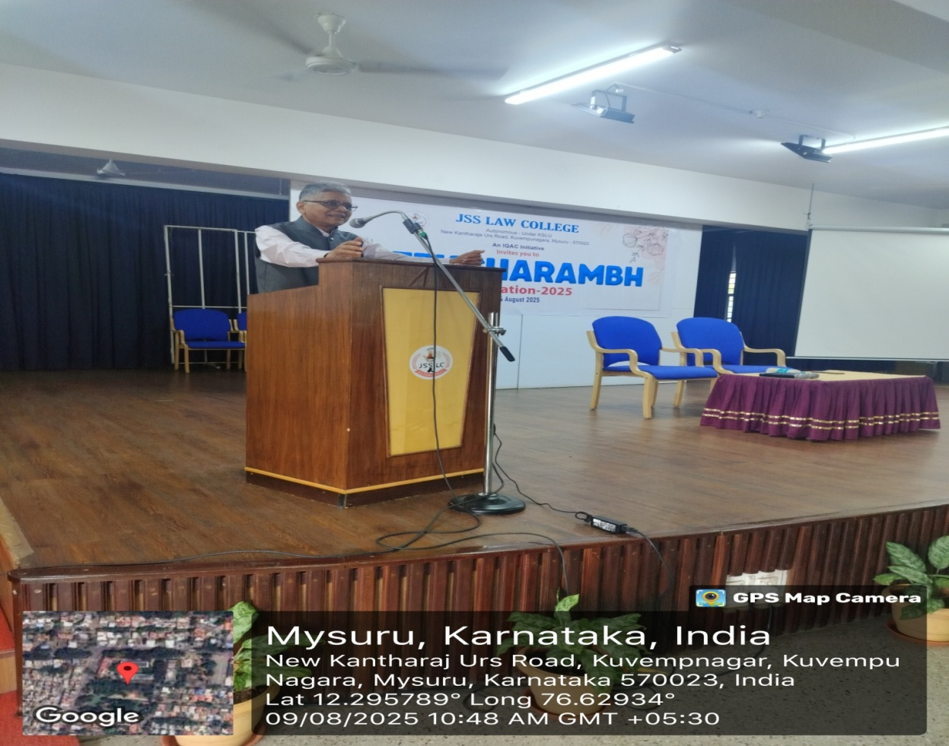
Deeksharambh – 25
Day 7: Dr. K M Veeraiah, Retd. Professor of Economics, JSS College, on Human Values and Social Life - 09.08.2025

Slide 14
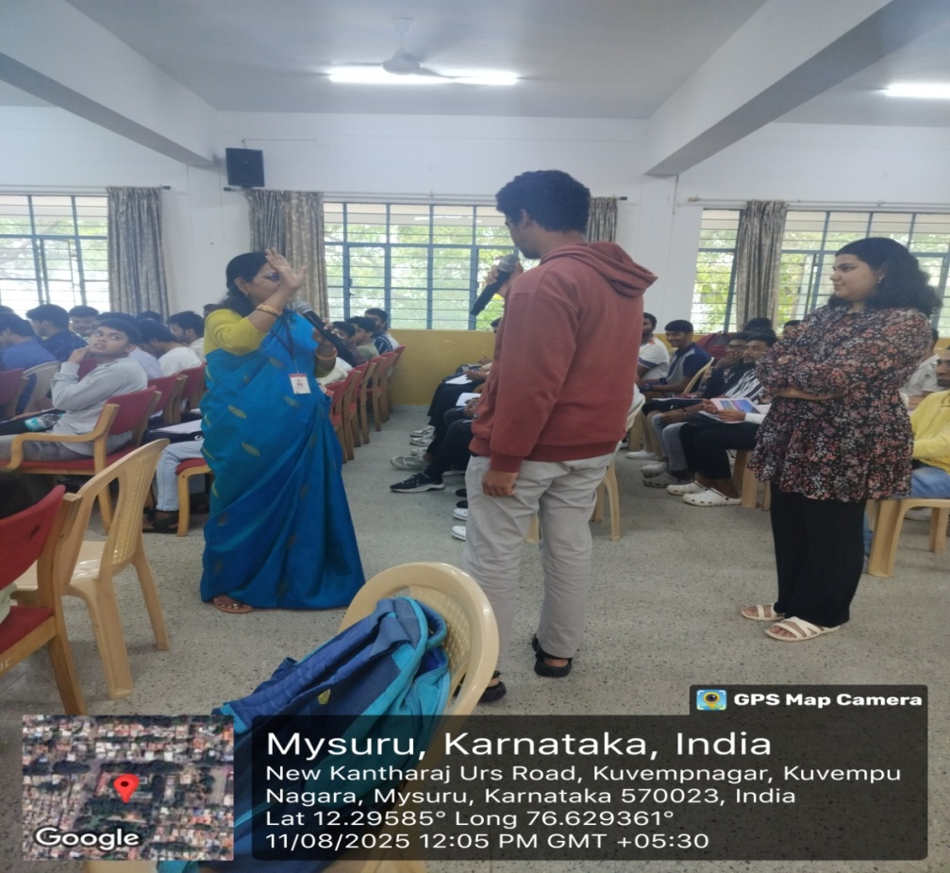
Deeksharambh – 25
Day 7: Dr. Nagamani S Khandre, Intervention Partner with P M Modi’s Mission – Karmayogi on Constitution of Life – 11.08.2025

Slide 15
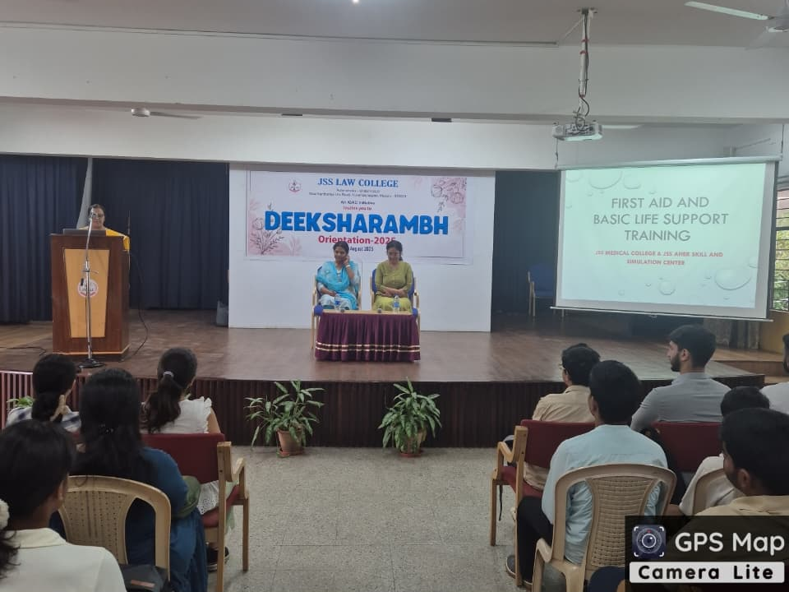
Deeksharambh – 25
Day 8: Dr. Archana and Dr. Sarika Shetty from JSS, AHER – Training on the importance of First Aid and CPR During Emergency - 12.08.2025

Slide 16
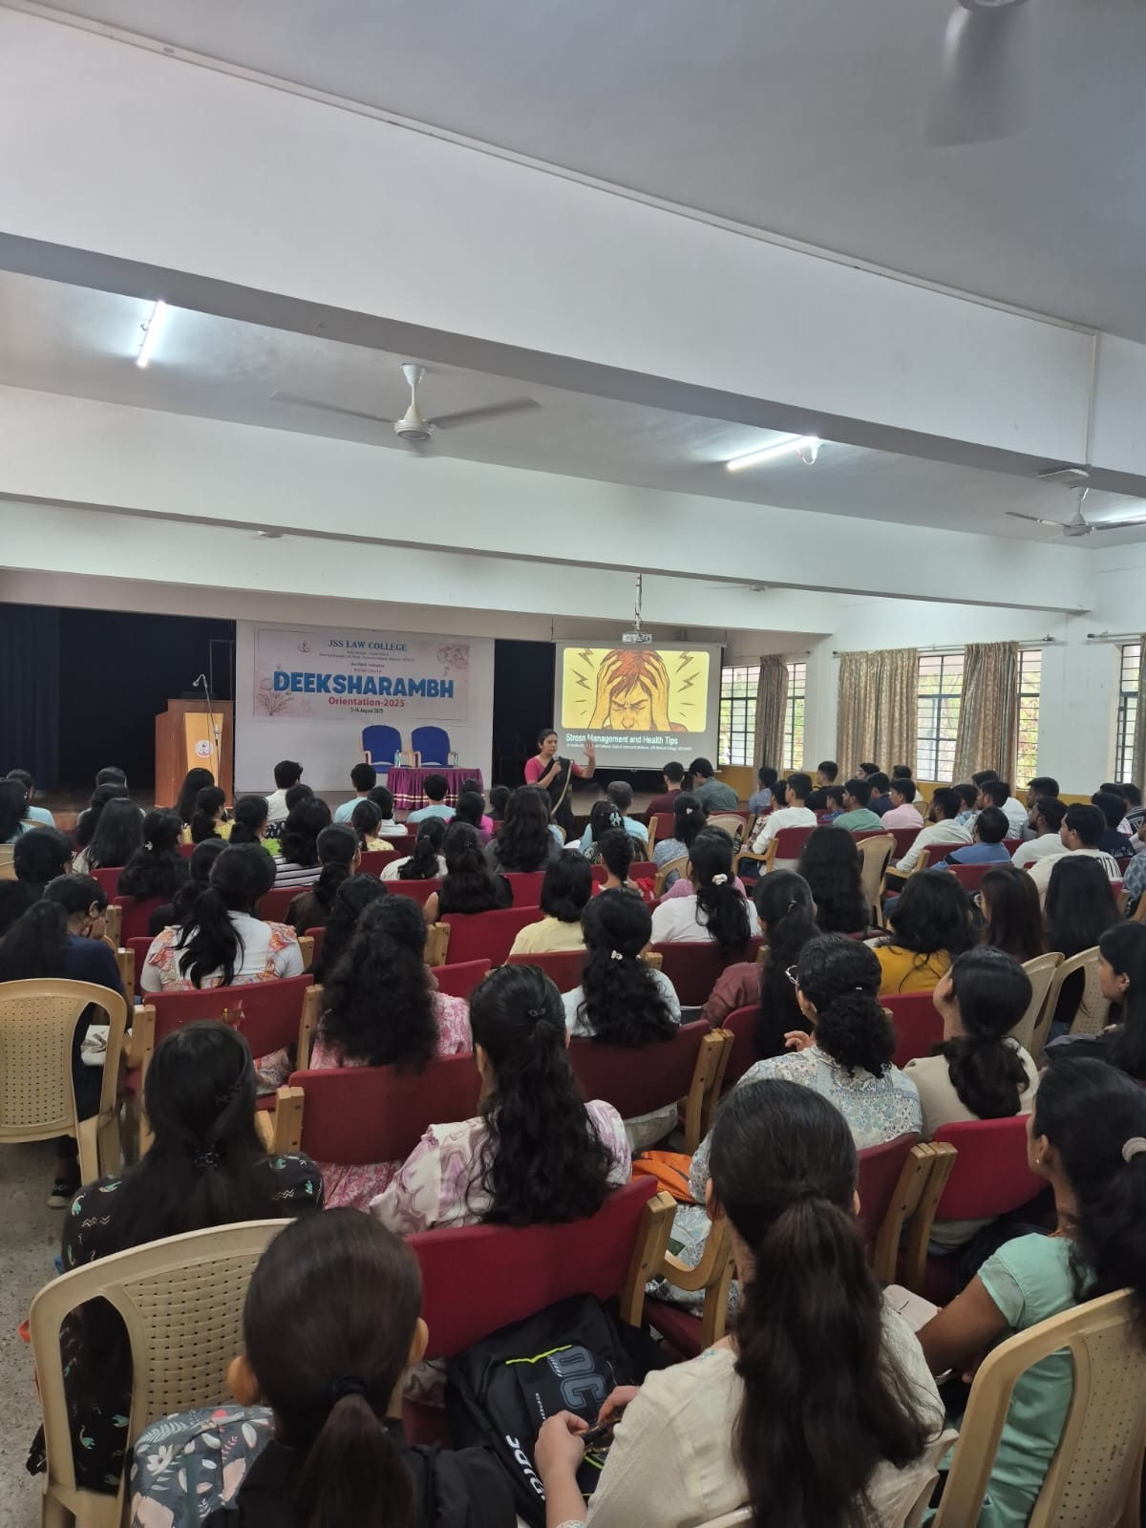
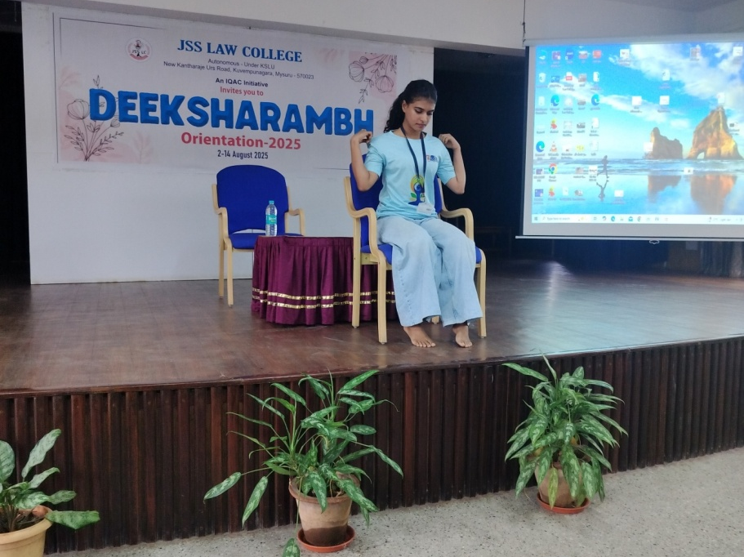
Deeksharambh – 25
Day 8: Dr. Smitha & Ms. Jahanavi on Stress Management & Health Tips – 13.08.2025

Slide 17
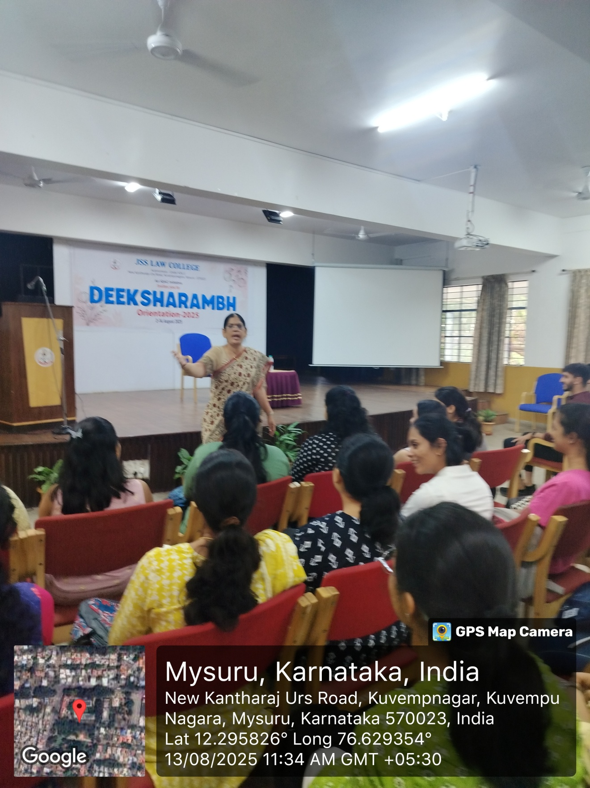
Deeksharambh – 25
Day 8: Smt. Shashikala Madhusudhan on Soft Skills for Professional Excellence – 13.08.2025

Slide 18
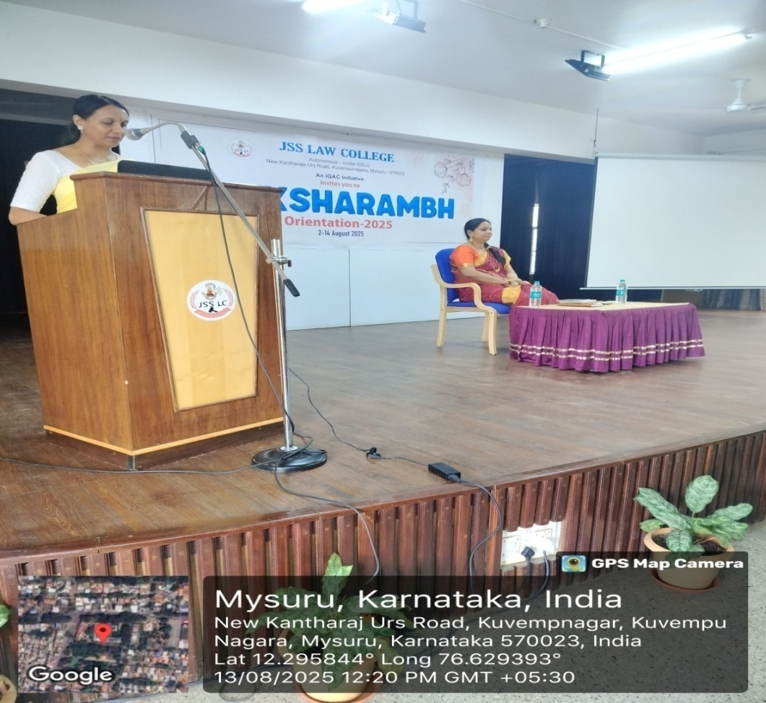
Deeksharambh – 25
Day 8: Dr. Shwetha Madapadi on Importance of co- curricular activities in student life 13.08.2025

Slide 19
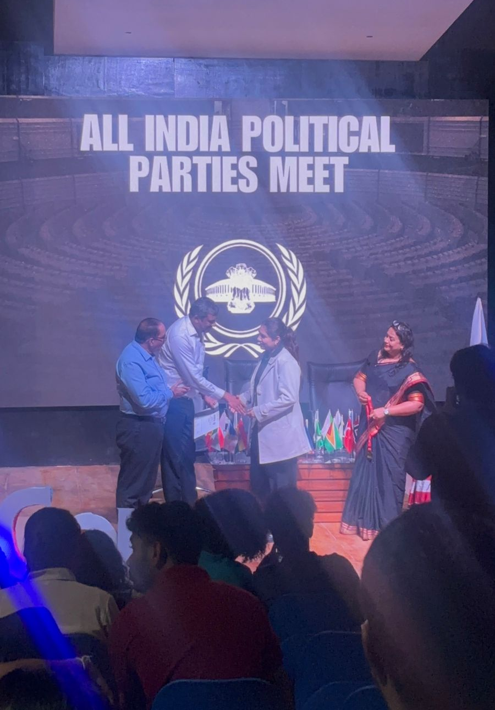
AICON25 - 09.08.2025
Participated by Ms. Bibi Nida Fathima, VII Semester B.A., LL.B (Hons.) AICON25 at Aacharya Institute in Bengaluru, won The Best Delegate award with a gavel, medal, certificate& cash prize of ₹12,000

Slide 20
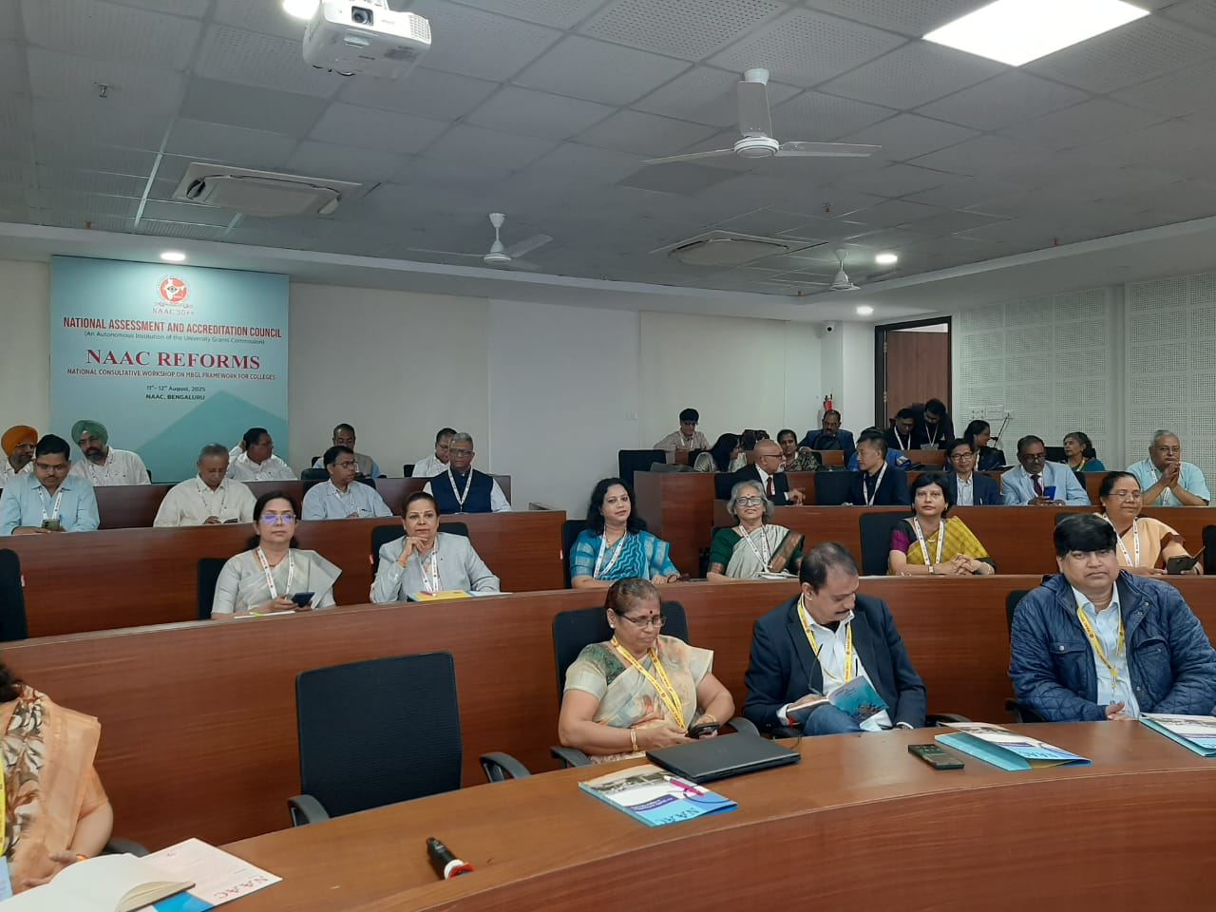
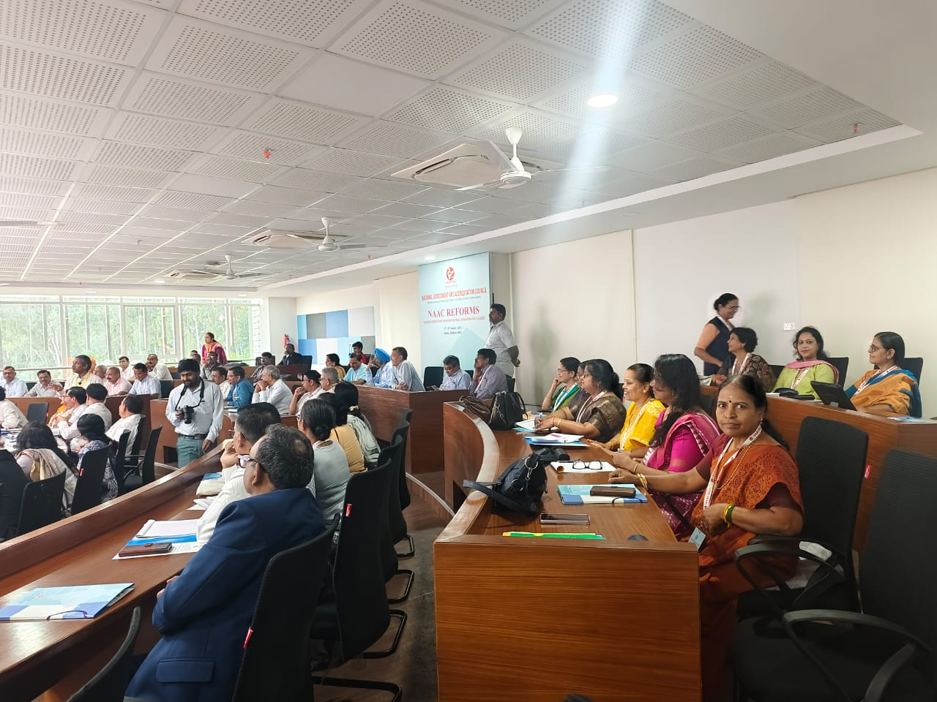
NAAC National Consultative Workshop for Principals (Binary Accreditation Framework (BAF) and Maturity Based Graded Levels (MBGL) – 11th & 12th August 2025
Attended by Dr. N Vani Shree, Principal

Slide 21
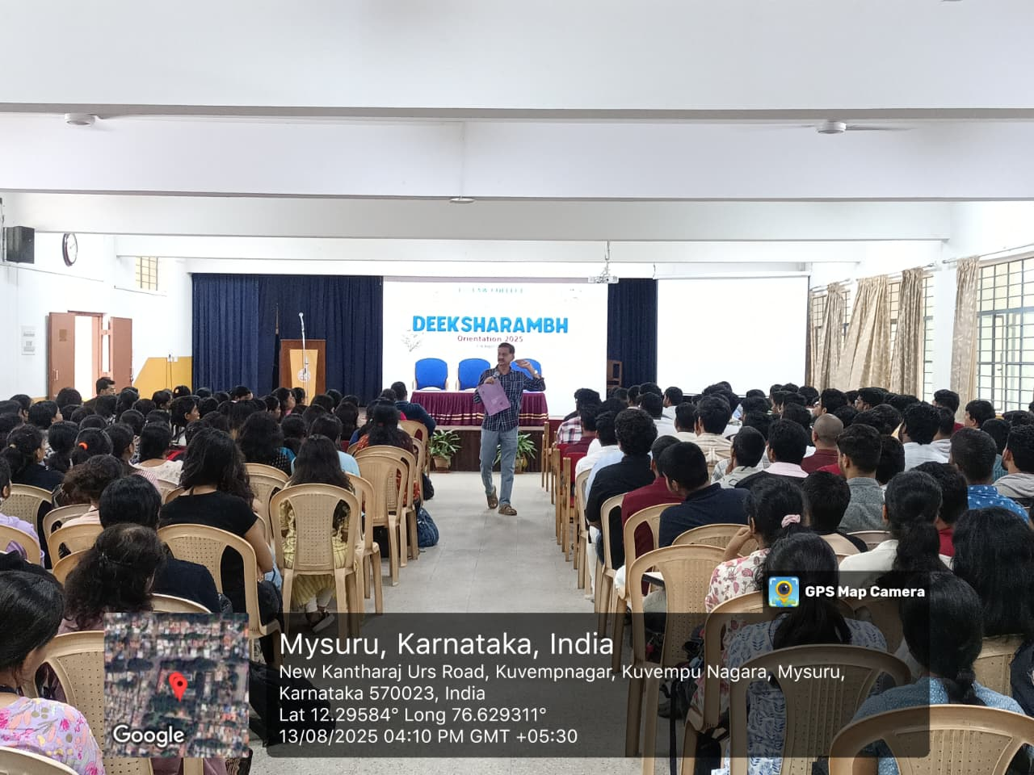
Orientation Programme for Senior Students 13.08.2025
Prof. K. S. Suresh, Chief Executive

Slide 22
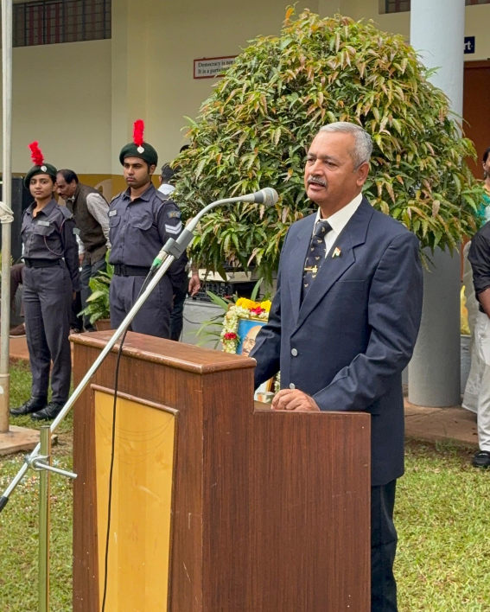
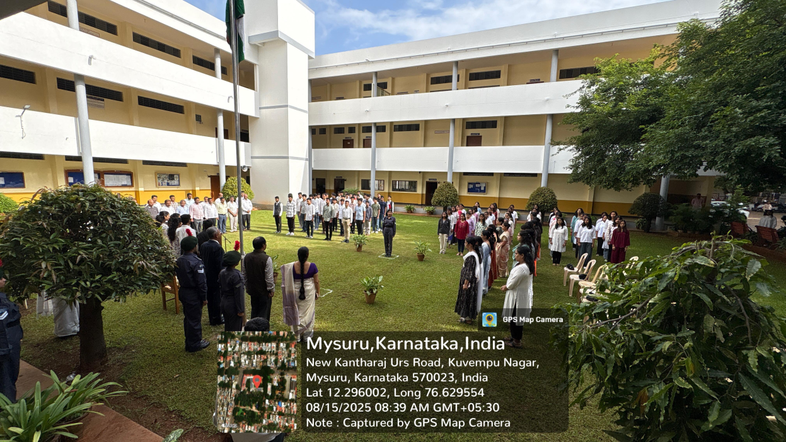
79th Independence Day – 15.08.2025
Chief Guest: Wg Cdr (Retd.) Rajagopal, Indian Air Force

Slide 23
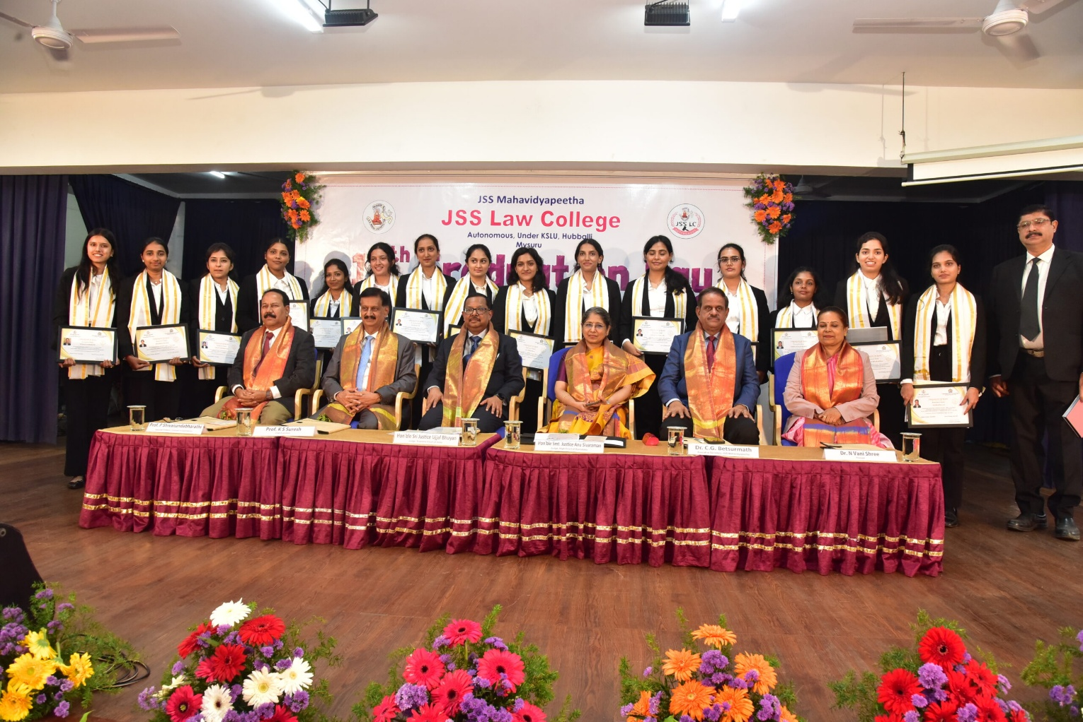
17th Graduation Day - 16.08.2025
Hon’ble Sri. Justice Ujjal Bhuhan, Judge, Supreme Court of India, Hon’ble Smt. Justice Anu Sivaraman, Judge, High Court of Karnataka, Dr. C. G. Betsumath, Executive Secretary, JSS Mahavidyapeetha, Mysuru

Slide 24
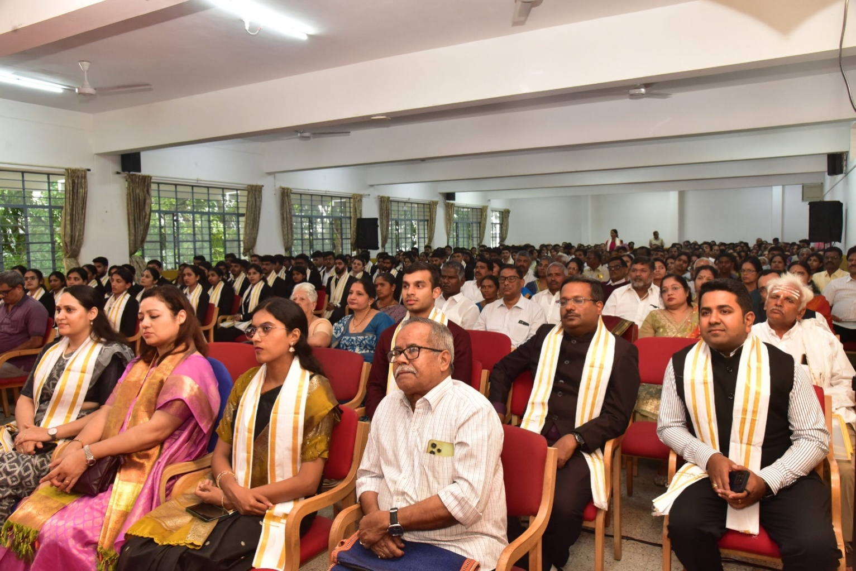
17th Graduation Day - 16.08.2025
Hon’ble Sri. Justice Ujjal Bhuhan, Judge, Supreme Court of India, Hon’ble Smt. Justice Anu Sivaraman, Judge, High Court of Karnataka, Dr. C. G. Betsumath, Executive Secretary, JSS Mahavidyapeetha, Mysuru

Slide 25
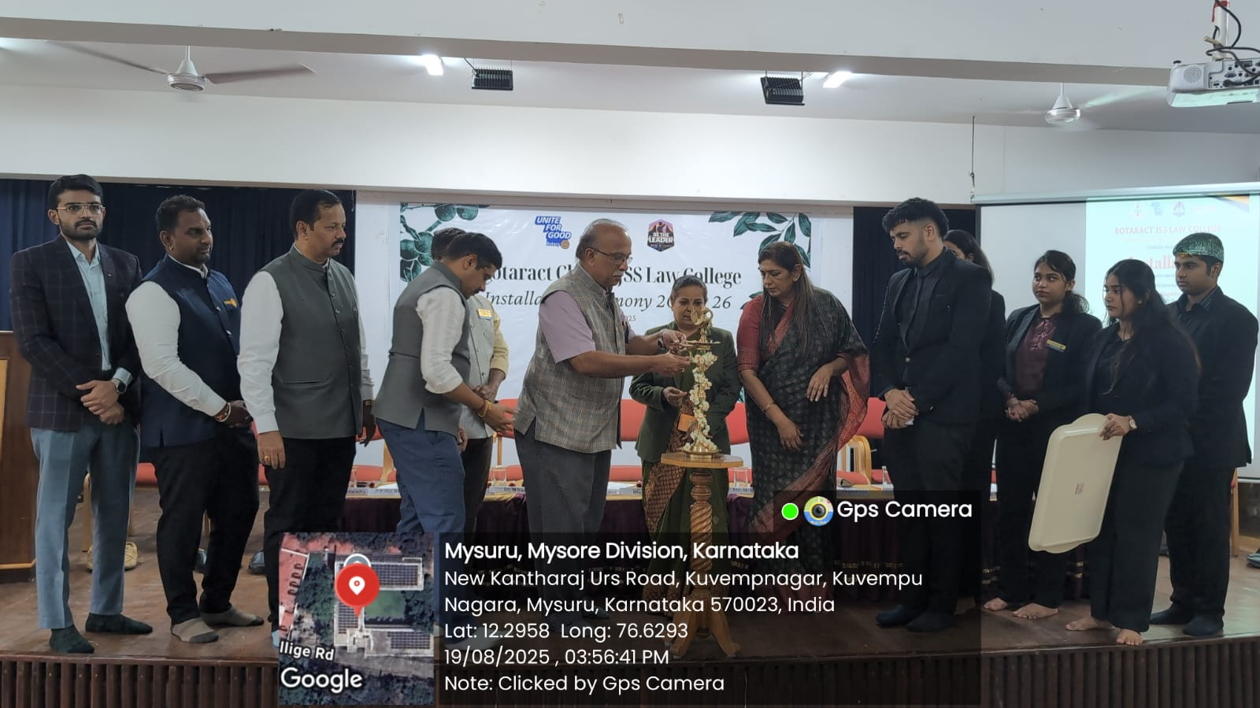
JSSLC Rotaract Installation Ceremony 19.08.2025

Slide 26
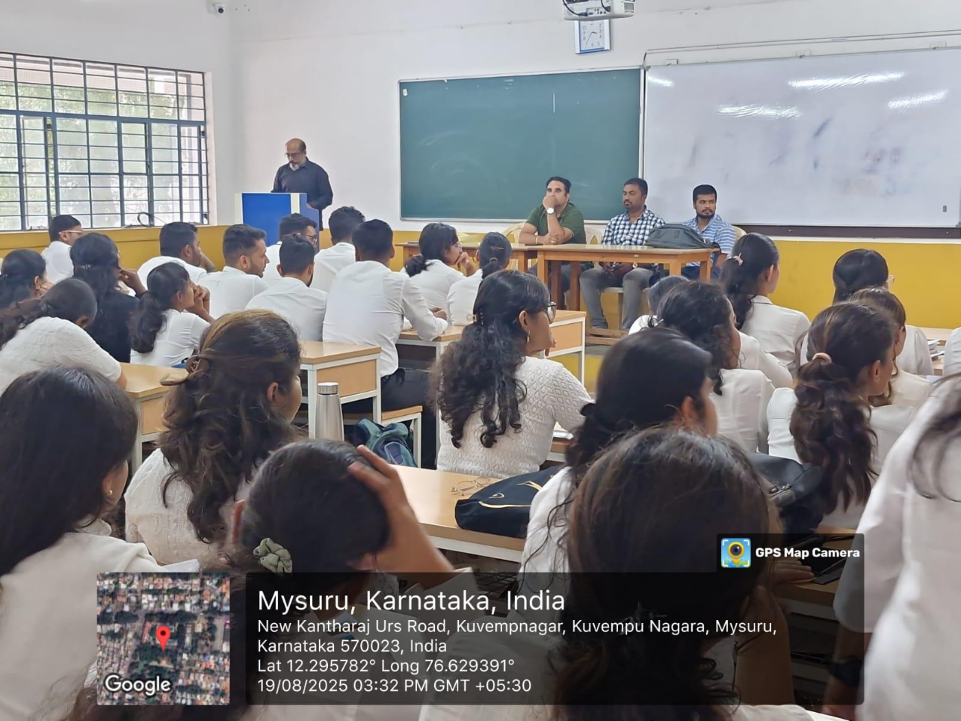
Awareness Programme – 19.08.2025
Ill-effects of Substance Abuse by Sri. Veeraraje Urs and team

Slide 27
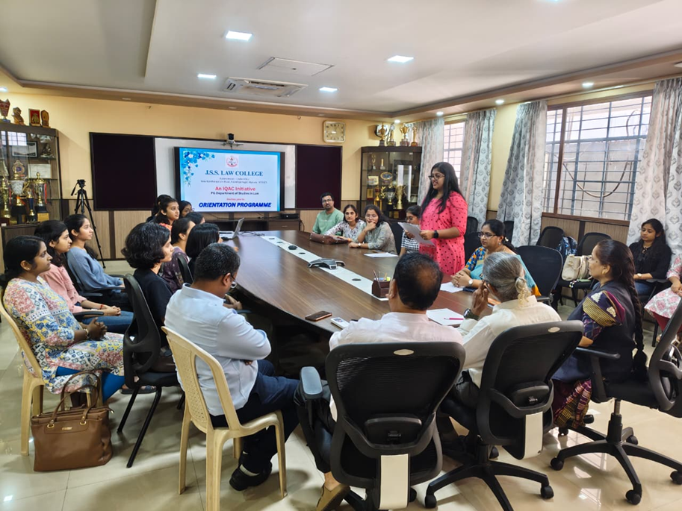
Orientation Programme for LL.M (2025-27) 22.08.2025
Chief Guest: Dr. S. Ravichandran, Advocate, Chennai

Slide 28
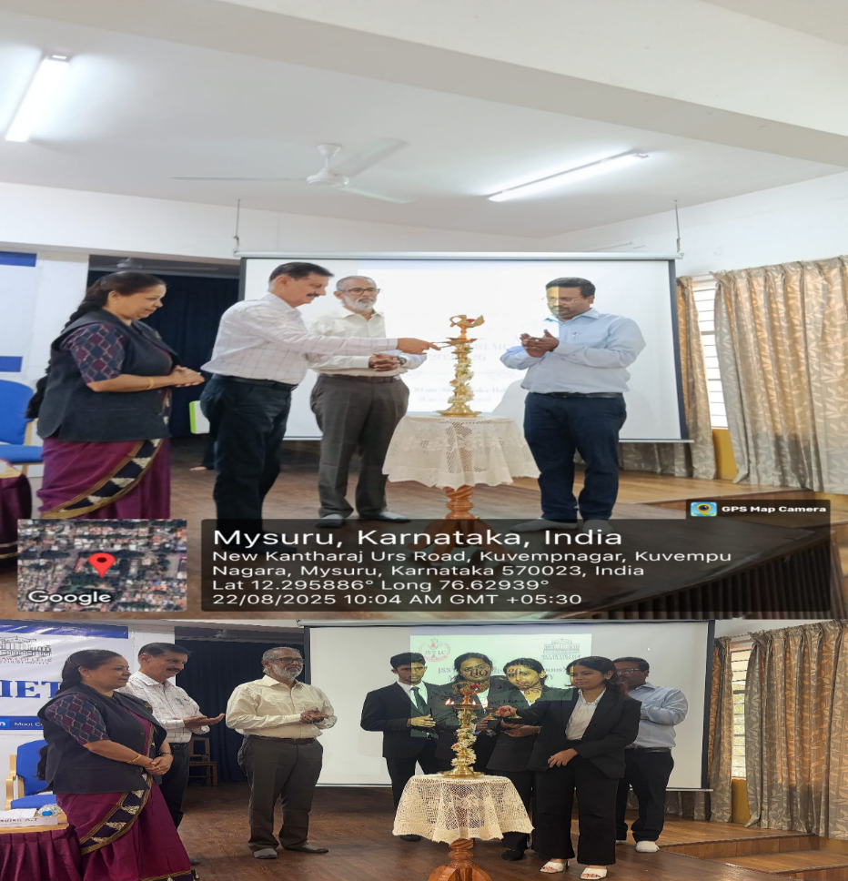
Moot Court Induction Ceremony 2025-26 22.08.2025
Chief Guest – Dr. S. Ravichandran, Advocate & Academician, Chennai

Slide 29
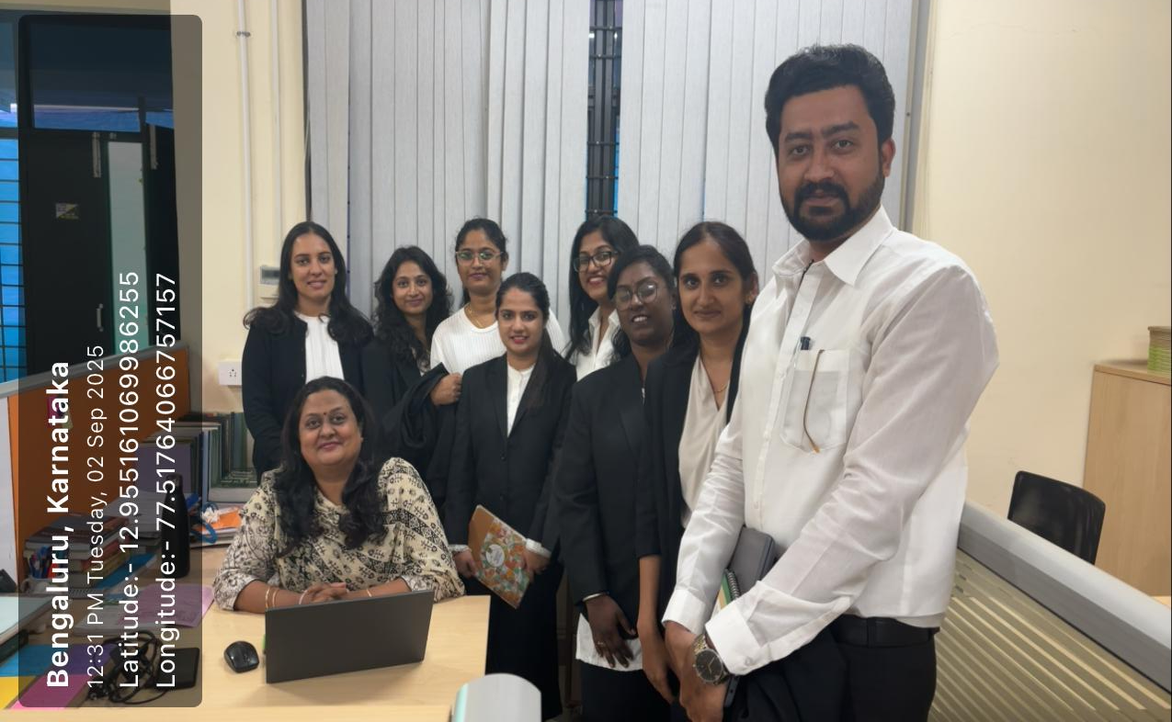
Internship at NLSIU
Batch of 8 students from the PG Department of Studies in Law completed their internship from 28.08.2025 to 31.08.2025 on Research Methodology at National Law School of India University, Bengaluru.

Slide 30
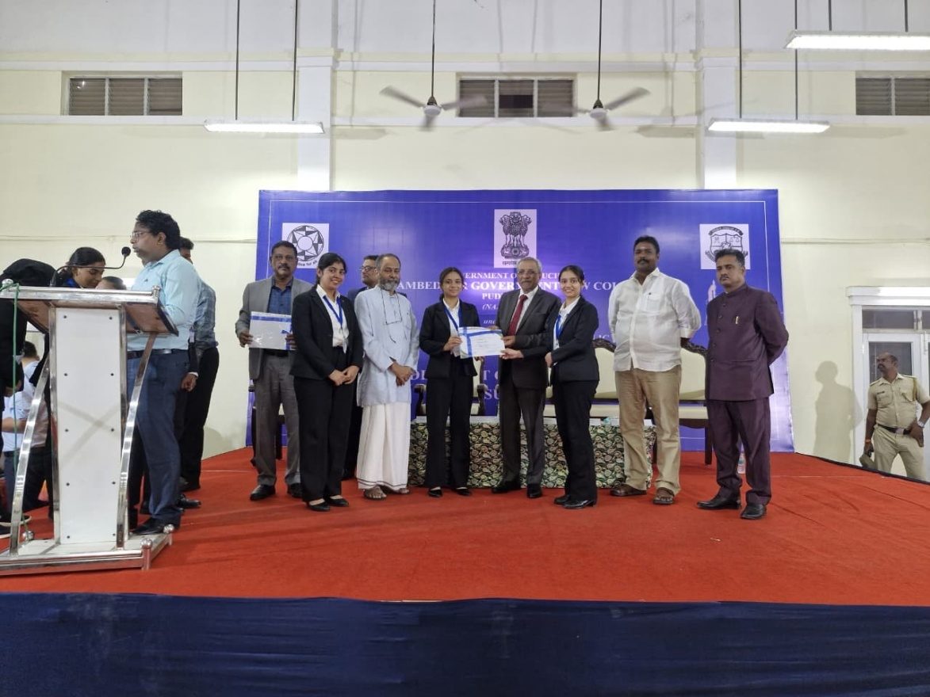
Moot Court Competition on Consumer Law
Participated by Ms. Afreen Taj N, Ms. Prarthana A. R, Ms. Vindhya P Hegde at the Dr. Ambedkar Government Law College, Puducherry held from 08.08.2025 to 10.08.2025 & won II Runners-up title

Slide 31
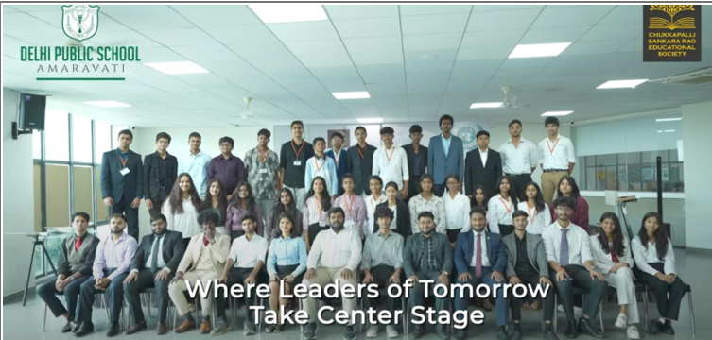
MUN Conference
Mr. Mohammad Subhan invited to Chair the UNHRC Committee, DPS Amaravathi 2025 Model United Nations Conference organised by Lam, Amaravati, Andhra Pradesh from 16.08.2025 to 18.08.2025.

Slide 32
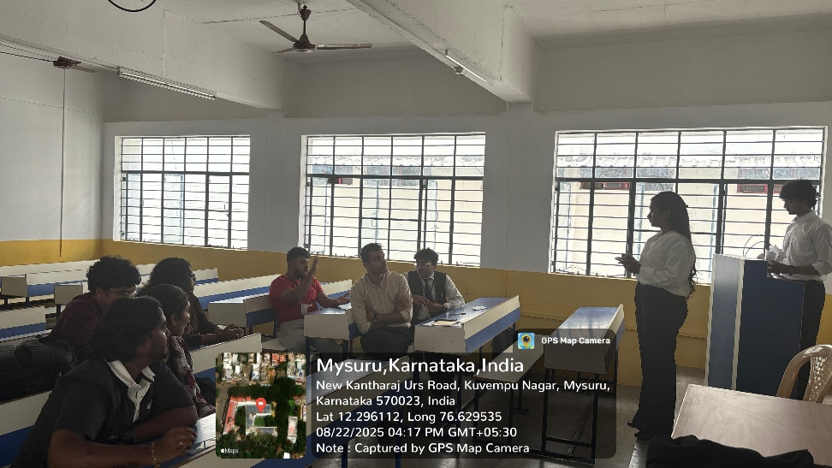
MUN Society – 22.08.2025
MUN Society meeting held on 22.08.2025

Slide 33
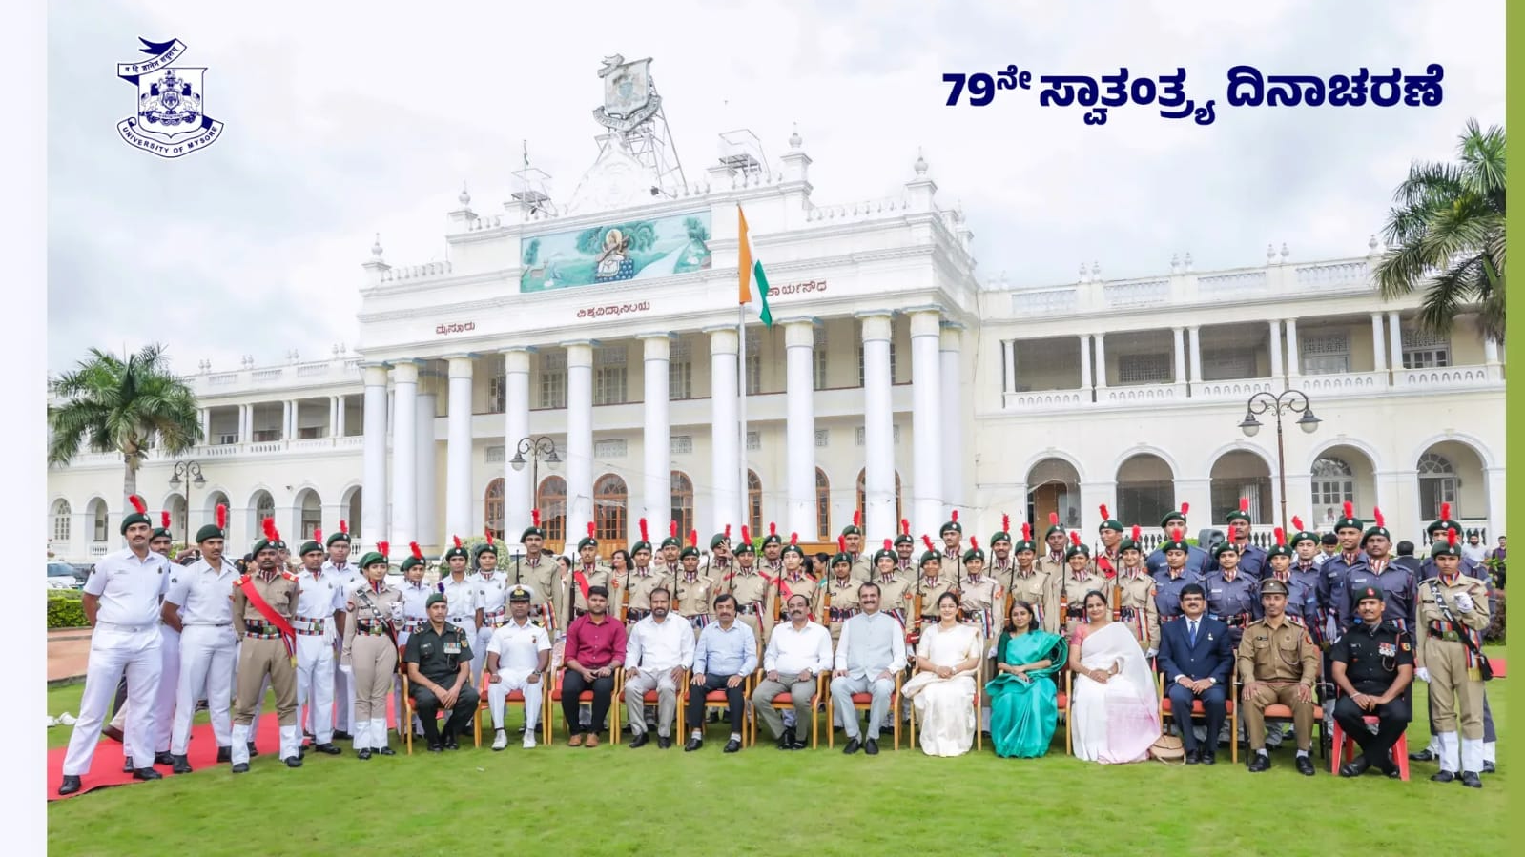
79th Independence Day – 15.08.2025
Cdt Cpl S Avik and Cdt Cpl Prajwal Gowda at University of Mysore, Crawford Hall Premises

Slide 34
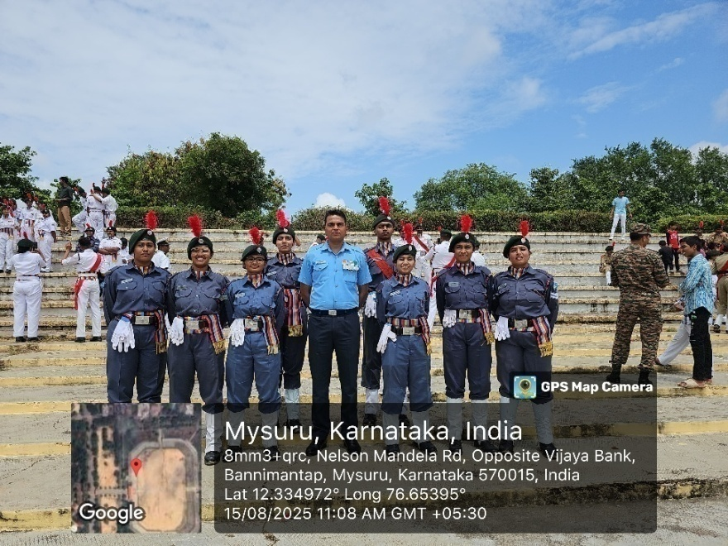
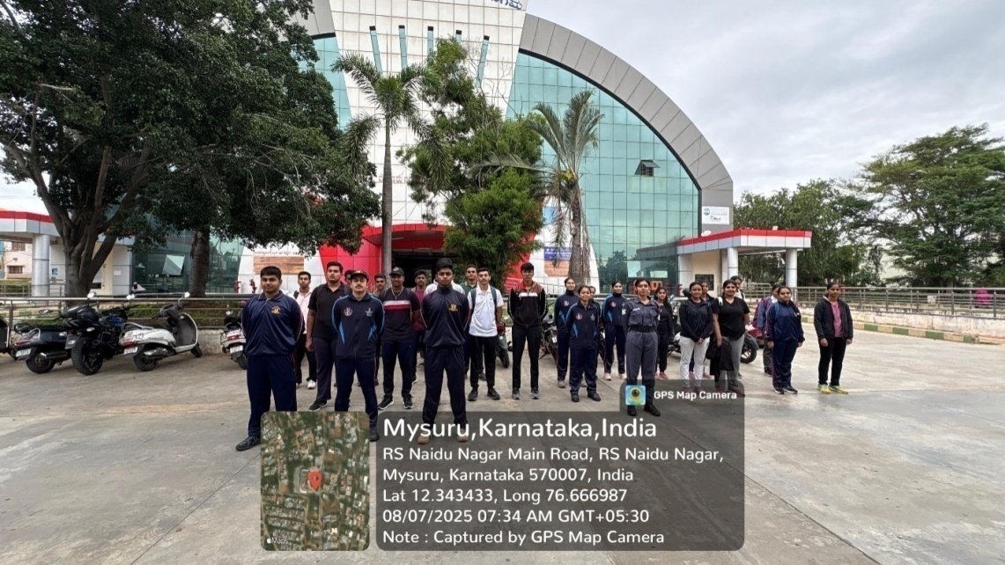
Independence Day Parade - 15.08.2025
Cdt Sgt Smriti Srikanth, Cdt Diya Mundasad, Cdt Cpl Fariya, Cdt Nikita, Cdt Johanna, Cdt Kritika and Cdt Gowri at Bannimantap Grounds, Mysuru

